Slide 1
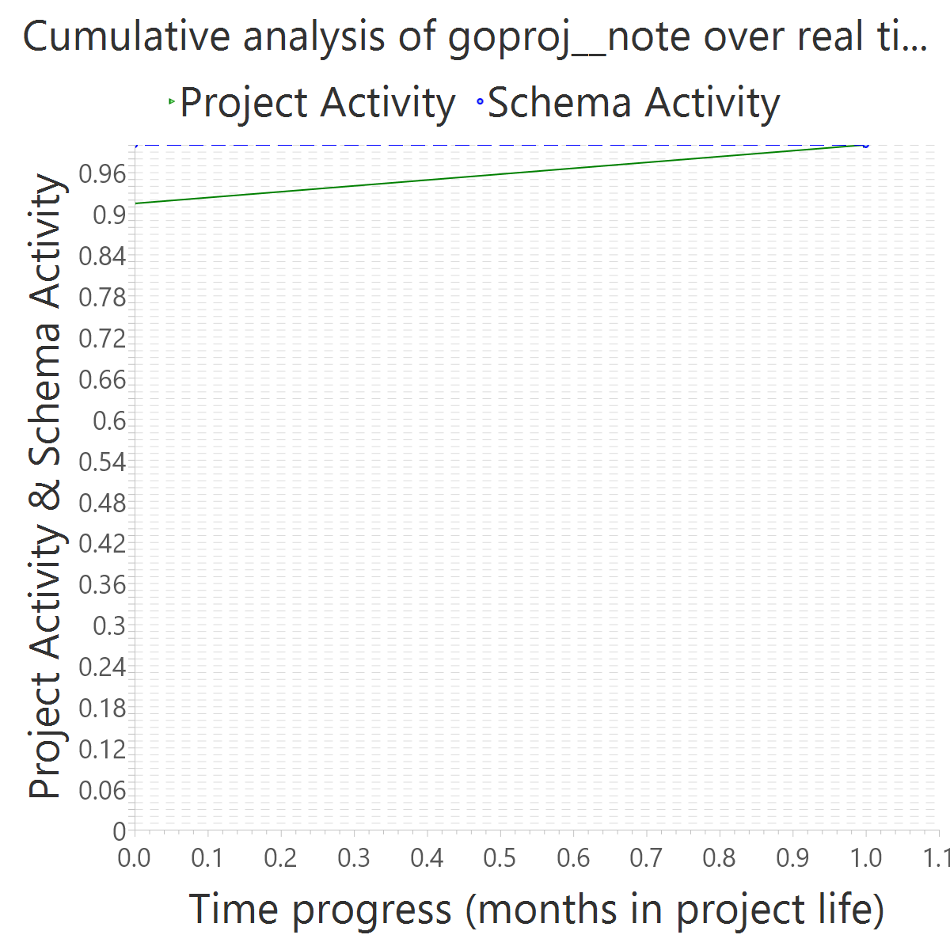
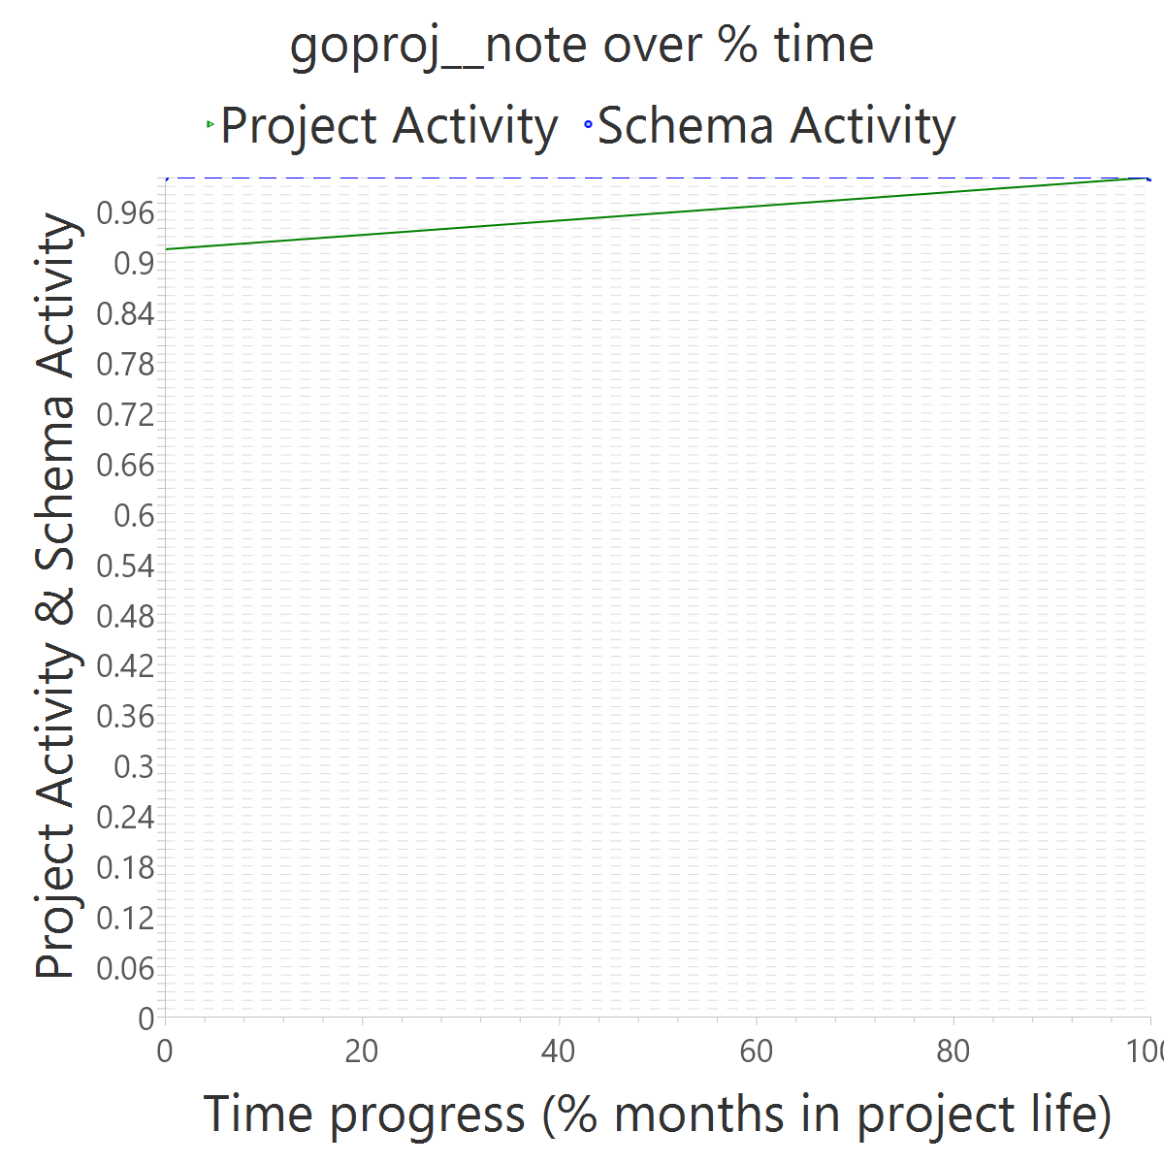
Project OVERALL CLASS #ActiveCommits #AreedspostV0 Activity Class SUP(Months) #Commits TotalActivity Project #Commits Project FileUpds Project Start Date UTC Project End Date UTC PUP+V0(Months) 10%-sync (%) 50%-attain.(%) 75%-attain.(%) 80%-attain.(%) 100%-attain.(%) AvgTimeLag AvgSrcLag TimeLagsSchemaAlways? SrcLagsSchemaAlways?
goproj__note 0_FROZEN 0 0 0_NONE 1 2 0 28 189 2014-08-14 02:38:25 +0000 2014-09-17 01:27:27 +0000 2 1.00 0.00 0.00 0.00 0.00 1.00 0.09 TRUE TRUE

Slide 2
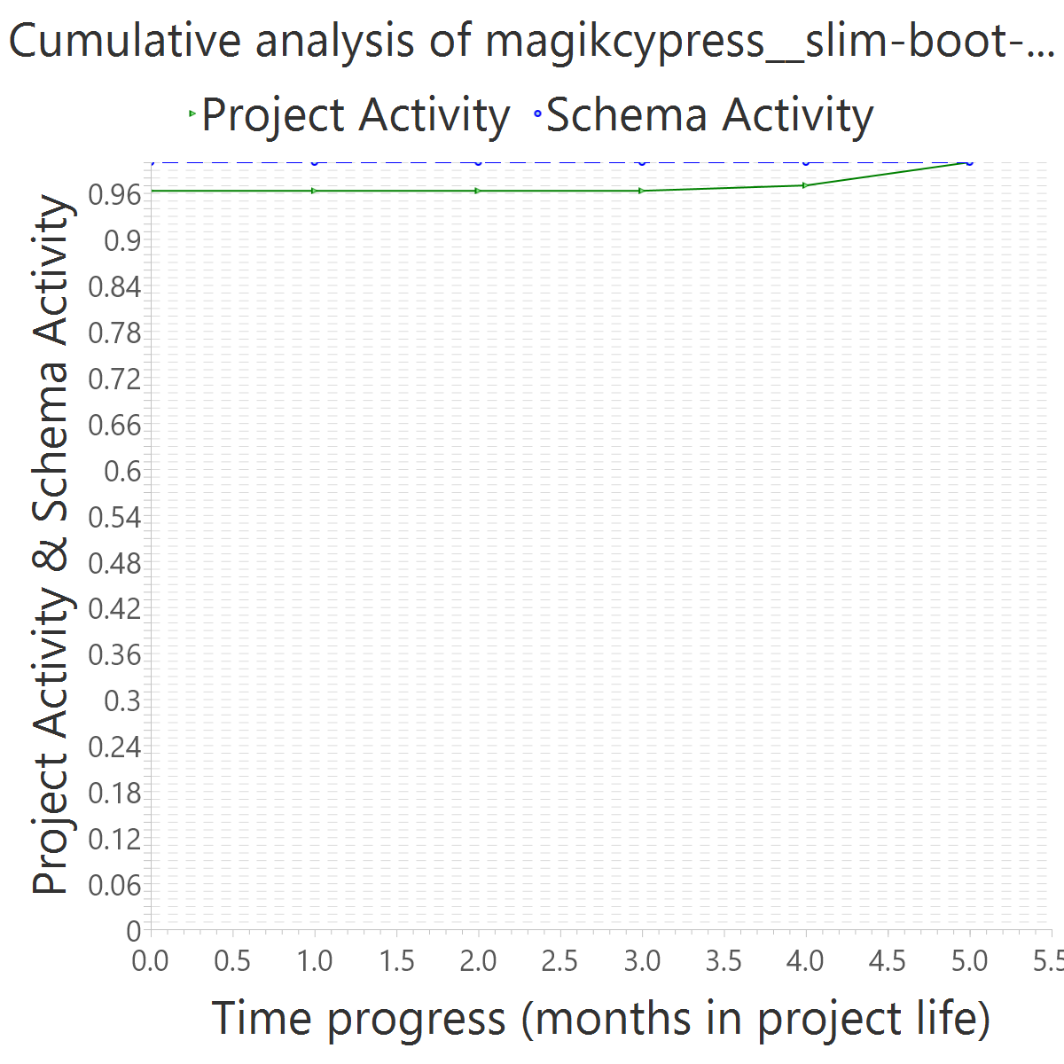
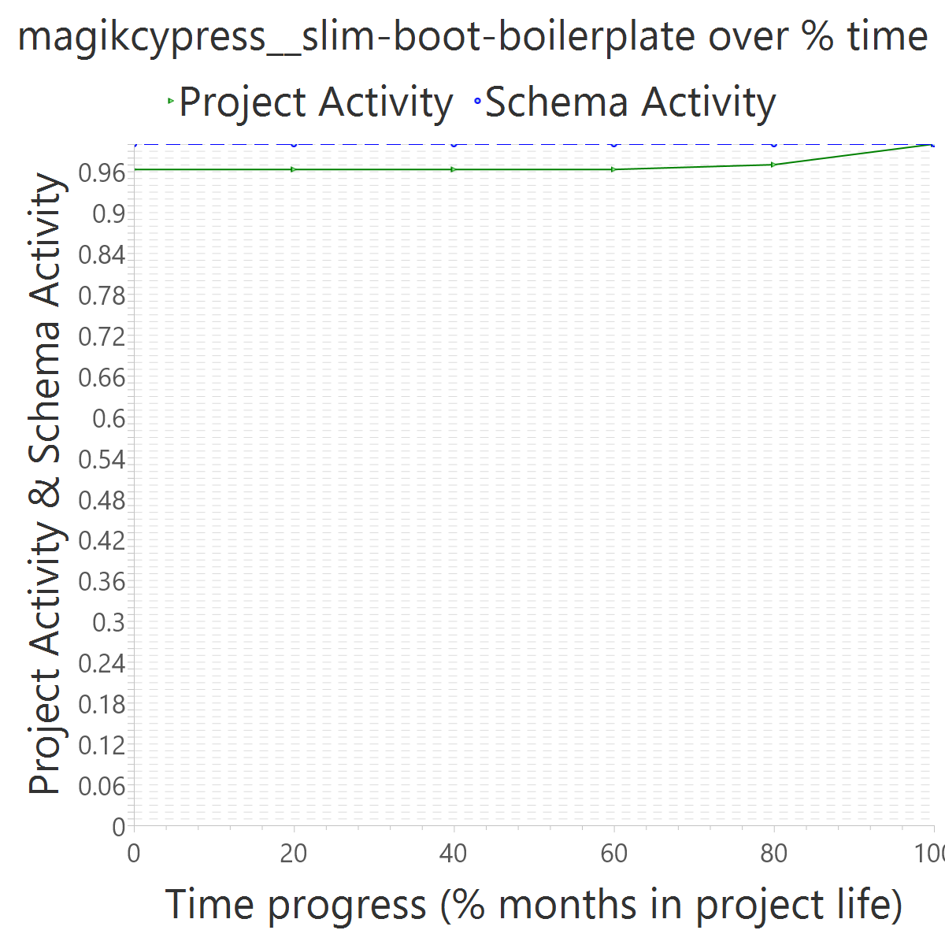
Project OVERALL CLASS #ActiveCommits #AreedspostV0 Activity Class SUP(Months) #Commits TotalActivity Project #Commits Project FileUpds Project Start Date UTC Project End Date UTC PUP+V0(Months) 10%-sync (%) 50%-attain.(%) 75%-attain.(%) 80%-attain.(%) 100%-attain.(%) AvgTimeLag AvgSrcLag TimeLagsSchemaAlways? SrcLagsSchemaAlways?
magikcypress__slim-boot-boilerplate 0_FROZEN 0 0 0_NONE 5 4 0 31 2287 2013-09-29 17:30:46 +0000 2014-02-02 22:43:30 +0000 6 1.00 0.00 0.00 0.00 0.00 0.60 0.04 TRUE TRUE

Slide 3
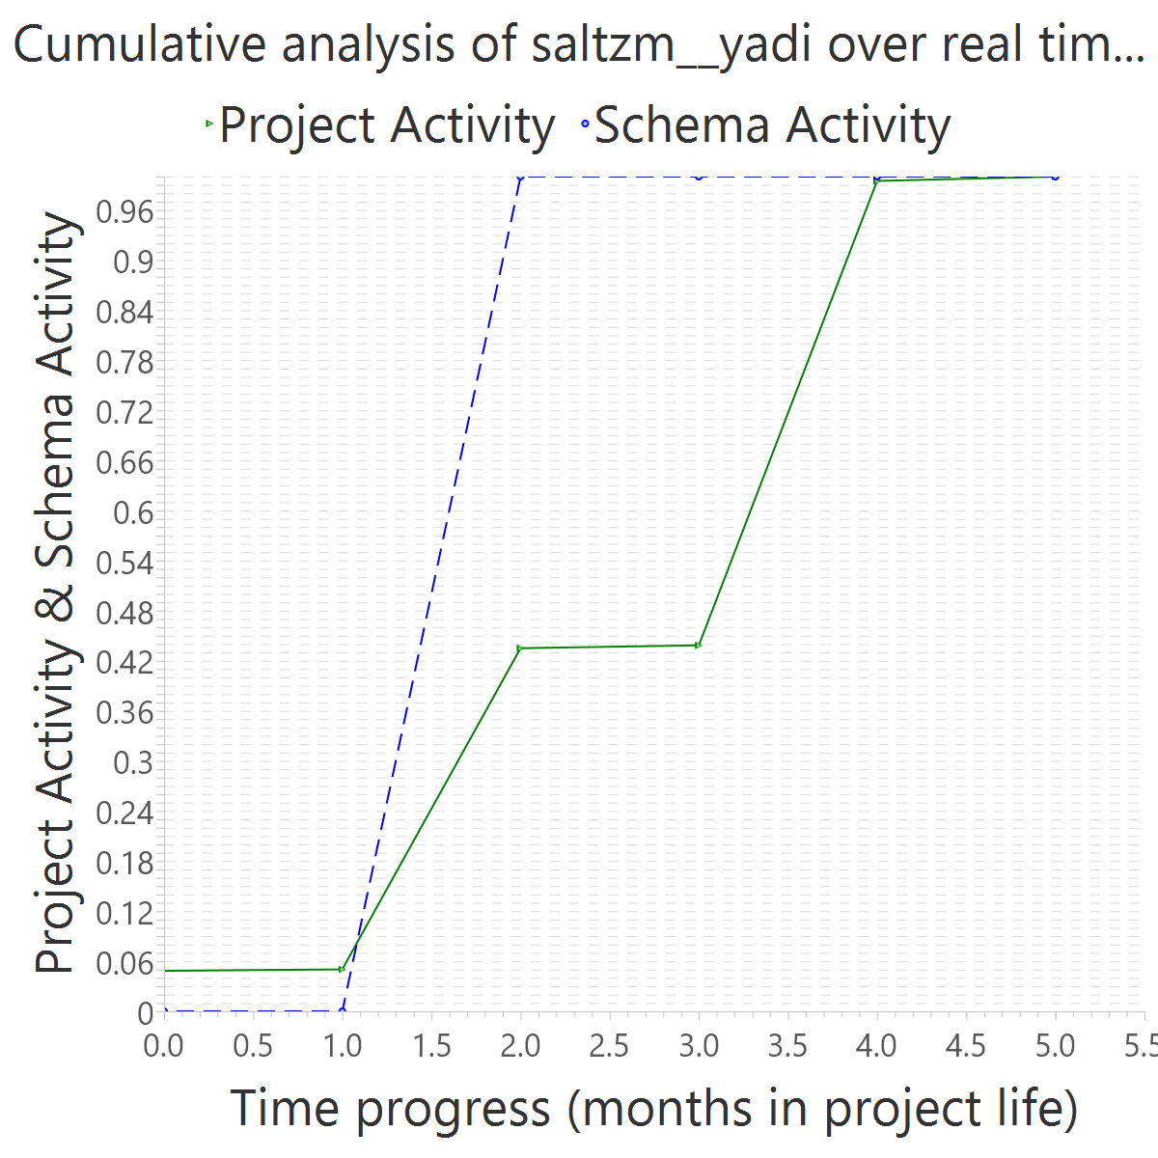
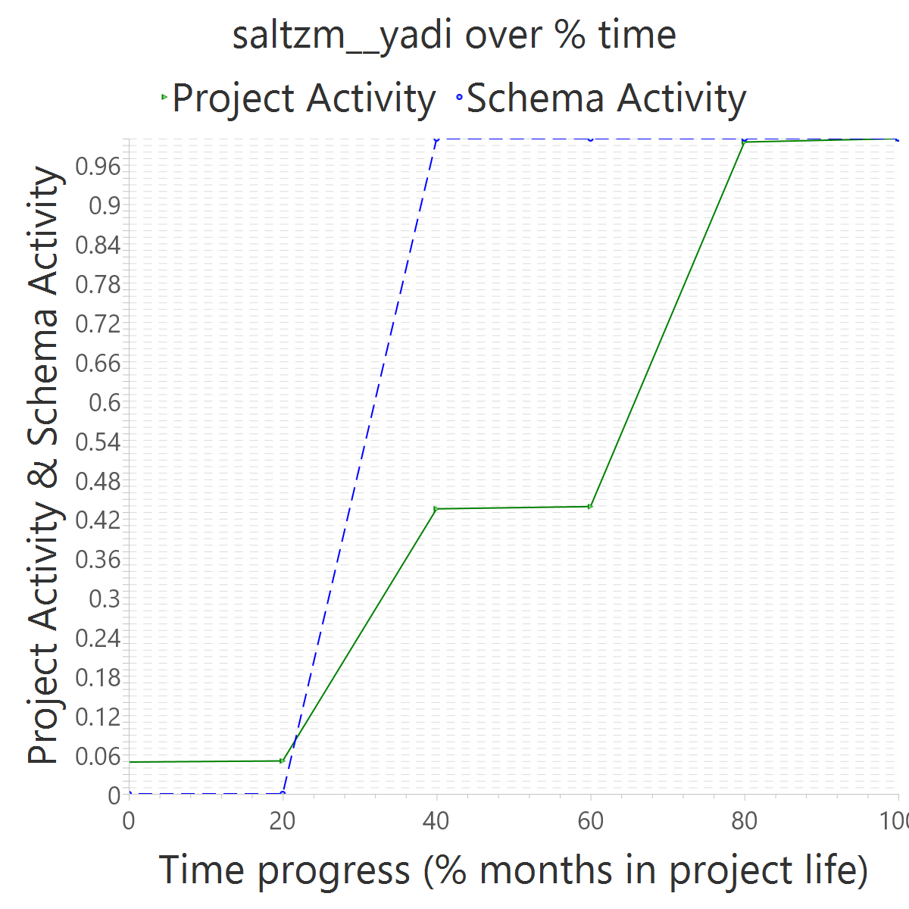
Project OVERALL CLASS #ActiveCommits #AreedspostV0 Activity Class SUP(Months) #Commits TotalActivity Project #Commits Project FileUpds Project Start Date UTC Project End Date UTC PUP+V0(Months) 10%-sync (%) 50%-attain.(%) 75%-attain.(%) 80%-attain.(%) 100%-attain.(%) AvgTimeLag AvgSrcLag TimeLagsSchemaAlways? SrcLagsSchemaAlways?
saltzm__yadi 0_FROZEN 0 0 0_NONE 1 2 0 128 585 2013-09-30 14:04:58 +0000 2014-02-04 18:19:33 +0000 6 0.67 0.40 0.40 0.40 0.40 0.20 0.21 FALSE FALSE

Slide 4
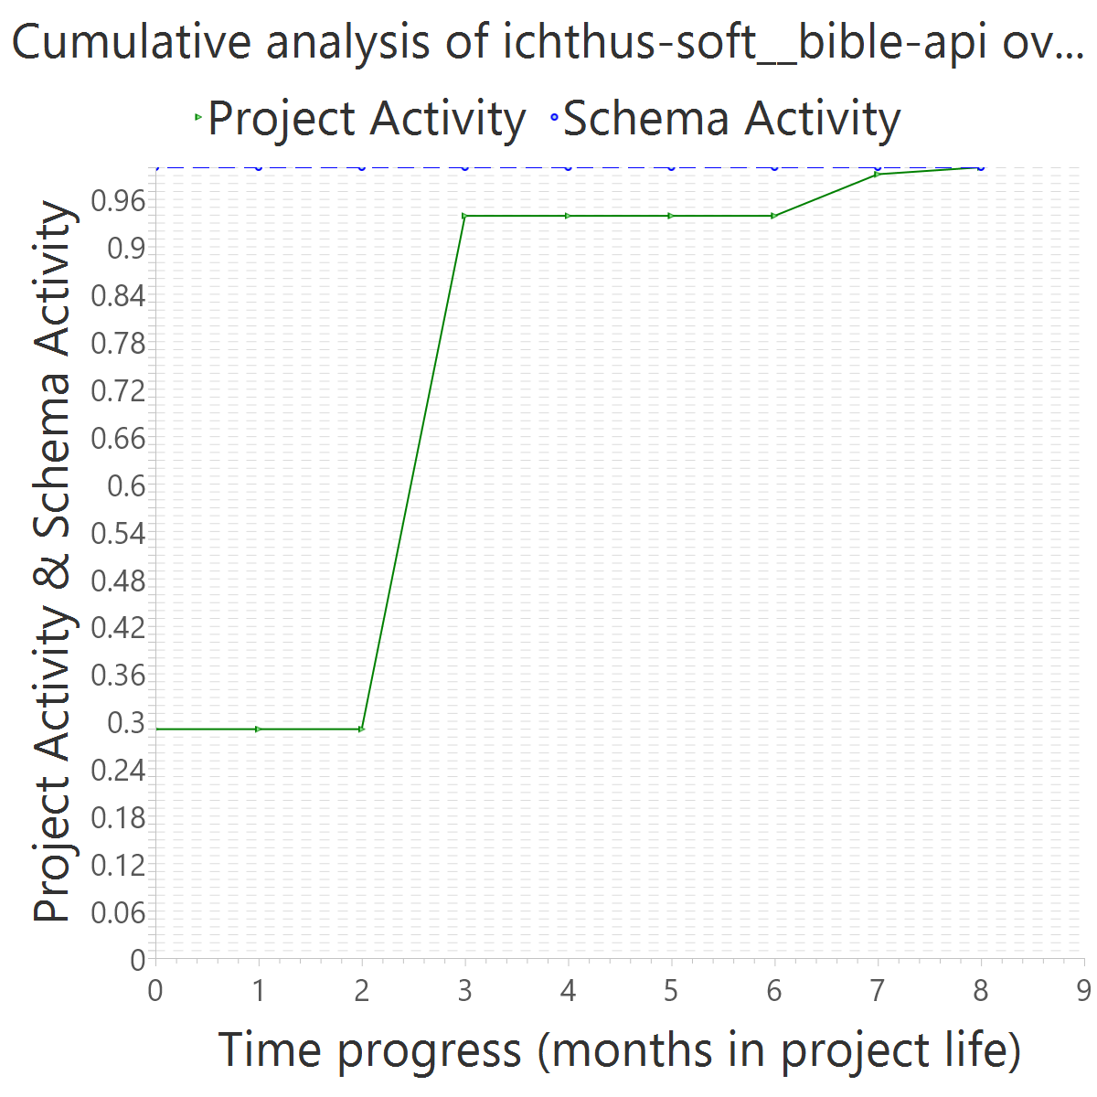
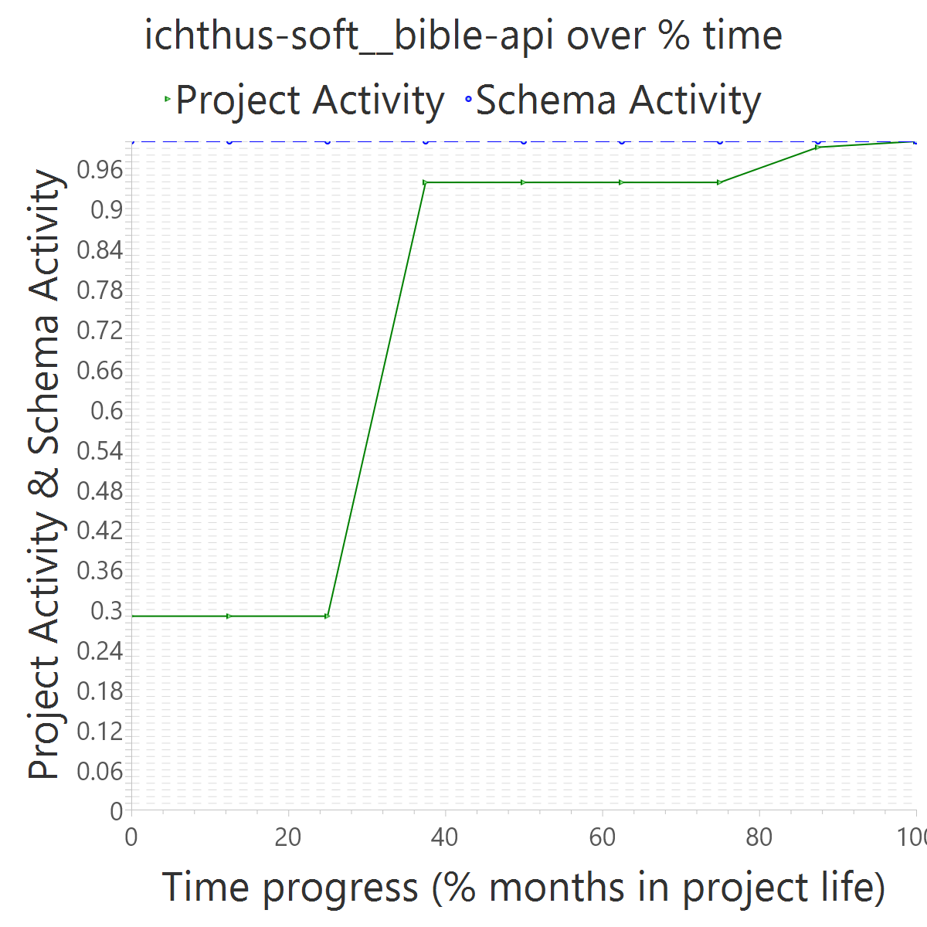
Project OVERALL CLASS #ActiveCommits #AreedspostV0 Activity Class SUP(Months) #Commits TotalActivity Project #Commits Project FileUpds Project Start Date UTC Project End Date UTC PUP+V0(Months) 10%-sync (%) 50%-attain.(%) 75%-attain.(%) 80%-attain.(%) 100%-attain.(%) AvgTimeLag AvgSrcLag TimeLagsSchemaAlways? SrcLagsSchemaAlways?
ichthus-soft__bible-api 0_FROZEN 0 0 0_NONE 1 2 0 38 116 2014-07-30 08:00:21 +0000 2015-03-17 12:08:49 +0000 9 0.67 0.00 0.00 0.00 0.00 0.56 0.30 TRUE TRUE

Slide 5
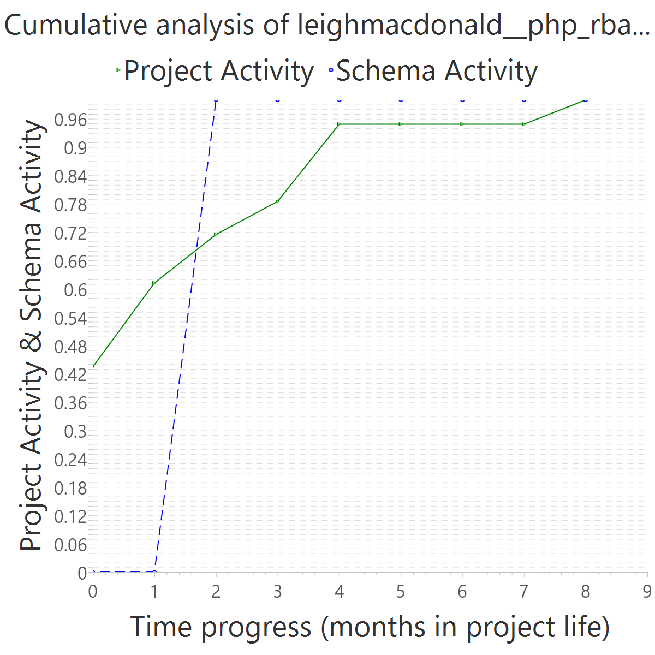
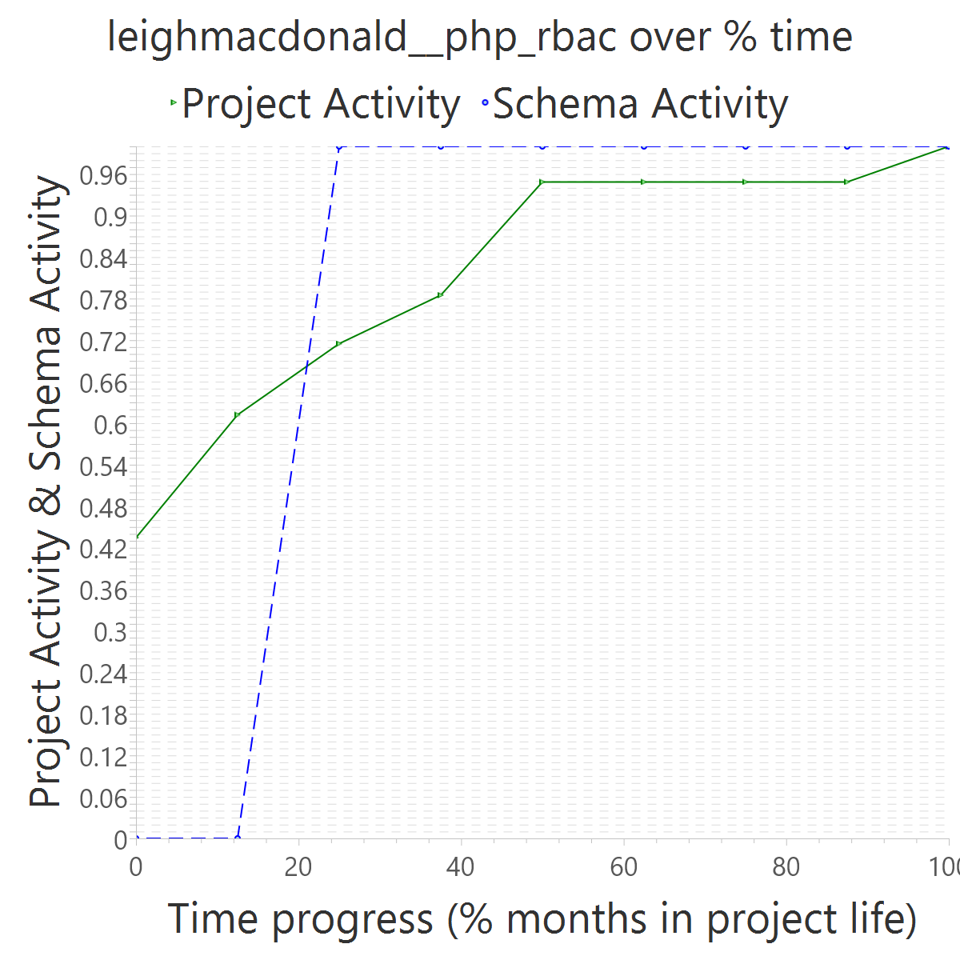
Project OVERALL CLASS #ActiveCommits #AreedspostV0 Activity Class SUP(Months) #Commits TotalActivity Project #Commits Project FileUpds Project Start Date UTC Project End Date UTC PUP+V0(Months) 10%-sync (%) 50%-attain.(%) 75%-attain.(%) 80%-attain.(%) 100%-attain.(%) AvgTimeLag AvgSrcLag TimeLagsSchemaAlways? SrcLagsSchemaAlways?
leighmacdonald__php_rbac 0_FROZEN 0 0 0_NONE 2 2 0 59 222 2013-03-11 22:40:18 +0000 2013-11-30 08:01:03 +0000 9 0.56 0.25 0.25 0.25 0.25 0.31 -0.04 FALSE FALSE

Slide 6
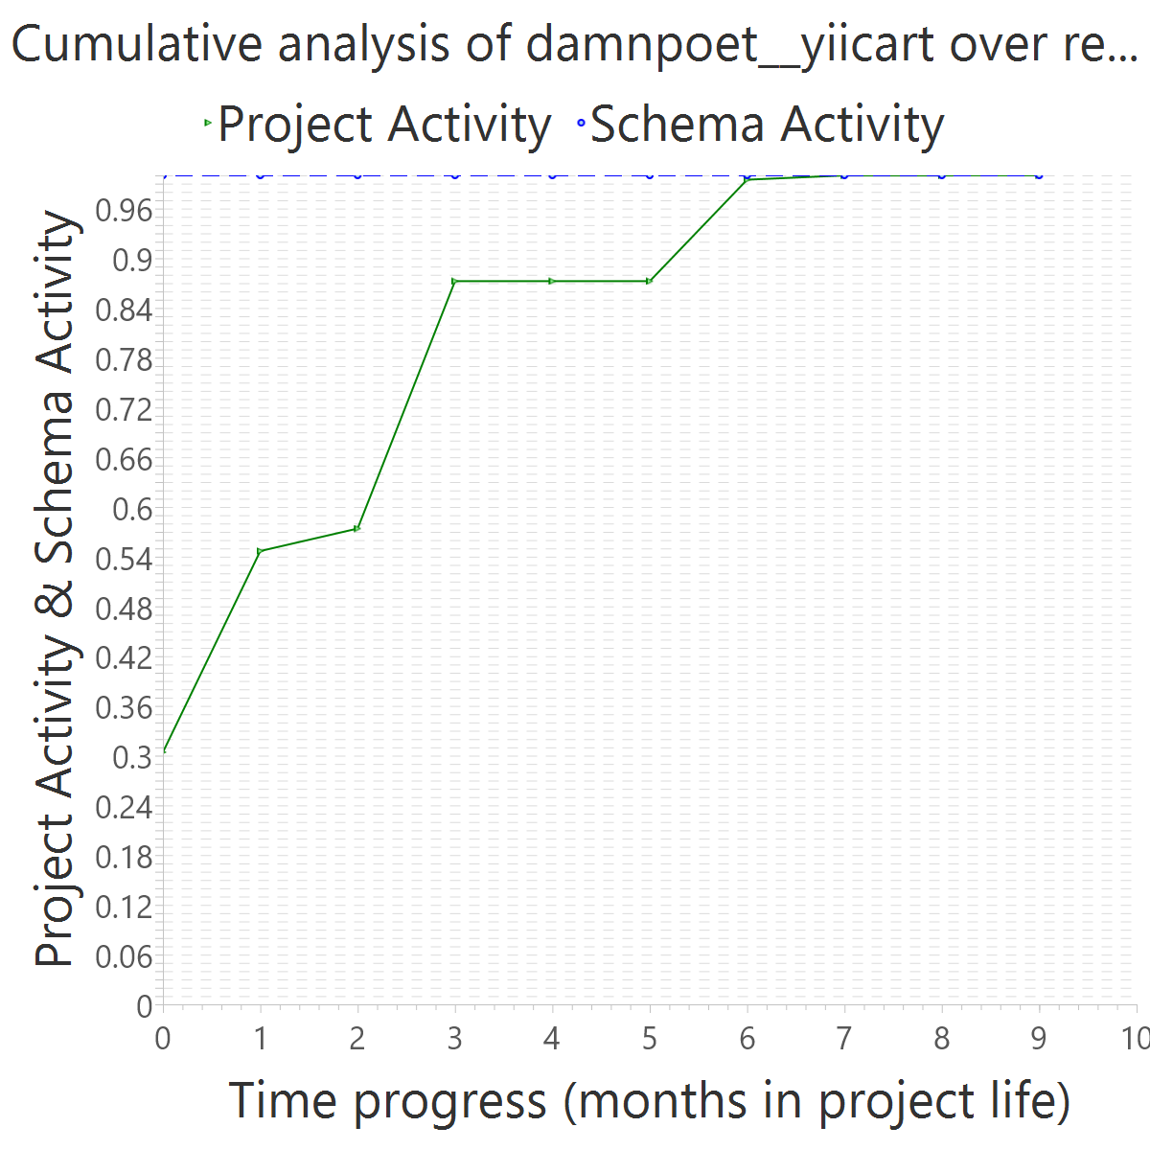
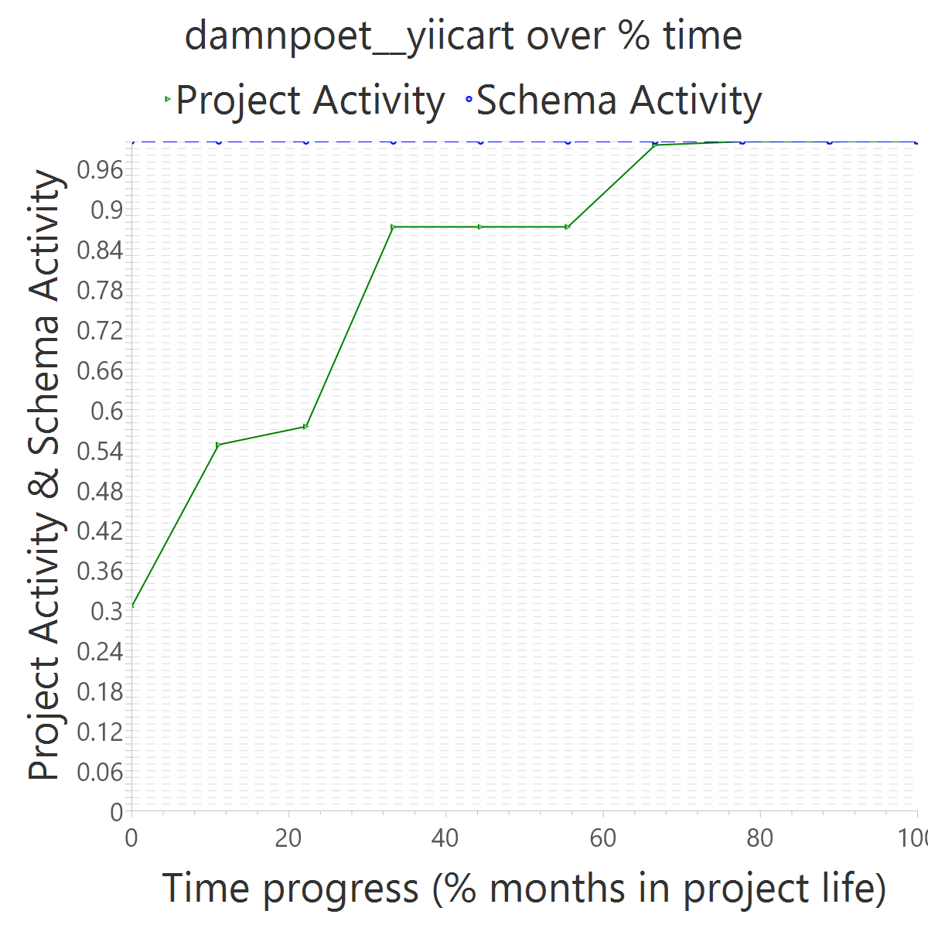
Project OVERALL CLASS #ActiveCommits #AreedspostV0 Activity Class SUP(Months) #Commits TotalActivity Project #Commits Project FileUpds Project Start Date UTC Project End Date UTC PUP+V0(Months) 10%-sync (%) 50%-attain.(%) 75%-attain.(%) 80%-attain.(%) 100%-attain.(%) AvgTimeLag AvgSrcLag TimeLagsSchemaAlways? SrcLagsSchemaAlways?
damnpoet__yiicart 0_FROZEN 0 0 0_NONE 7 7 0 209 12283 2013-07-16 12:26:44 +0000 2014-04-06 05:50:35 +0000 10 0.40 0.00 0.00 0.00 0.00 0.56 0.22 TRUE TRUE

Slide 7
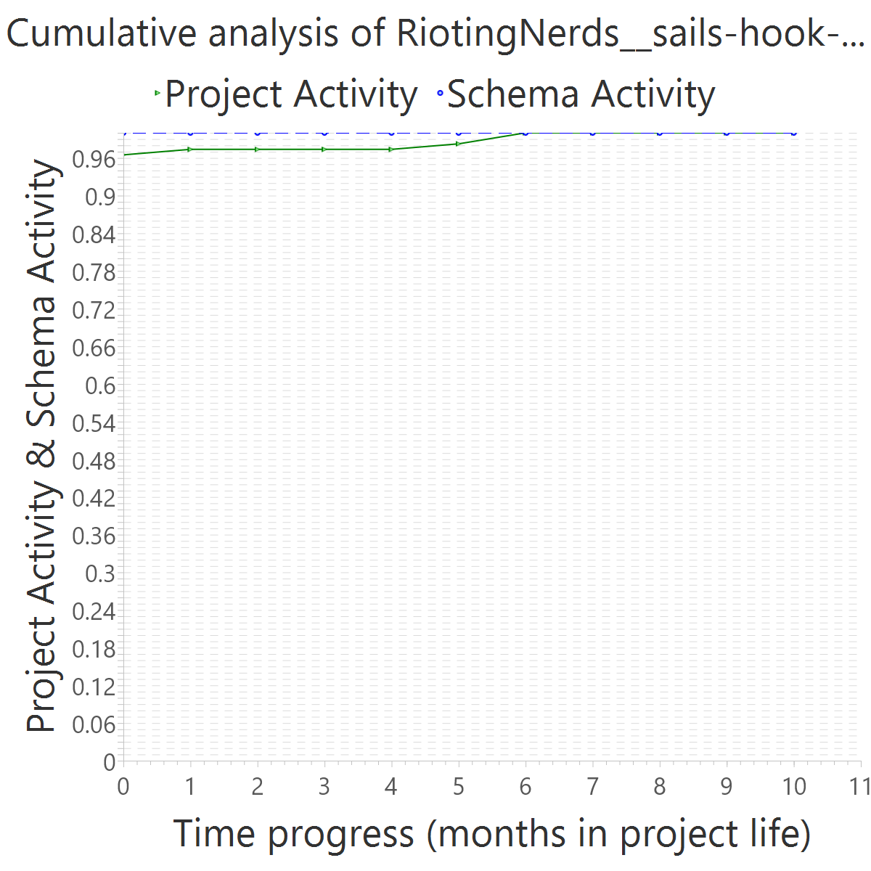
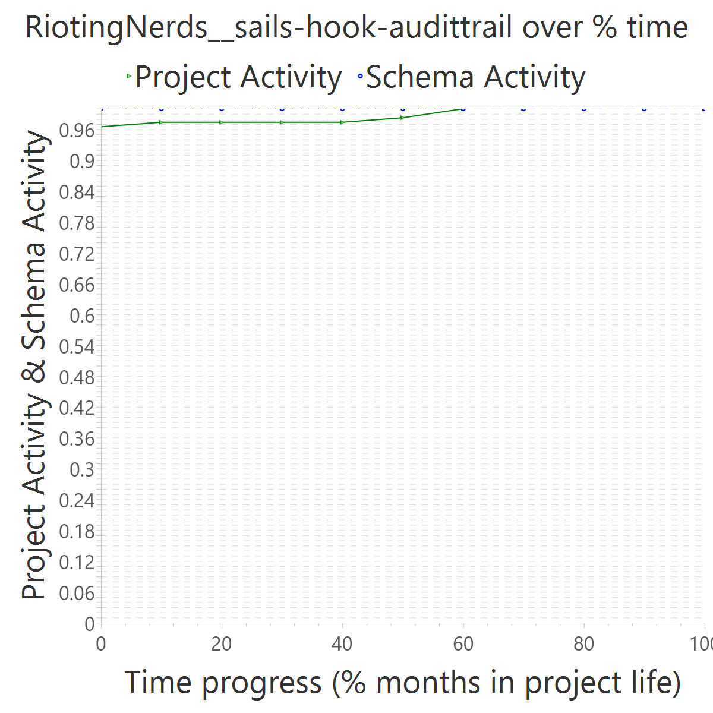
Project OVERALL CLASS #ActiveCommits #AreedspostV0 Activity Class SUP(Months) #Commits TotalActivity Project #Commits Project FileUpds Project Start Date UTC Project End Date UTC PUP+V0(Months) 10%-sync (%) 50%-attain.(%) 75%-attain.(%) 80%-attain.(%) 100%-attain.(%) AvgTimeLag AvgSrcLag TimeLagsSchemaAlways? SrcLagsSchemaAlways?
RiotingNerds__sails-hook-audittrail 0_FROZEN 0 0 0_NONE 11 2 0 39 116 2015-07-06 15:43:20 +0000 2016-05-28 17:40:04 +0000 11 1.00 0.00 0.00 0.00 0.00 0.55 0.02 TRUE TRUE

Slide 8
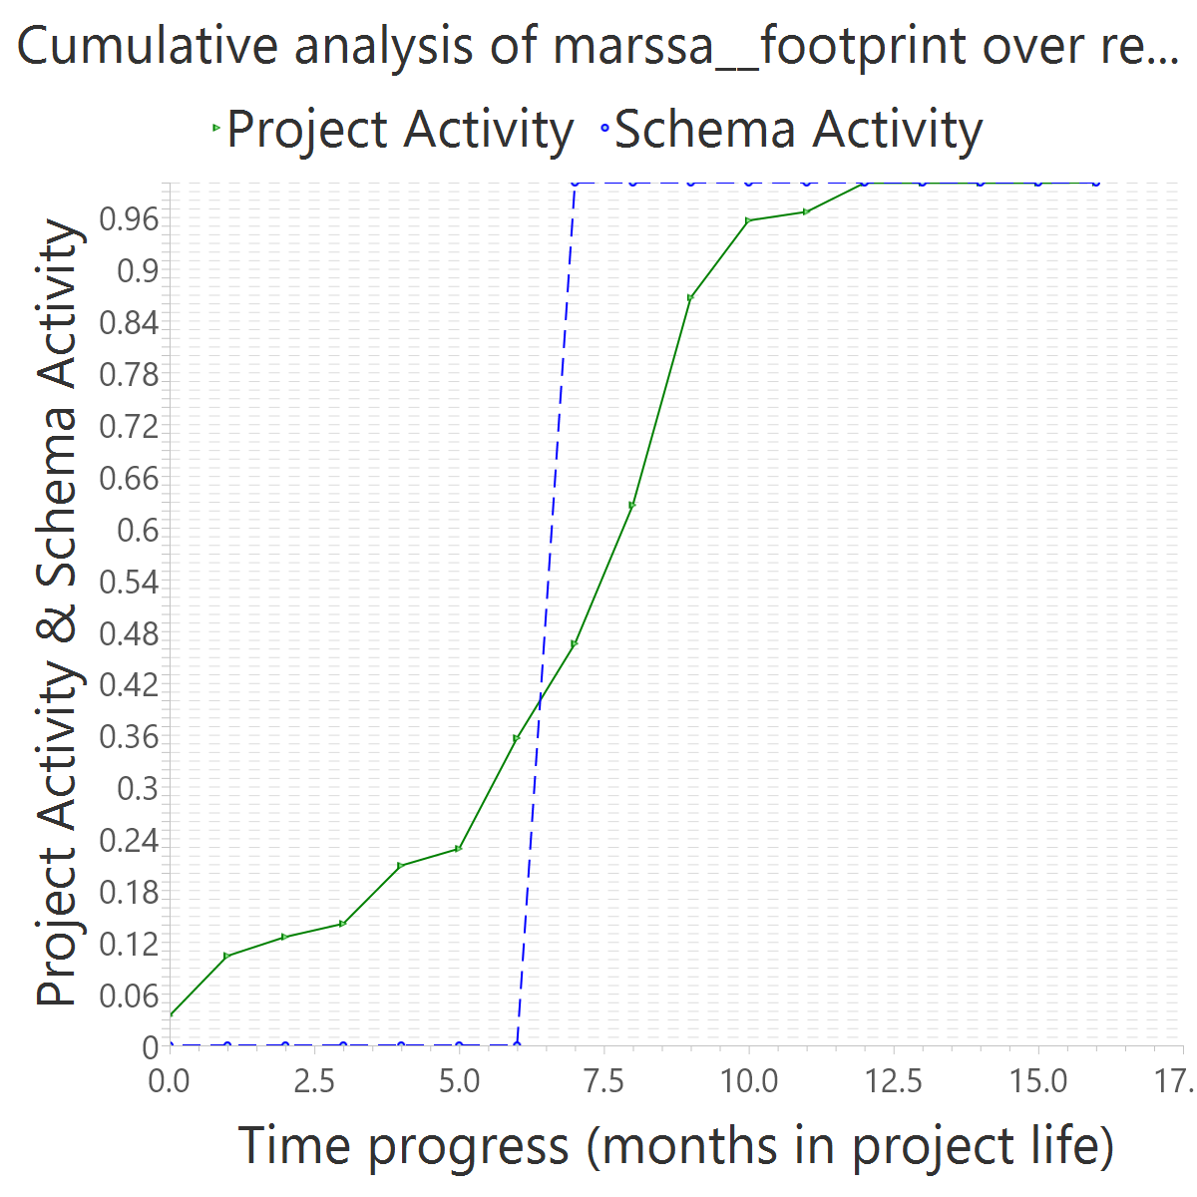
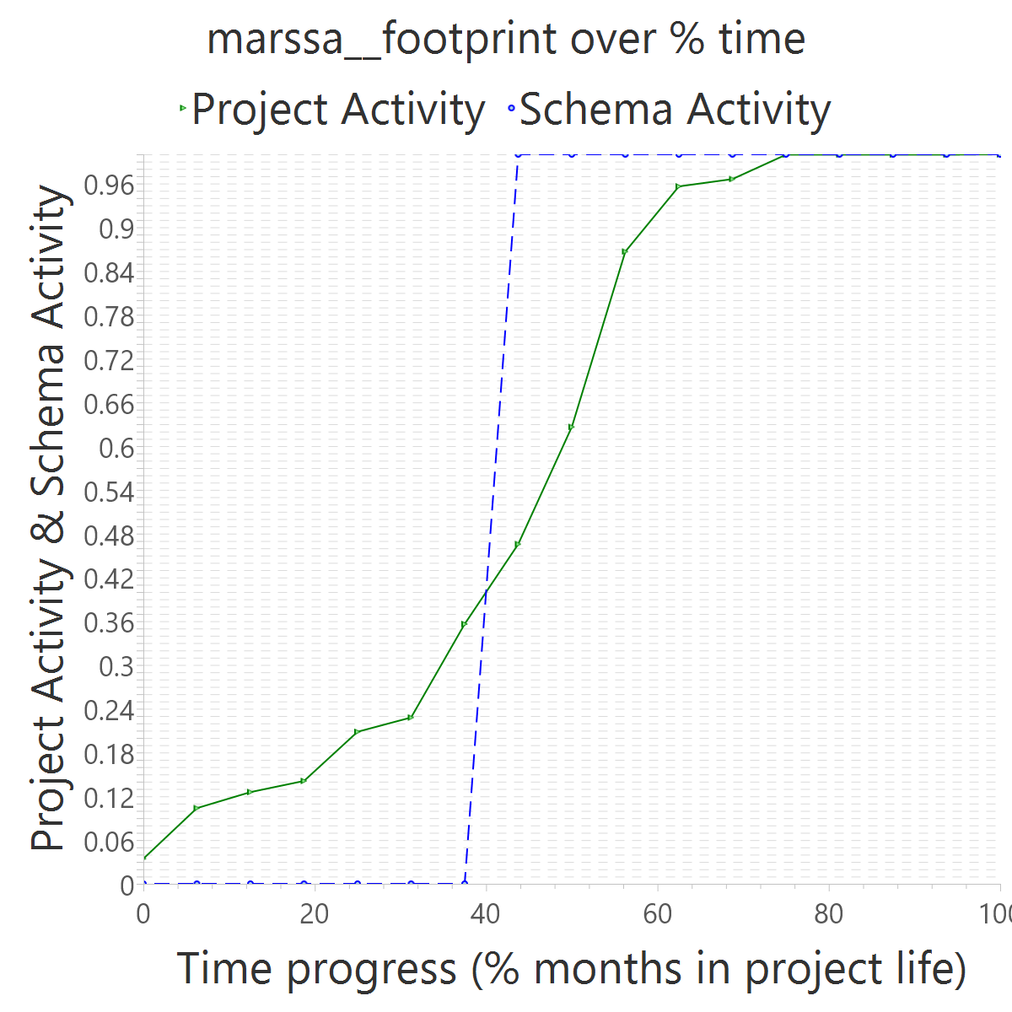
Project OVERALL CLASS #ActiveCommits #AreedspostV0 Activity Class SUP(Months) #Commits TotalActivity Project #Commits Project FileUpds Project Start Date UTC Project End Date UTC PUP+V0(Months) 10%-sync (%) 50%-attain.(%) 75%-attain.(%) 80%-attain.(%) 100%-attain.(%) AvgTimeLag AvgSrcLag TimeLagsSchemaAlways? SrcLagsSchemaAlways?
marssa__footprint 0_FROZEN 0 0 0_NONE 2 3 0 162 2095 2011-07-25 13:58:30 +0000 2012-11-16 12:28:35 +0000 17 0.47 0.44 0.44 0.44 0.44 0.09 0.00 FALSE FALSE

Slide 9
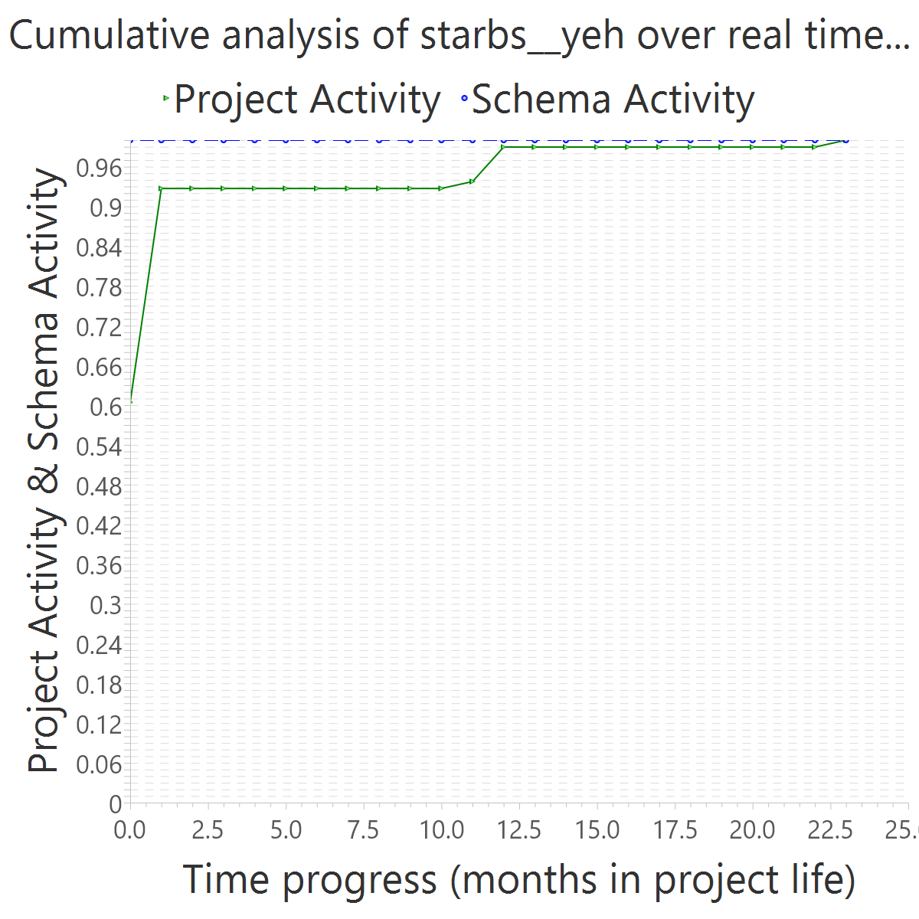
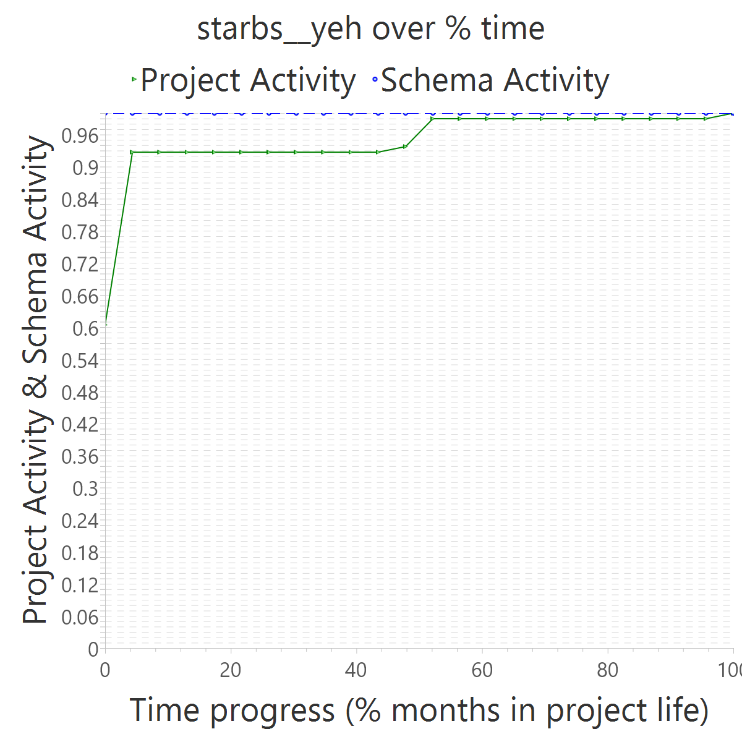
Project OVERALL CLASS #ActiveCommits #AreedspostV0 Activity Class SUP(Months) #Commits TotalActivity Project #Commits Project FileUpds Project Start Date UTC Project End Date UTC PUP+V0(Months) 10%-sync (%) 50%-attain.(%) 75%-attain.(%) 80%-attain.(%) 100%-attain.(%) AvgTimeLag AvgSrcLag TimeLagsSchemaAlways? SrcLagsSchemaAlways?
starbs__yeh 0_FROZEN 0 0 0_NONE 1 2 0 33 98 2014-12-12 22:19:33 +0000 2016-11-26 17:59:33 +0000 24 0.96 0.00 0.00 0.00 0.00 0.52 0.06 TRUE TRUE

Slide 10
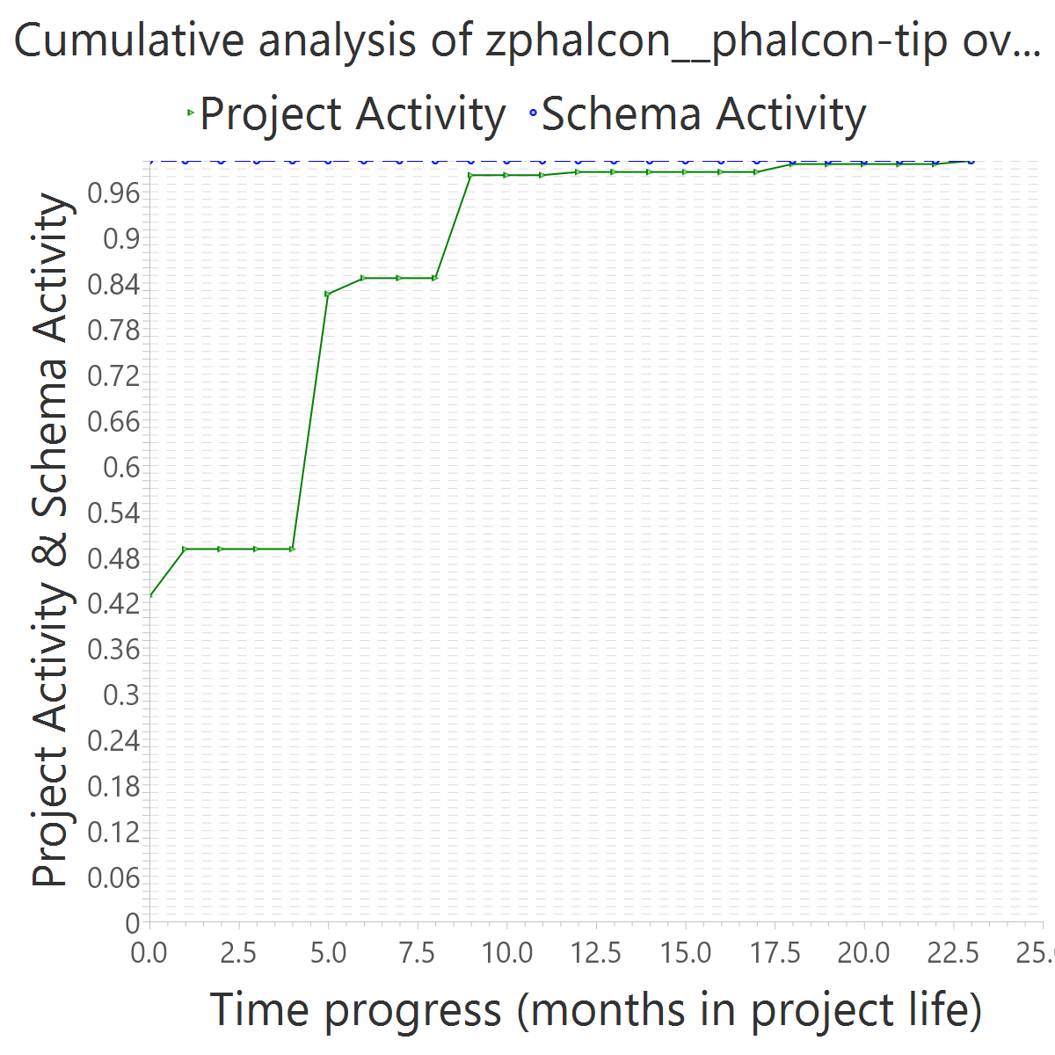
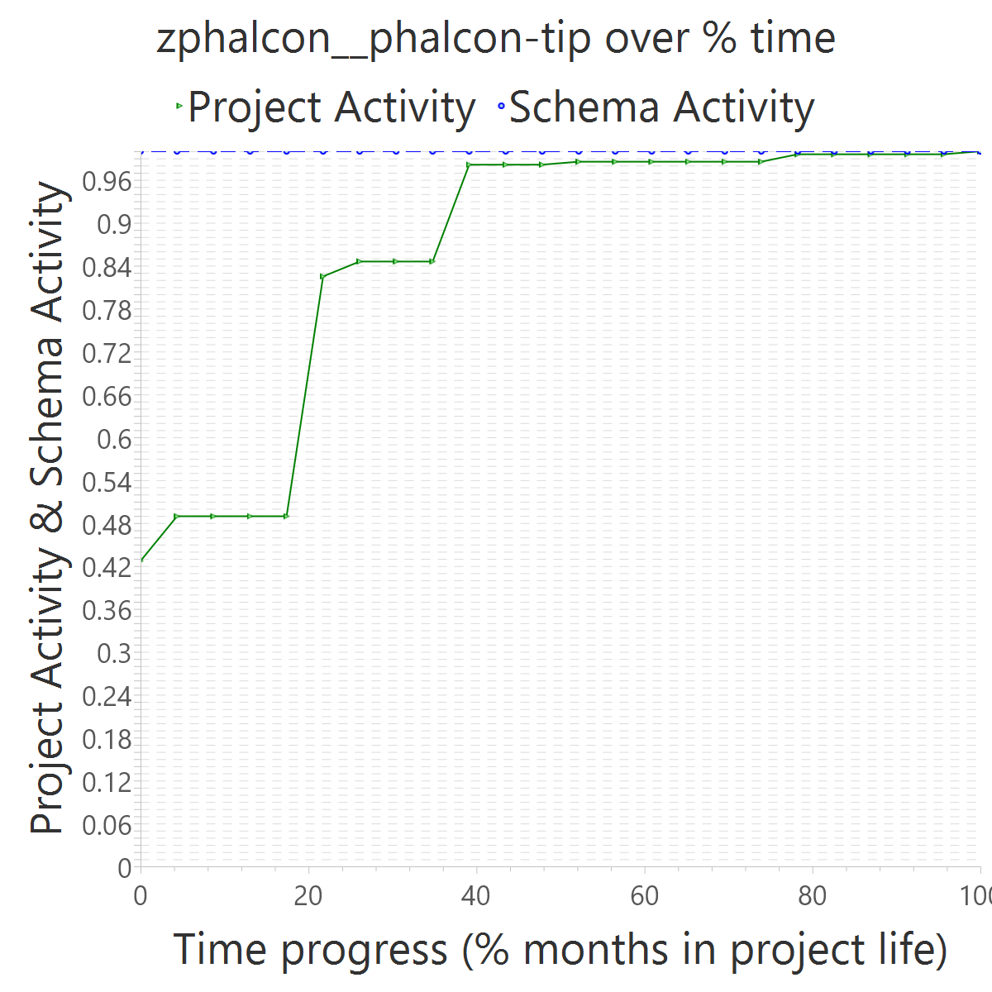
Project OVERALL CLASS #ActiveCommits #AreedspostV0 Activity Class SUP(Months) #Commits TotalActivity Project #Commits Project FileUpds Project Start Date UTC Project End Date UTC PUP+V0(Months) 10%-sync (%) 50%-attain.(%) 75%-attain.(%) 80%-attain.(%) 100%-attain.(%) AvgTimeLag AvgSrcLag TimeLagsSchemaAlways? SrcLagsSchemaAlways?
zphalcon__phalcon-tip 0_FROZEN 0 0 0_NONE 1 2 0 81 489 2014-11-09 03:09:17 +0000 2016-10-12 06:17:05 +0000 24 0.63 0.00 0.00 0.00 0.00 0.52 0.15 TRUE TRUE

Slide 11
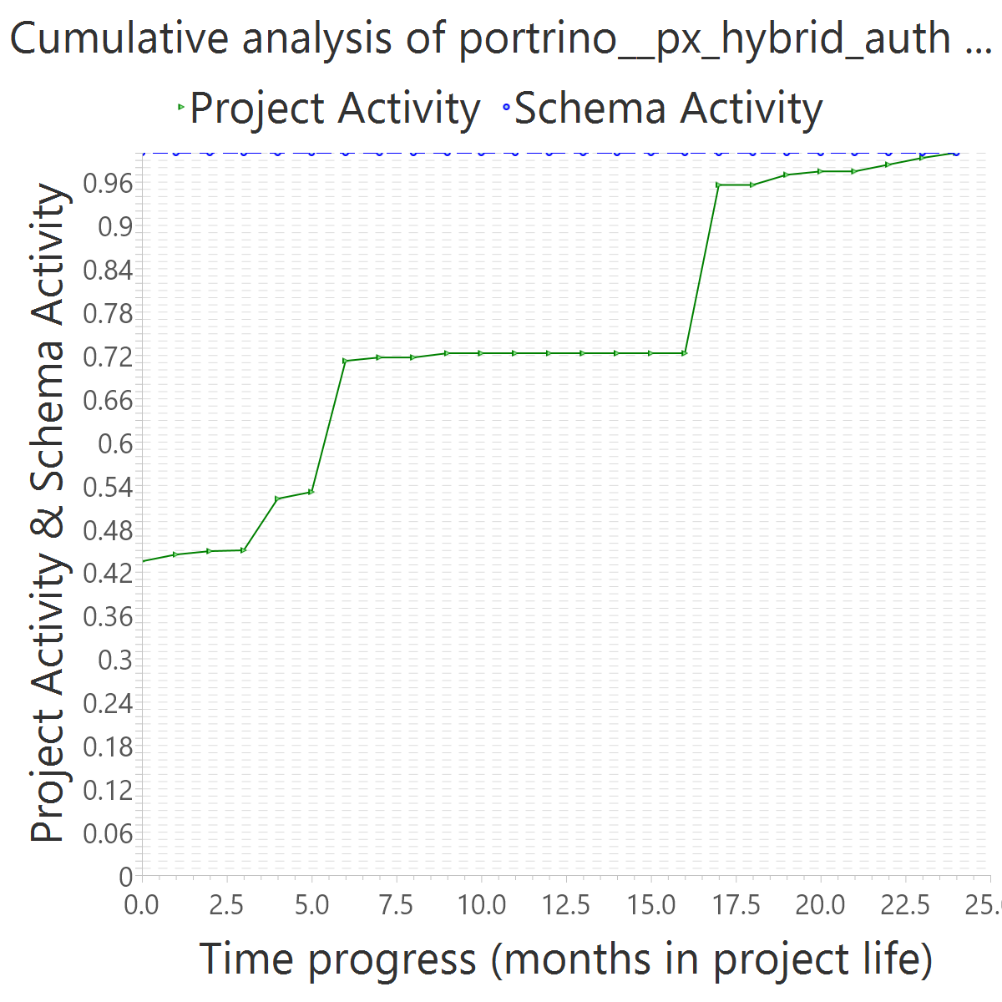
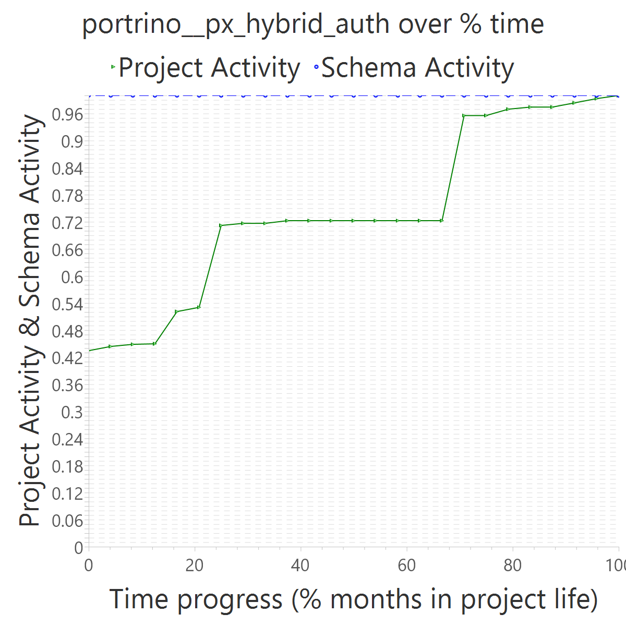
Project OVERALL CLASS #ActiveCommits #AreedspostV0 Activity Class SUP(Months) #Commits TotalActivity Project #Commits Project FileUpds Project Start Date UTC Project End Date UTC PUP+V0(Months) 10%-sync (%) 50%-attain.(%) 75%-attain.(%) 80%-attain.(%) 100%-attain.(%) AvgTimeLag AvgSrcLag TimeLagsSchemaAlways? SrcLagsSchemaAlways?
portrino__px_hybrid_auth 0_FROZEN 0 0 0_NONE 17 2 0 79 857 2015-04-09 05:33:37 +0000 2017-04-26 11:30:09 +0000 25 0.32 0.00 0.00 0.00 0.00 0.52 0.27 TRUE TRUE

Slide 12
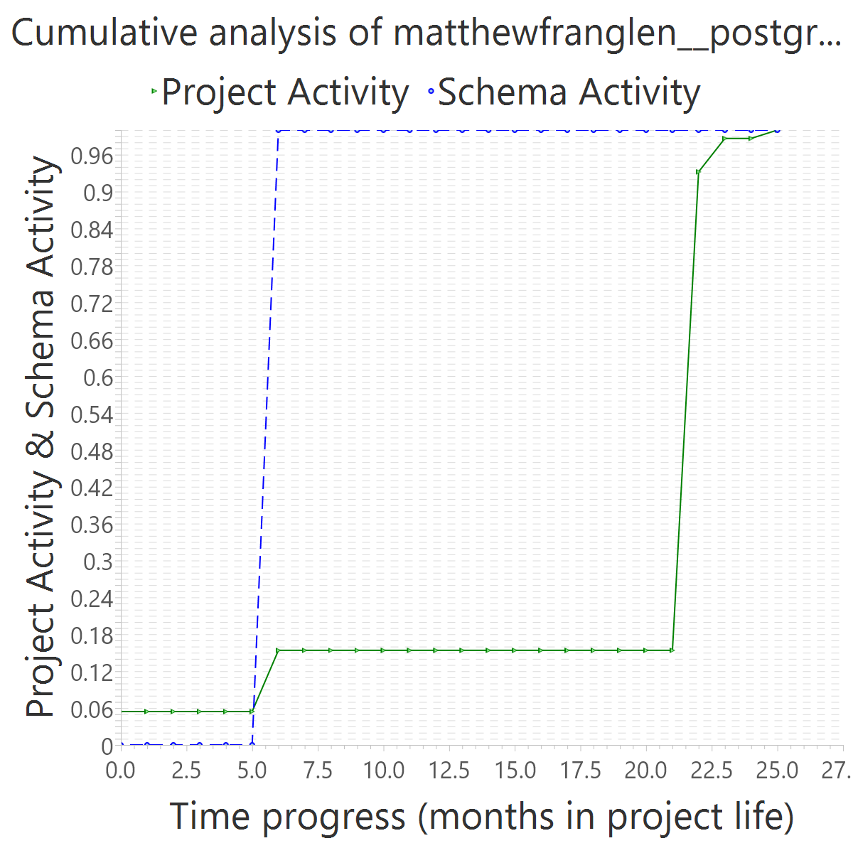
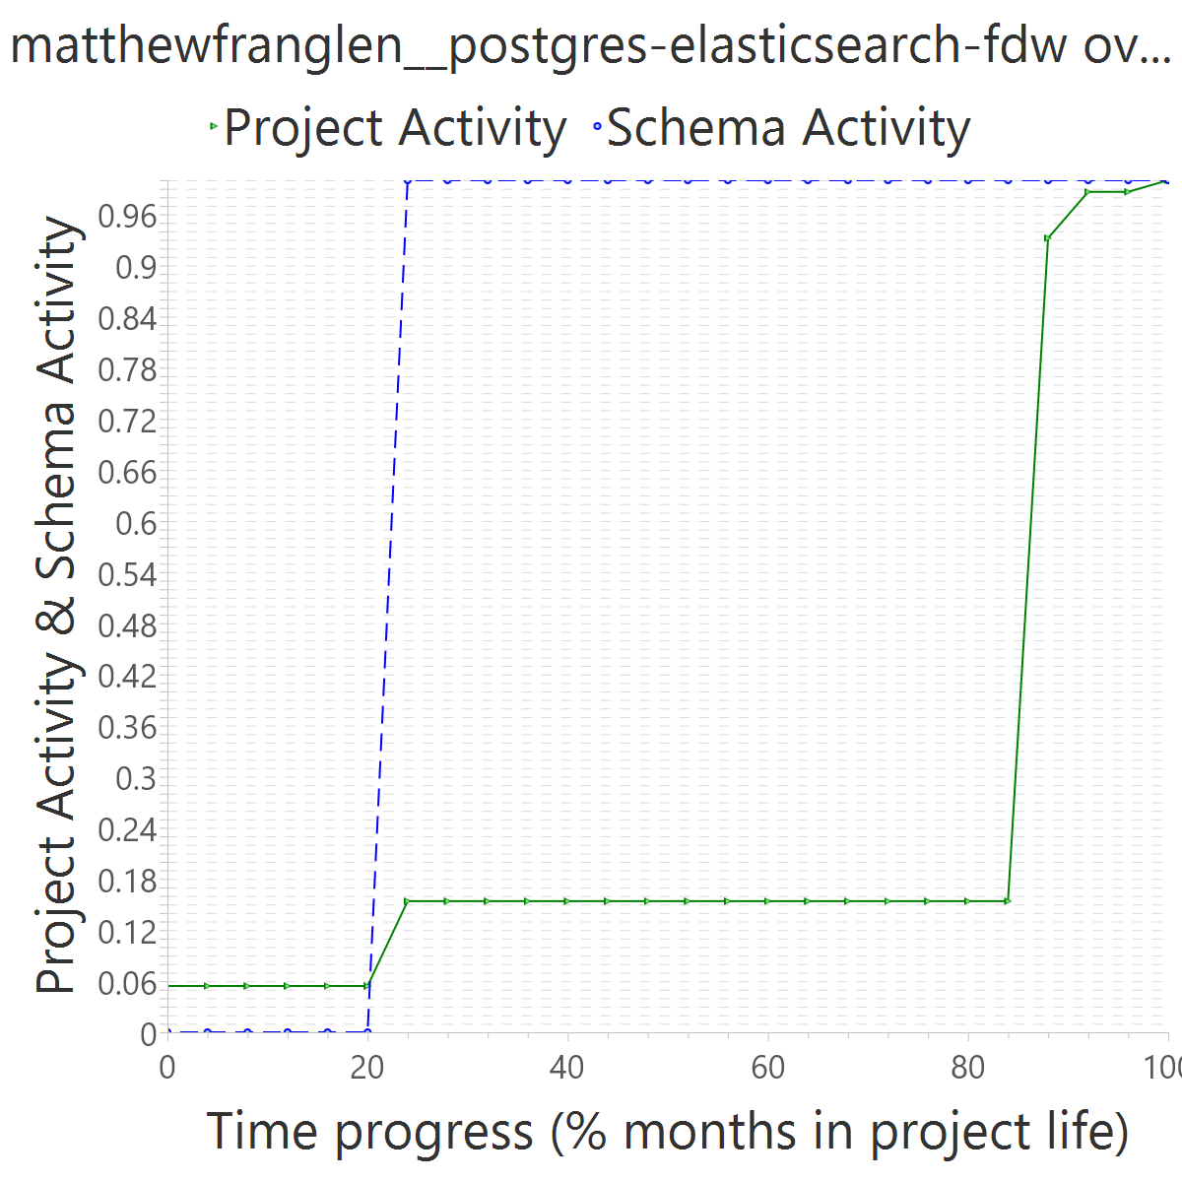
Project OVERALL CLASS #ActiveCommits #AreedspostV0 Activity Class SUP(Months) #Commits TotalActivity Project #Commits Project FileUpds Project Start Date UTC Project End Date UTC PUP+V0(Months) 10%-sync (%) 50%-attain.(%) 75%-attain.(%) 80%-attain.(%) 100%-attain.(%) AvgTimeLag AvgSrcLag TimeLagsSchemaAlways? SrcLagsSchemaAlways?
matthewfranglen__postgres-elasticsearch-fdw 0_FROZEN 0 0 0_NONE 17 4 0 128 252 2015-06-09 11:04:51 +0000 2017-07-28 21:14:50 +0000 26 0.38 0.24 0.24 0.24 0.24 0.28 0.53 FALSE FALSE

Slide 13
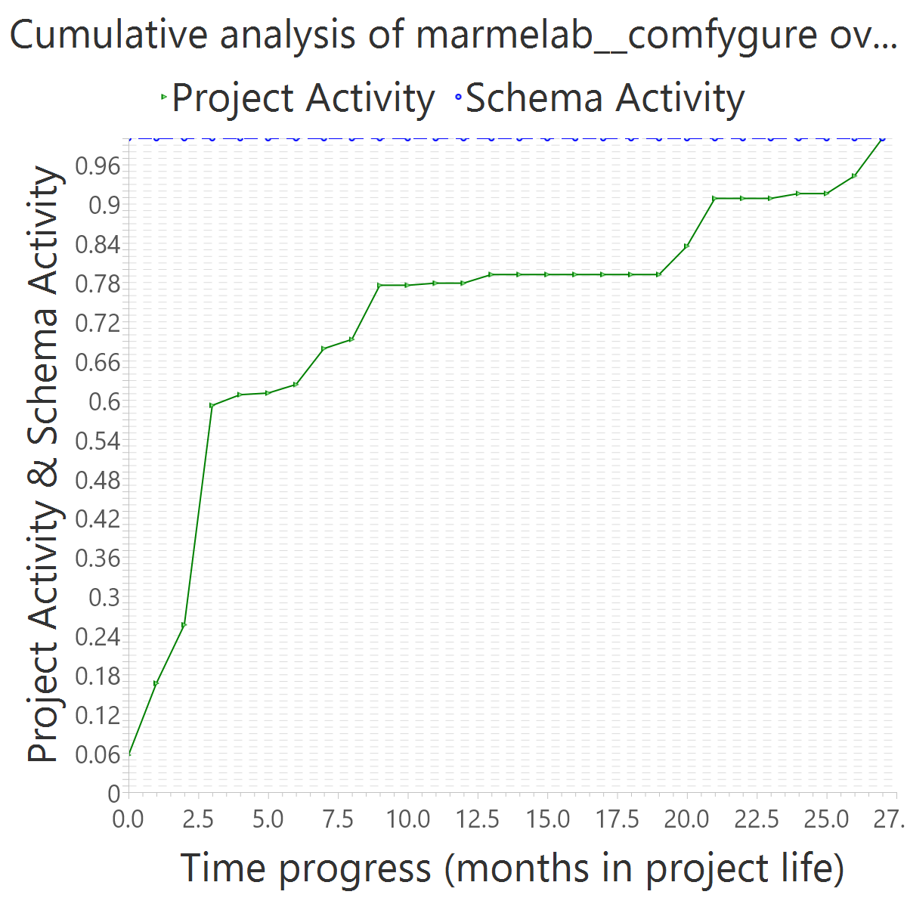
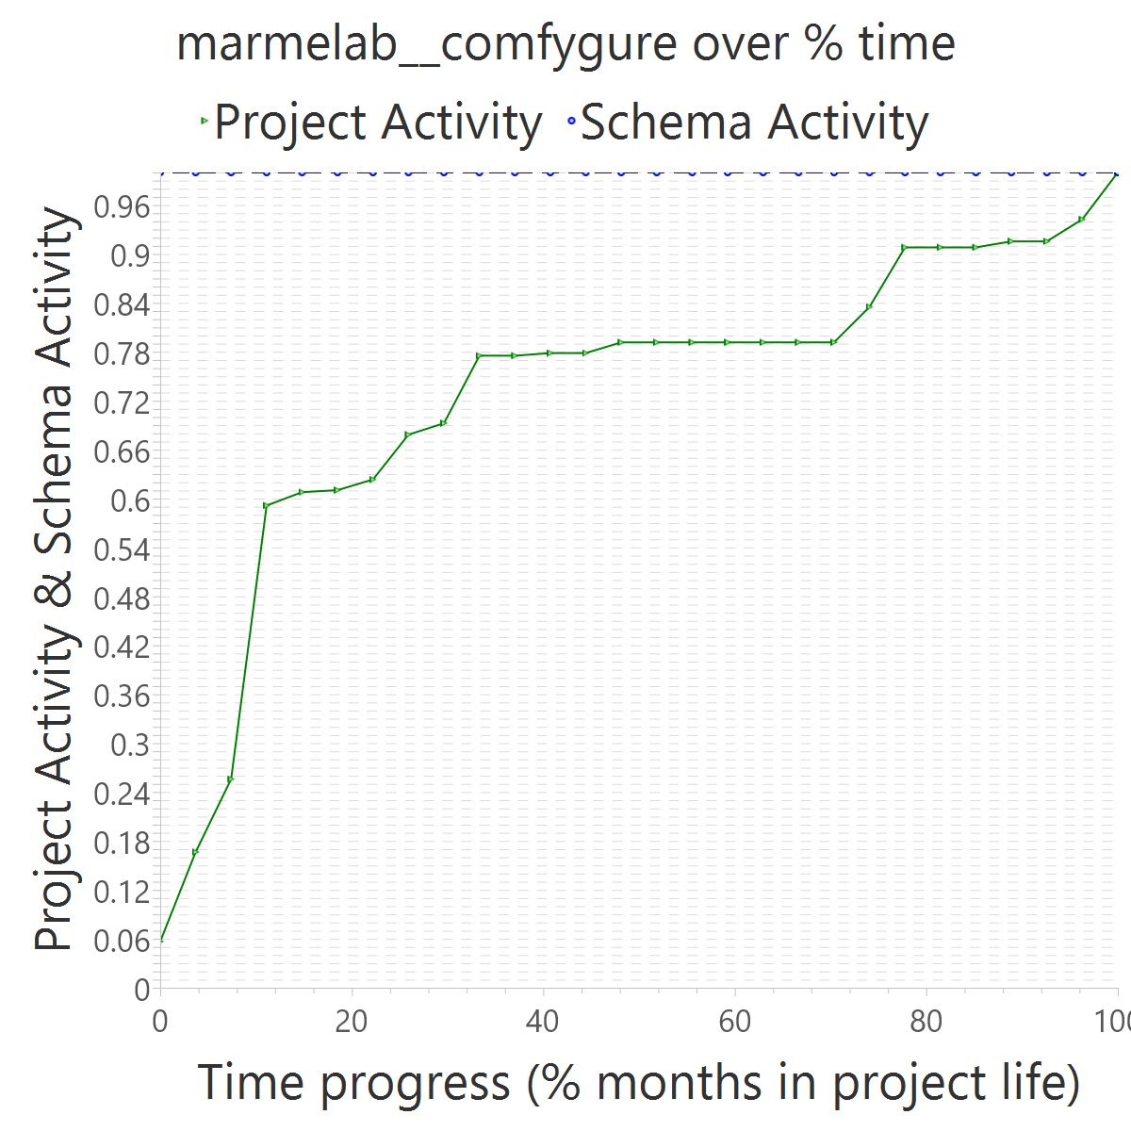
Project OVERALL CLASS #ActiveCommits #AreedspostV0 Activity Class SUP(Months) #Commits TotalActivity Project #Commits Project FileUpds Project Start Date UTC Project End Date UTC PUP+V0(Months) 10%-sync (%) 50%-attain.(%) 75%-attain.(%) 80%-attain.(%) 100%-attain.(%) AvgTimeLag AvgSrcLag TimeLagsSchemaAlways? SrcLagsSchemaAlways?
marmelab__comfygure 0_FROZEN 0 0 0_NONE 1 2 0 274 1222 2017-02-24 13:03:52 +0000 2019-05-24 16:21:01 +0000 28 0.25 0.00 0.00 0.00 0.00 0.52 0.29 TRUE TRUE

Slide 14
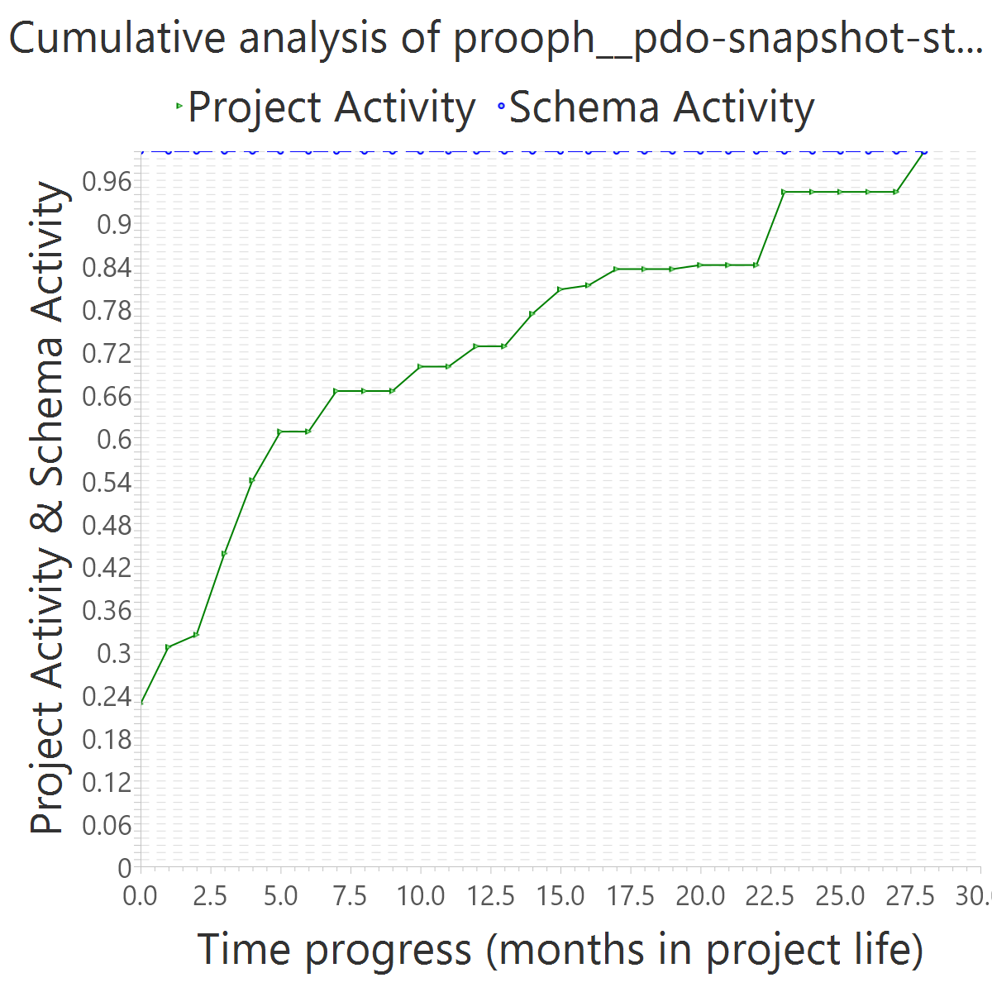
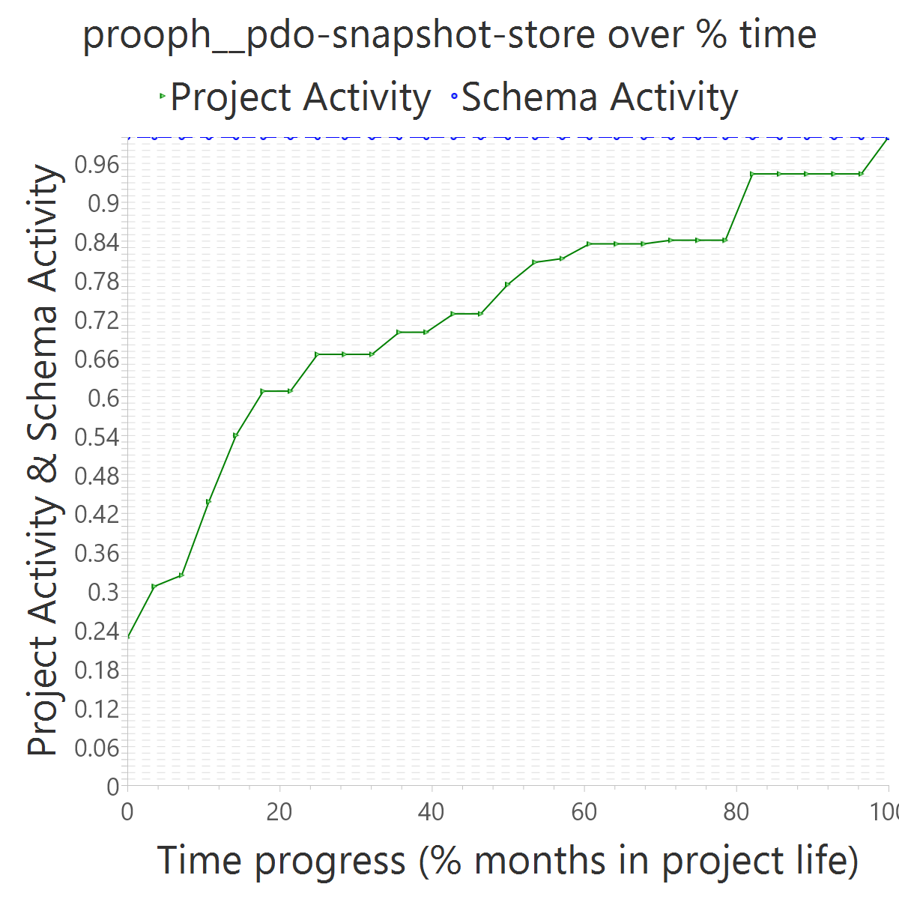
Project OVERALL CLASS #ActiveCommits #AreedspostV0 Activity Class SUP(Months) #Commits TotalActivity Project #Commits Project FileUpds Project Start Date UTC Project End Date UTC PUP+V0(Months) 10%-sync (%) 50%-attain.(%) 75%-attain.(%) 80%-attain.(%) 100%-attain.(%) AvgTimeLag AvgSrcLag TimeLagsSchemaAlways? SrcLagsSchemaAlways?
prooph__pdo-snapshot-store 0_FROZEN 0 0 0_NONE 17 3 0 76 181 2016-12-02 09:04:23 +0000 2019-04-26 23:36:01 +0000 29 0.21 0.00 0.00 0.00 0.00 0.52 0.28 TRUE TRUE

Slide 15
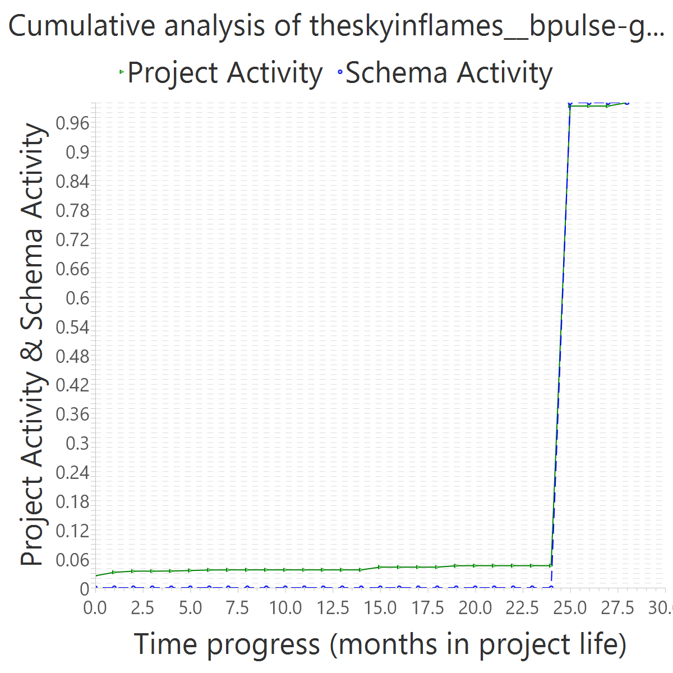
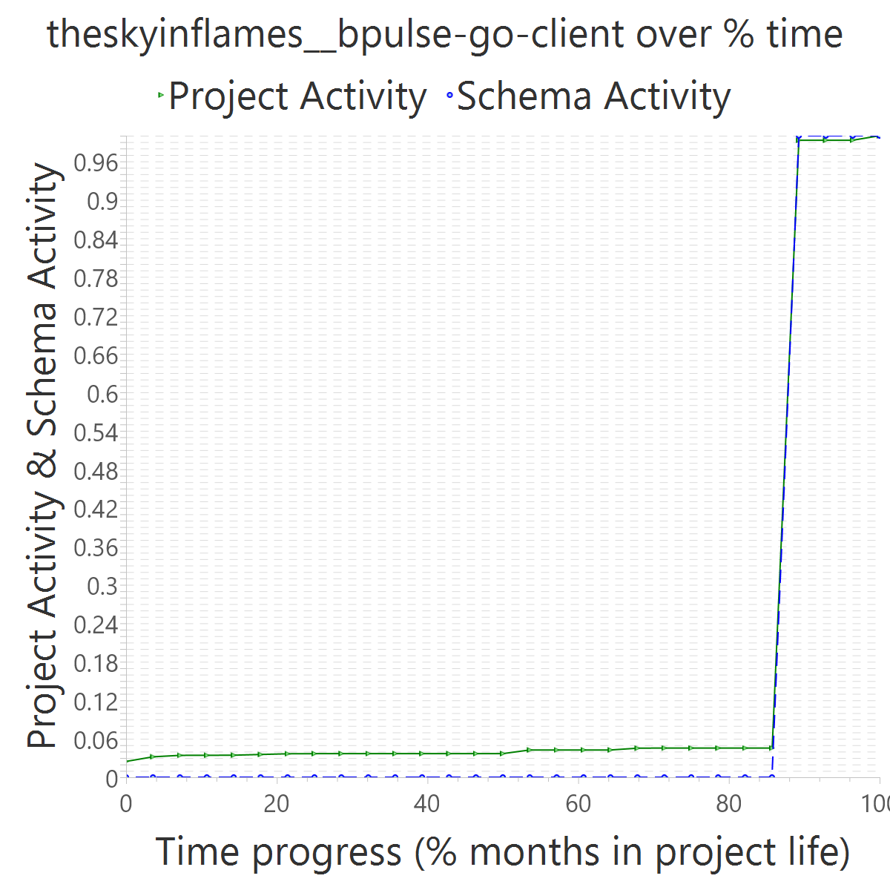
Project OVERALL CLASS #ActiveCommits #AreedspostV0 Activity Class SUP(Months) #Commits TotalActivity Project #Commits Project FileUpds Project Start Date UTC Project End Date UTC PUP+V0(Months) 10%-sync (%) 50%-attain.(%) 75%-attain.(%) 80%-attain.(%) 100%-attain.(%) AvgTimeLag AvgSrcLag TimeLagsSchemaAlways? SrcLagsSchemaAlways?
theskyinflames__bpulse-go-client 0_FROZEN 0 0 0_NONE 1 2 0 105 11857 2015-09-08 14:56:03 +0000 2018-01-12 10:24:09 +0000 29 1.00 0.89 0.89 0.89 0.89 -0.38 -0.03 FALSE FALSE

Slide 16
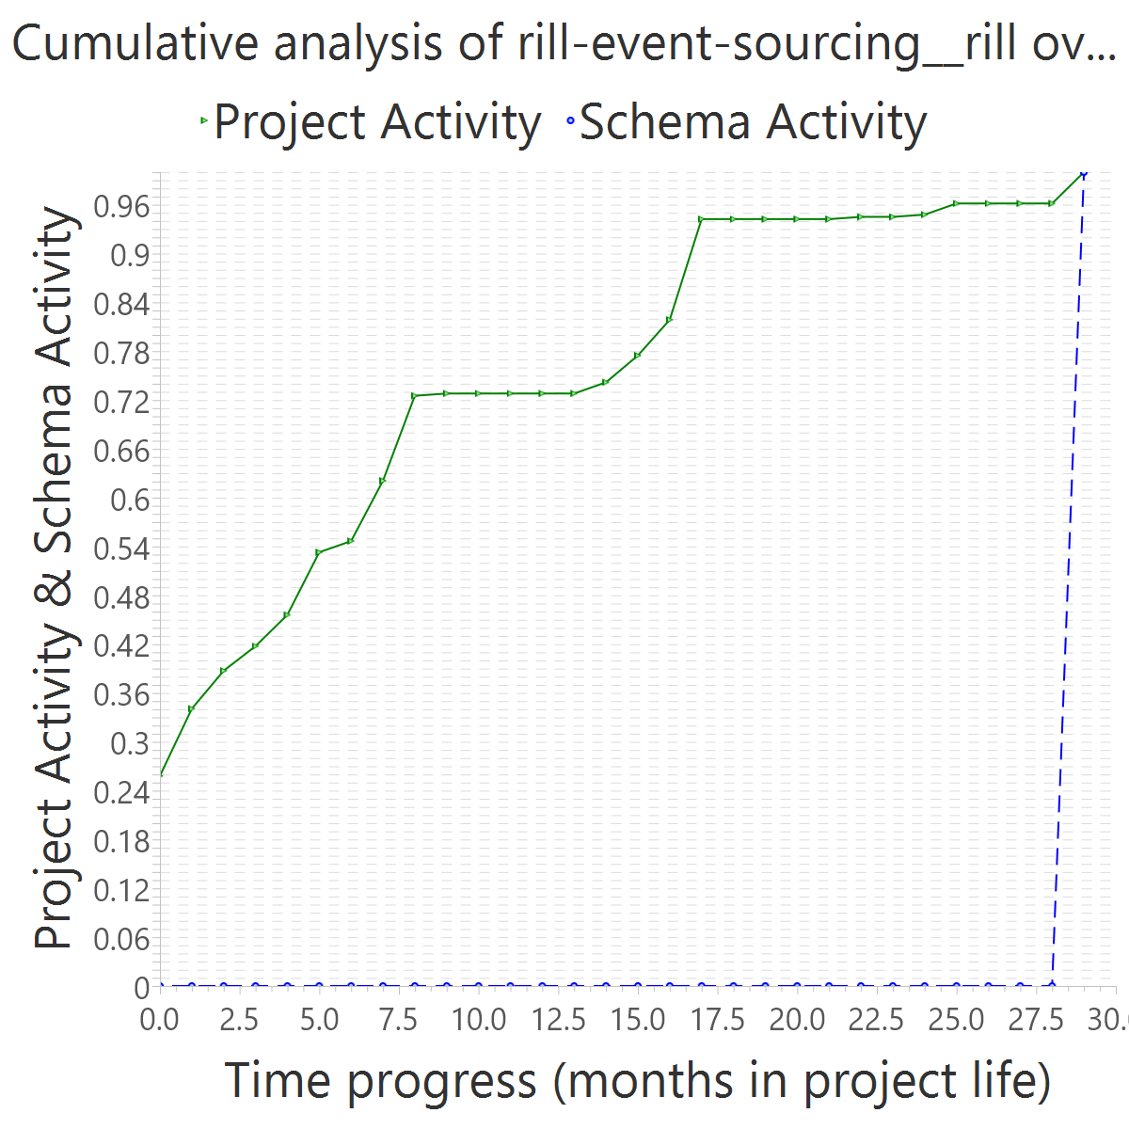
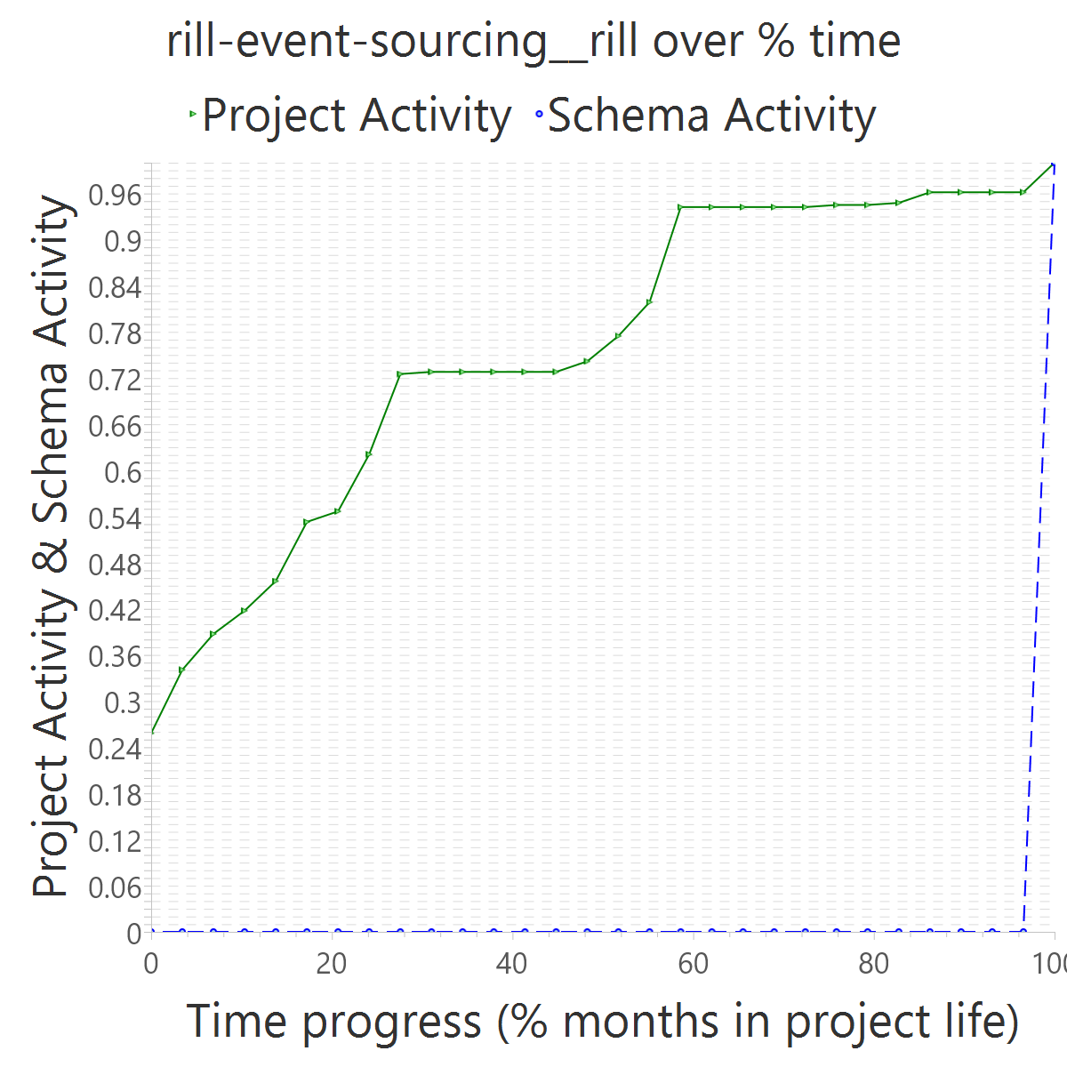
Project OVERALL CLASS #ActiveCommits #AreedspostV0 Activity Class SUP(Months) #Commits TotalActivity Project #Commits Project FileUpds Project Start Date UTC Project End Date UTC PUP+V0(Months) 10%-sync (%) 50%-attain.(%) 75%-attain.(%) 80%-attain.(%) 100%-attain.(%) AvgTimeLag AvgSrcLag TimeLagsSchemaAlways? SrcLagsSchemaAlways?
rill-event-sourcing__rill 0_FROZEN 0 0 0_NONE 1 2 0 152 385 2014-07-08 14:20:42 +0000 2016-12-29 11:07:41 +0000 30 0.03 1.00 1.00 1.00 1.00 -0.48 -0.75 FALSE FALSE

Slide 17
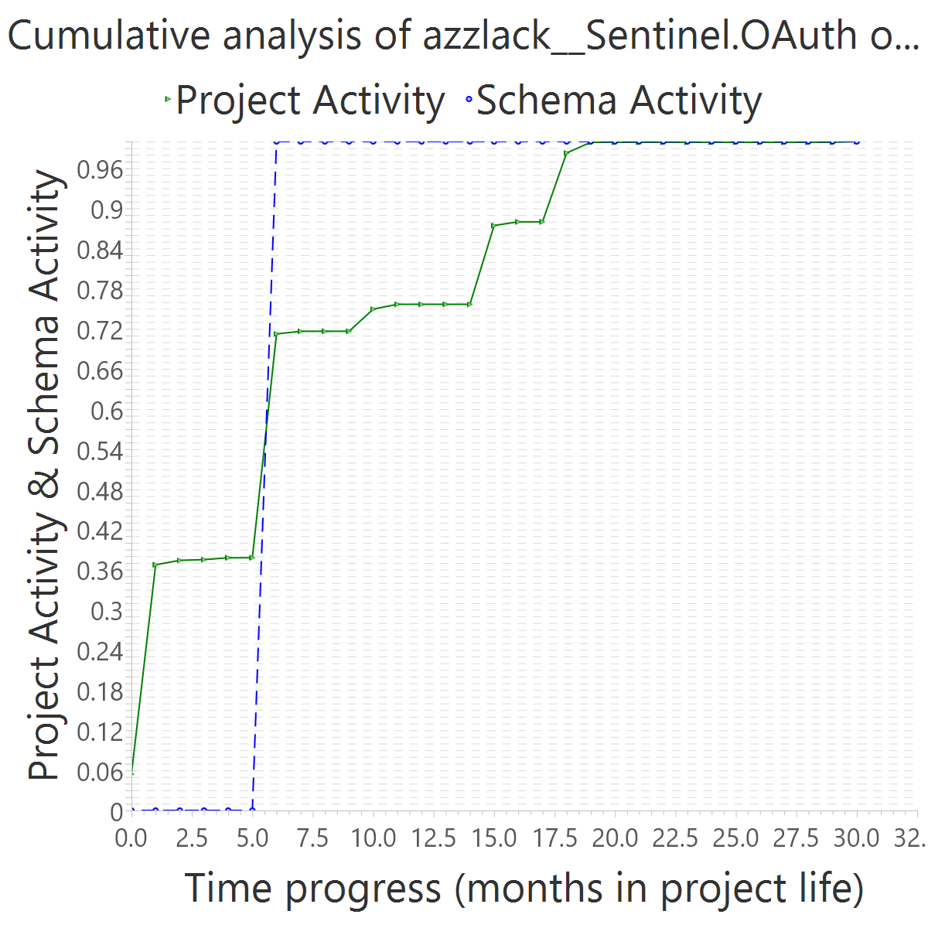
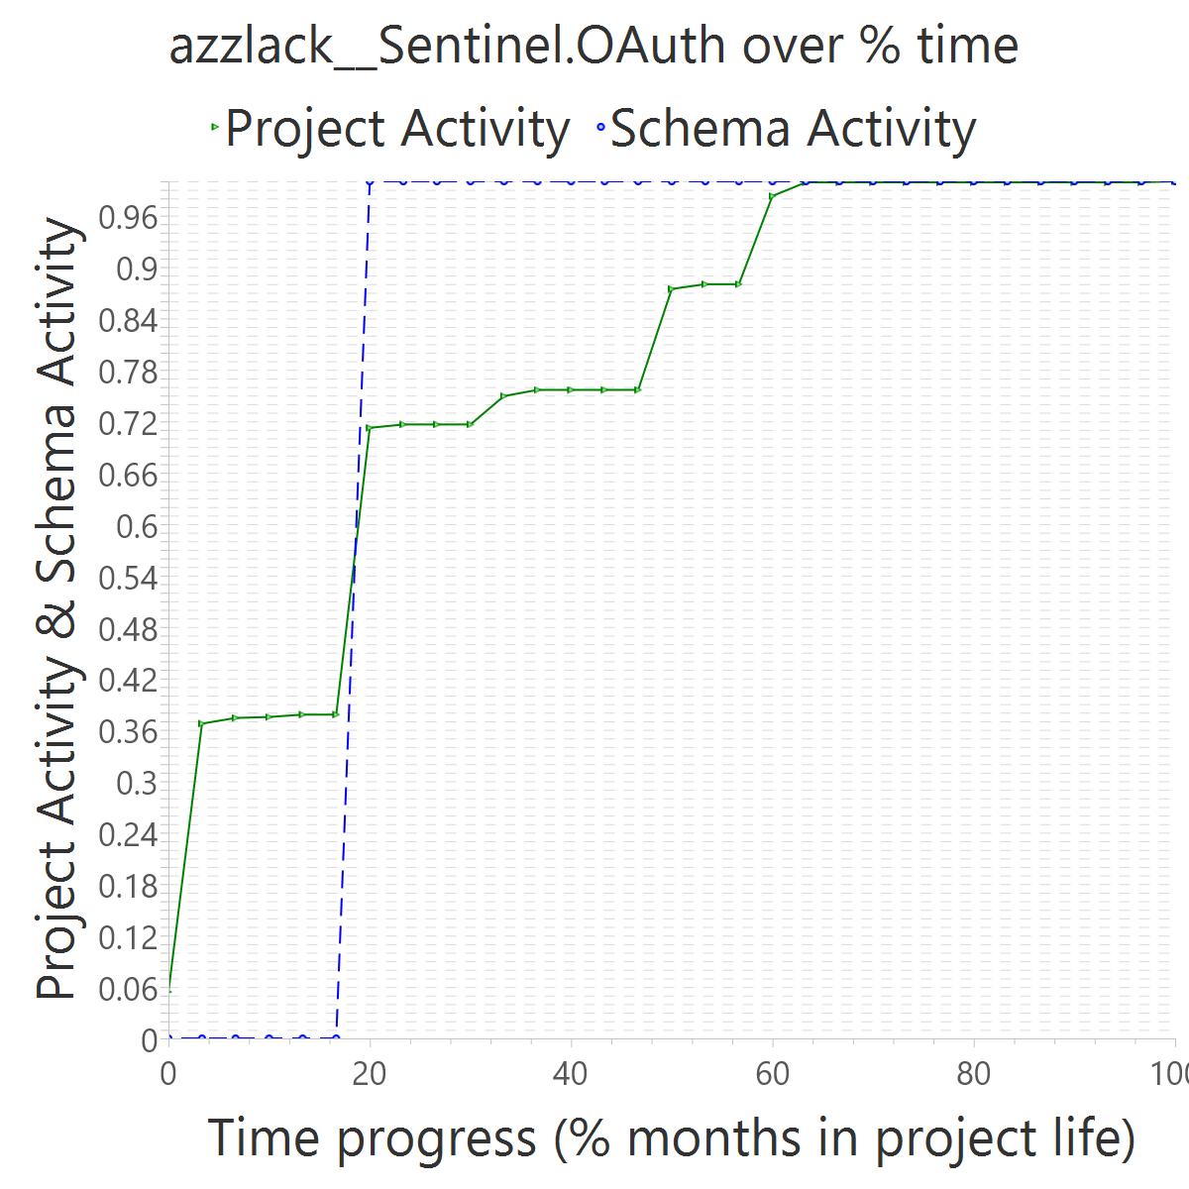
Project OVERALL CLASS #ActiveCommits #AreedspostV0 Activity Class SUP(Months) #Commits TotalActivity Project #Commits Project FileUpds Project Start Date UTC Project End Date UTC PUP+V0(Months) 10%-sync (%) 50%-attain.(%) 75%-attain.(%) 80%-attain.(%) 100%-attain.(%) AvgTimeLag AvgSrcLag TimeLagsSchemaAlways? SrcLagsSchemaAlways?
azzlack__Sentinel.OAuth 0_FROZEN 0 0 0_NONE 1 3 0 313 1813 2015-04-17 21:49:56 +0000 2017-10-31 11:17:42 +0000 31 0.45 0.20 0.20 0.20 0.20 0.32 0.03 FALSE FALSE

Slide 18
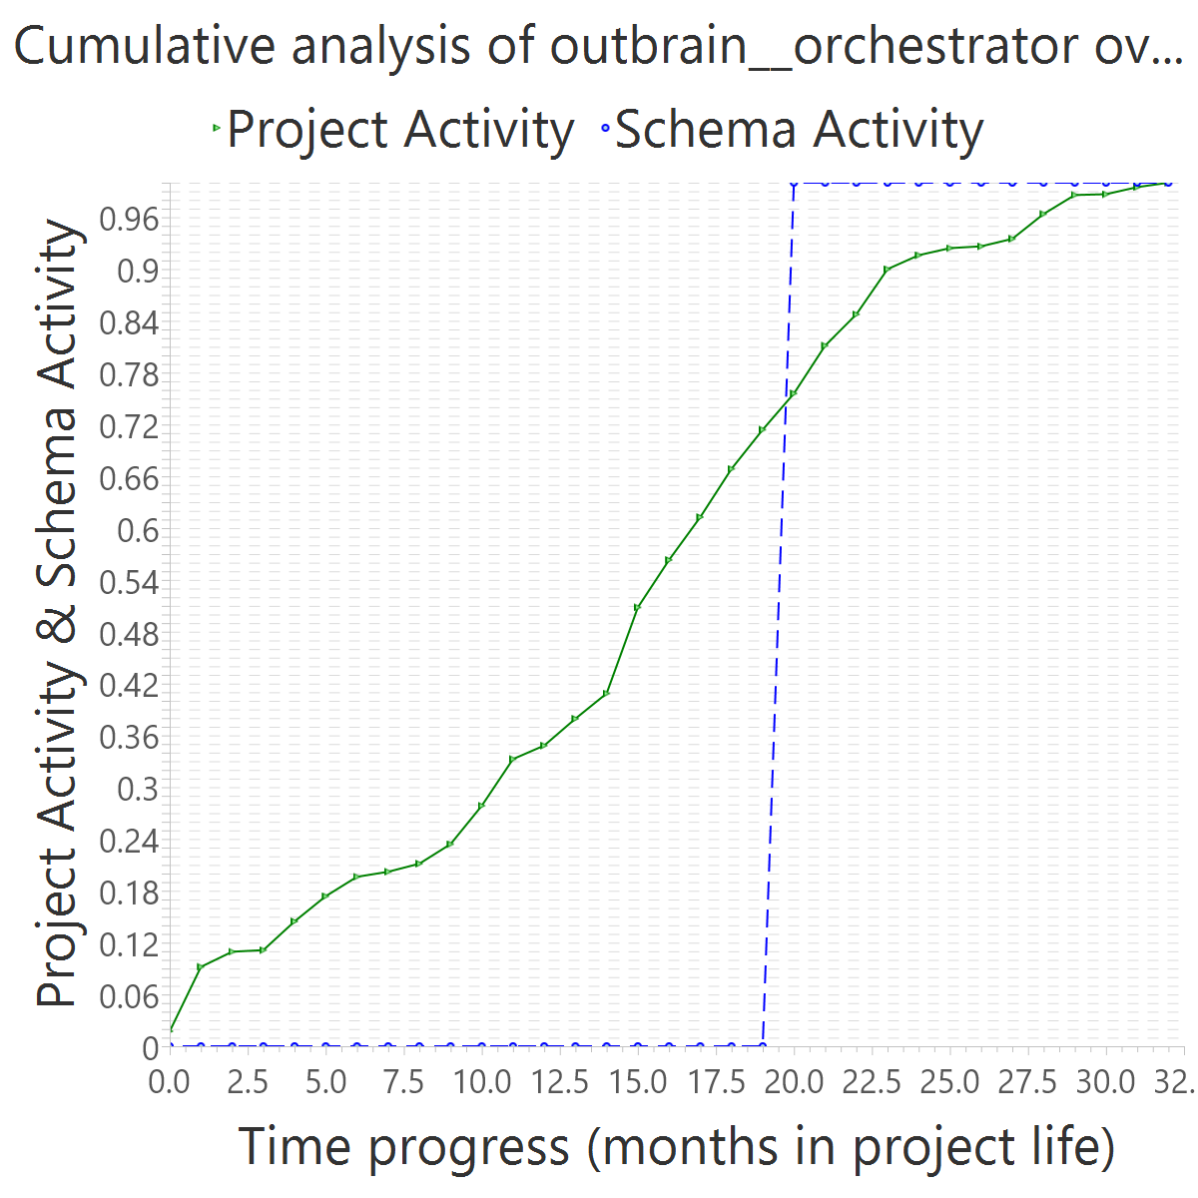
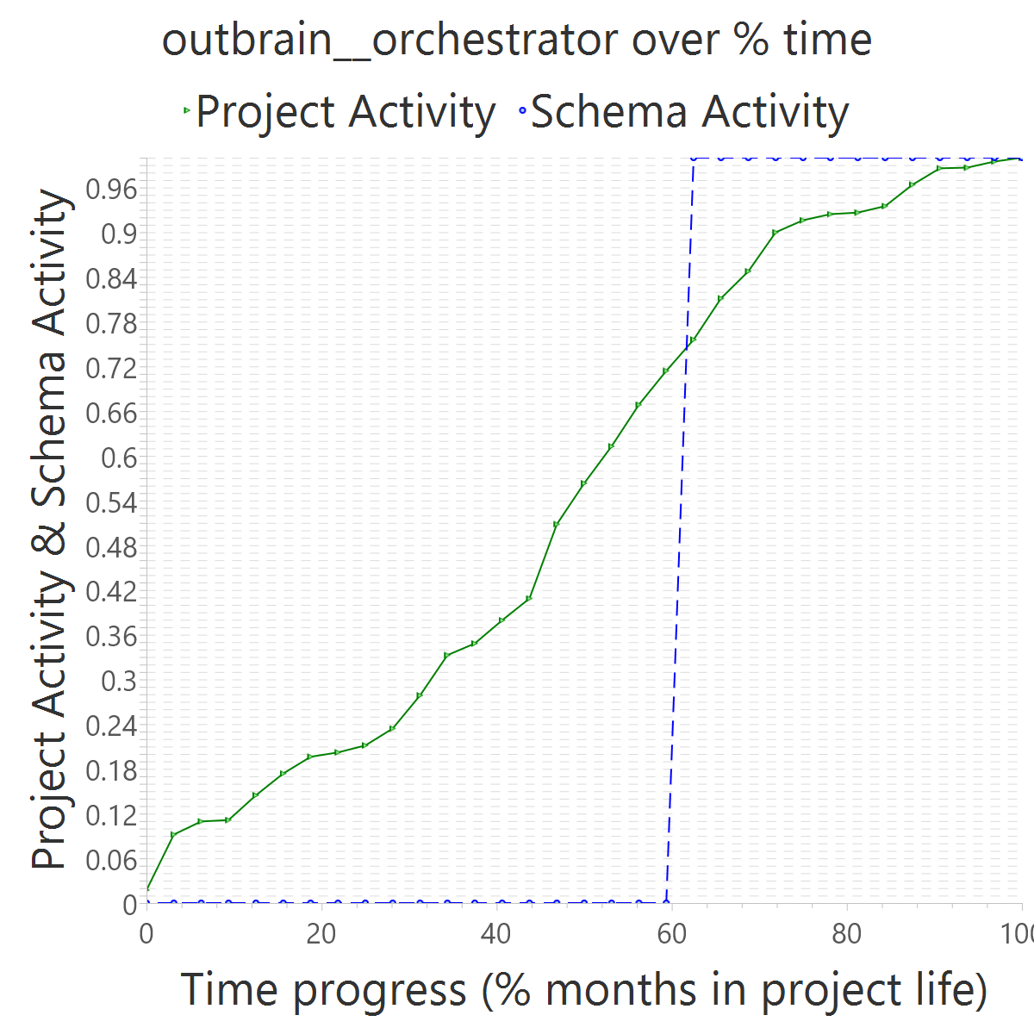
Project OVERALL CLASS #ActiveCommits #AreedspostV0 Activity Class SUP(Months) #Commits TotalActivity Project #Commits Project FileUpds Project Start Date UTC Project End Date UTC PUP+V0(Months) 10%-sync (%) 50%-attain.(%) 75%-attain.(%) 80%-attain.(%) 100%-attain.(%) AvgTimeLag AvgSrcLag TimeLagsSchemaAlways? SrcLagsSchemaAlways?
outbrain__orchestrator 0_FROZEN 0 0 0_NONE 8 3 0 979 4281 2014-04-24 12:06:37 +0000 2016-12-08 14:29:25 +0000 33 0.33 0.63 0.63 0.63 0.63 -0.11 -0.16 FALSE FALSE

Slide 19
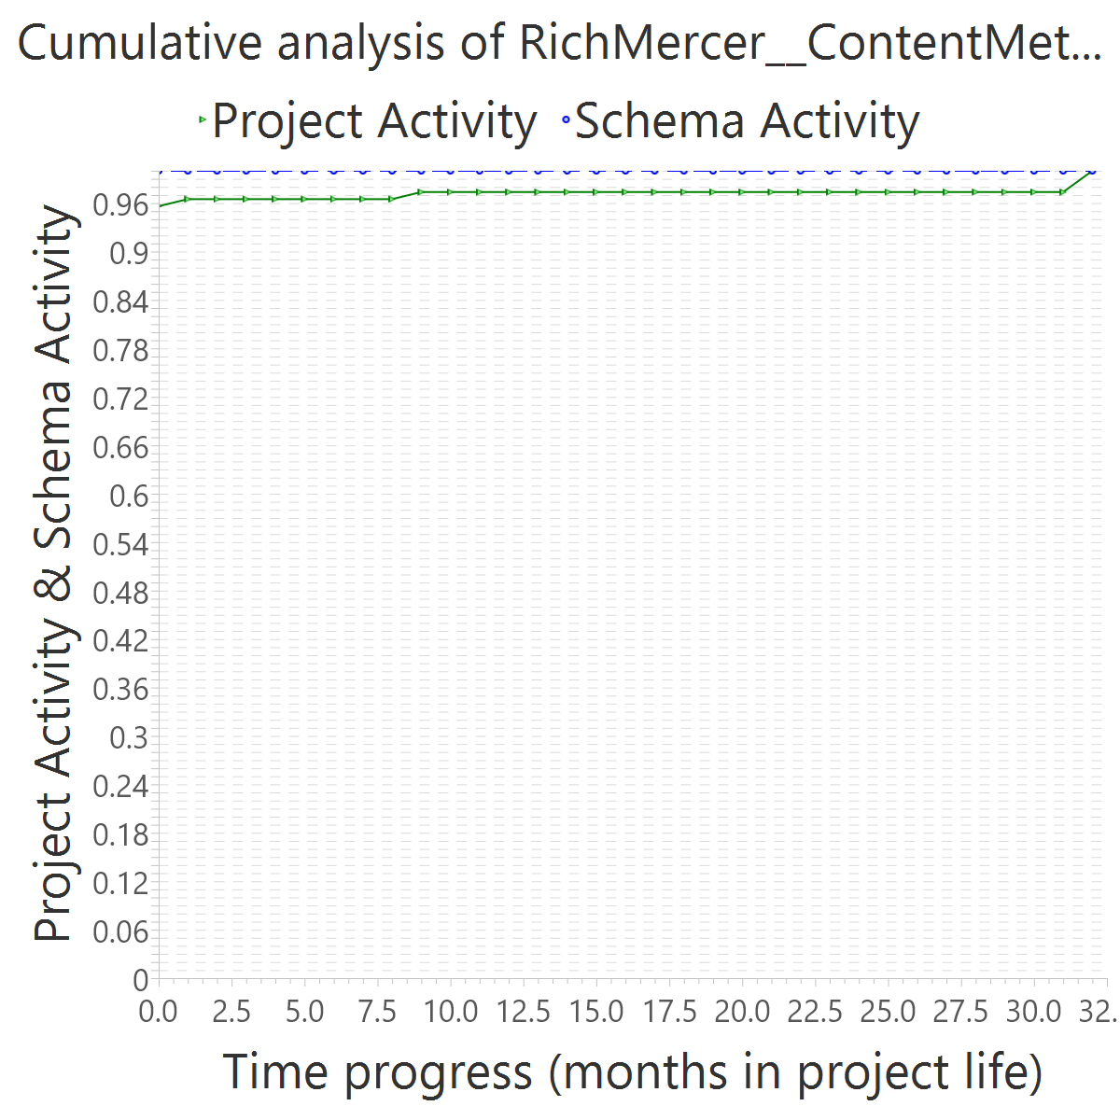
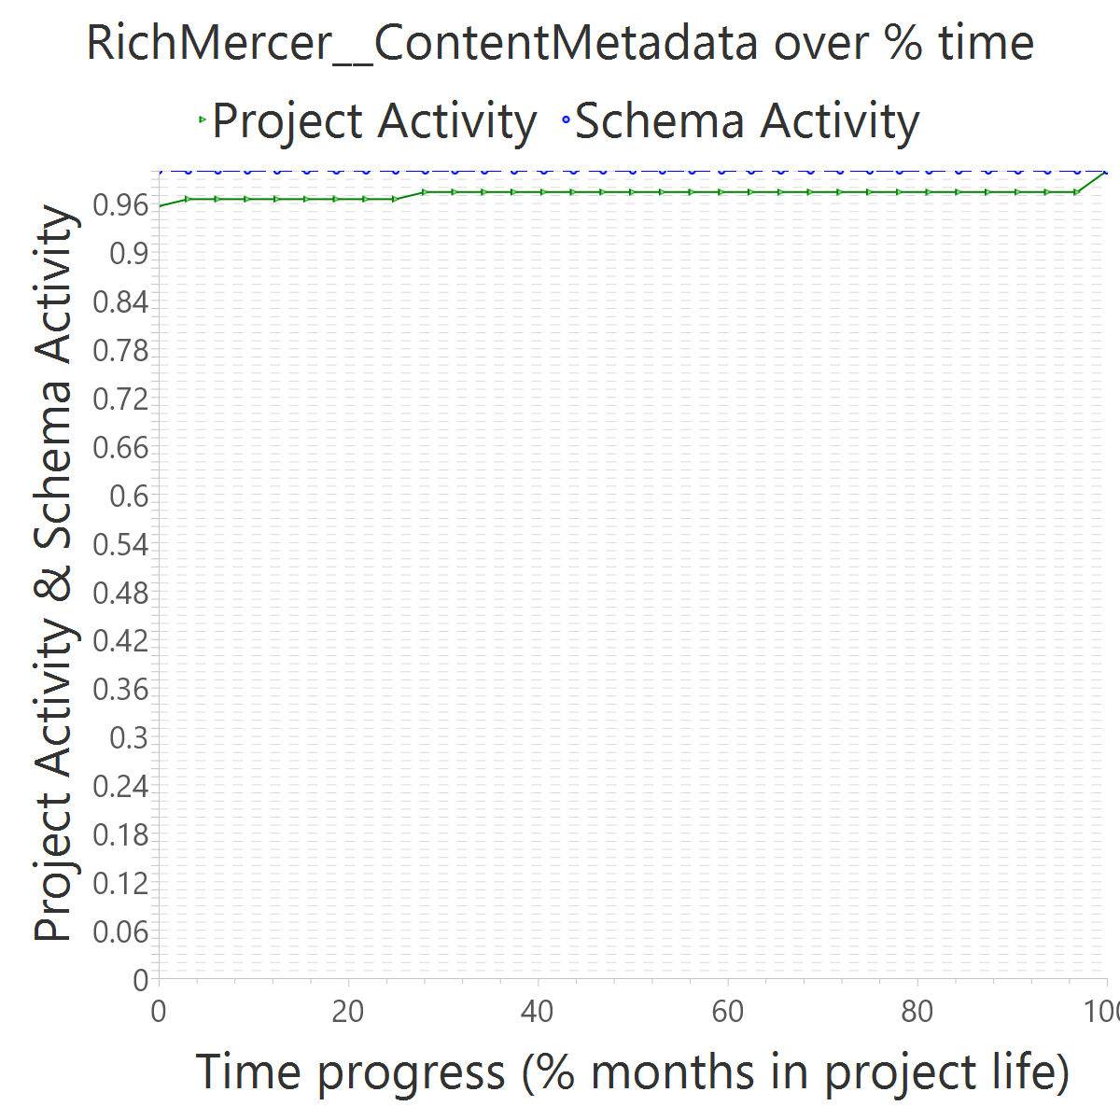
Project OVERALL CLASS #ActiveCommits #AreedspostV0 Activity Class SUP(Months) #Commits TotalActivity Project #Commits Project FileUpds Project Start Date UTC Project End Date UTC PUP+V0(Months) 10%-sync (%) 50%-attain.(%) 75%-attain.(%) 80%-attain.(%) 100%-attain.(%) AvgTimeLag AvgSrcLag TimeLagsSchemaAlways? SrcLagsSchemaAlways?
RichMercer__ContentMetadata 0_FROZEN 0 0 0_NONE 1 3 0 40 126 2016-07-03 17:51:06 +0000 2019-03-22 11:13:10 +0000 33 1.00 0.00 0.00 0.00 0.00 0.52 0.03 TRUE TRUE

Slide 20
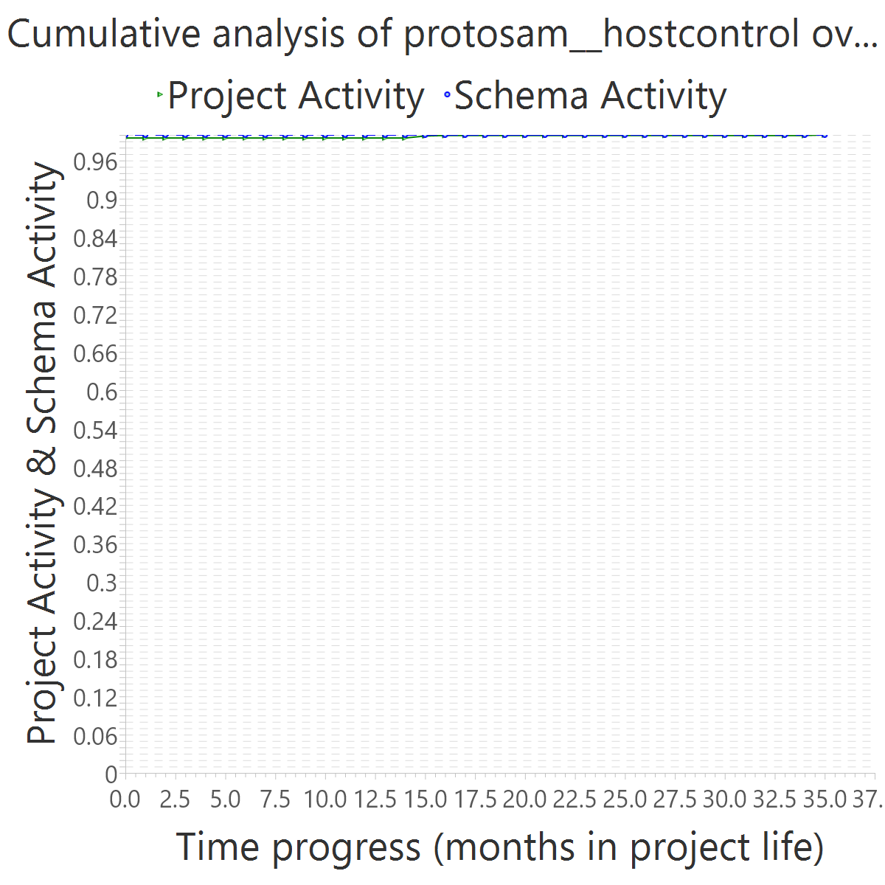
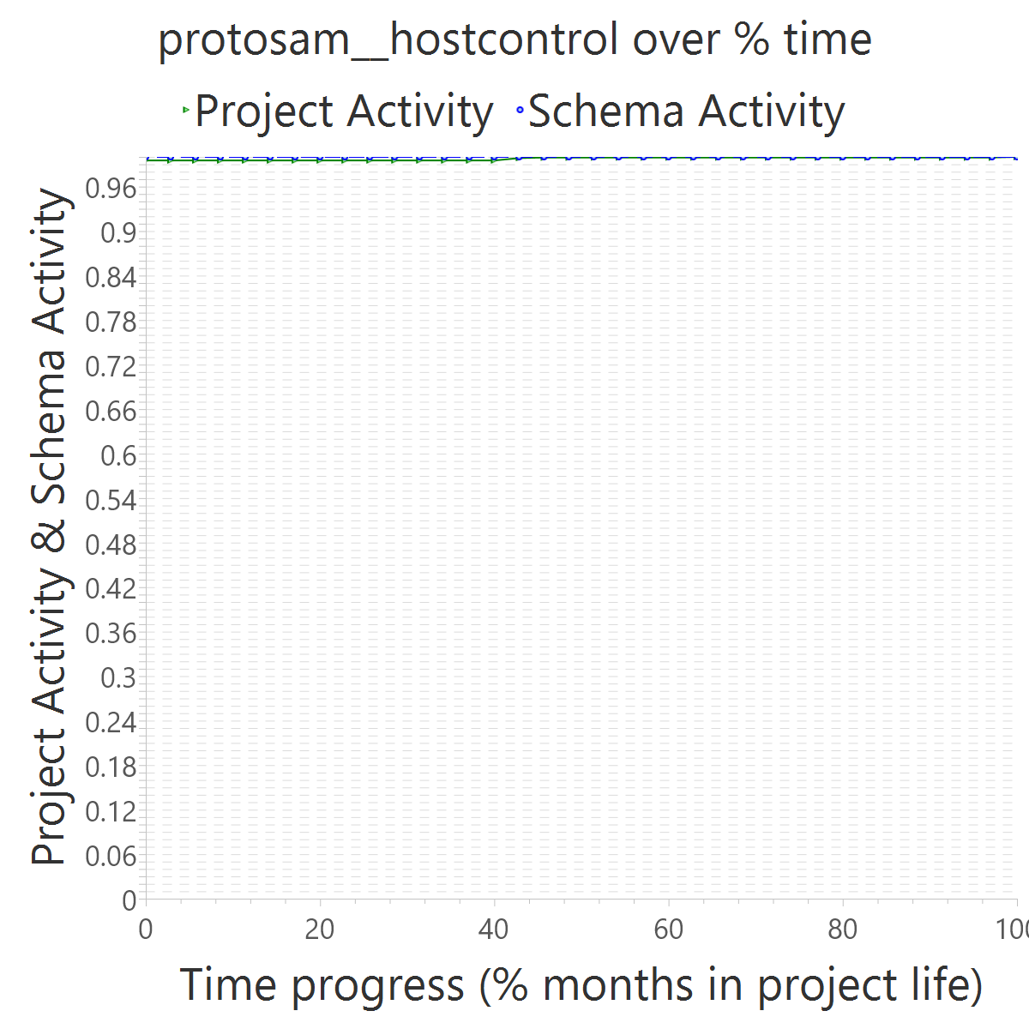
Project OVERALL CLASS #ActiveCommits #AreedspostV0 Activity Class SUP(Months) #Commits TotalActivity Project #Commits Project FileUpds Project Start Date UTC Project End Date UTC PUP+V0(Months) 10%-sync (%) 50%-attain.(%) 75%-attain.(%) 80%-attain.(%) 100%-attain.(%) AvgTimeLag AvgSrcLag TimeLagsSchemaAlways? SrcLagsSchemaAlways?
protosam__hostcontrol 0_FROZEN 0 0 0_NONE 1 7 0 18 1258 2016-01-14 23:46:31 +0000 2018-12-23 07:10:58 +0000 36 1.00 0.00 0.00 0.00 0.00 0.51 0.00 TRUE TRUE

Slide 21
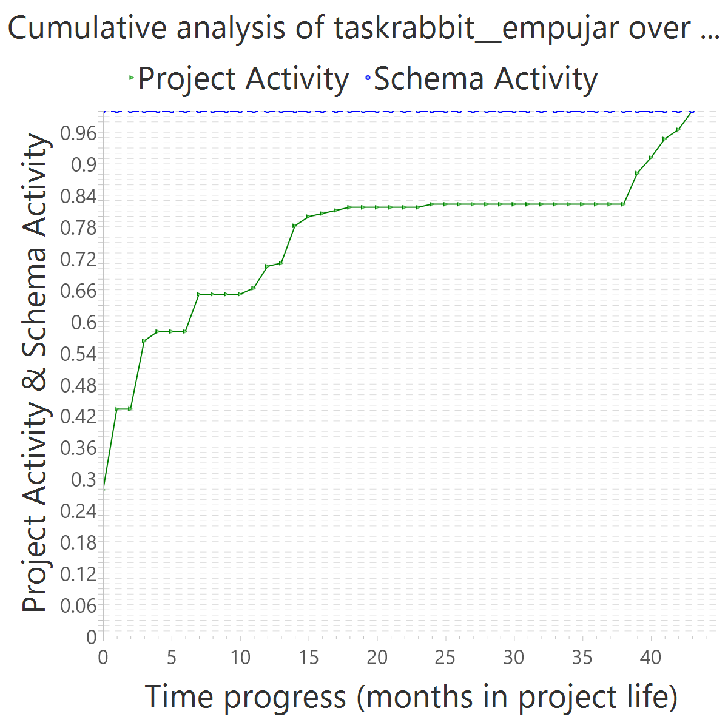
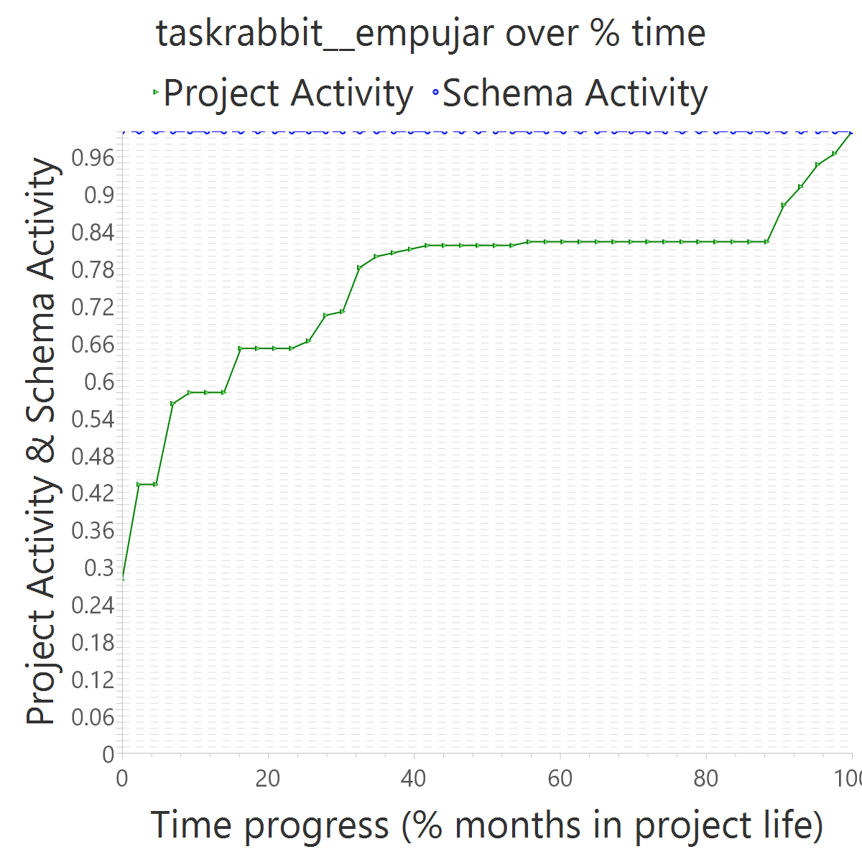
Project OVERALL CLASS #ActiveCommits #AreedspostV0 Activity Class SUP(Months) #Commits TotalActivity Project #Commits Project FileUpds Project Start Date UTC Project End Date UTC PUP+V0(Months) 10%-sync (%) 50%-attain.(%) 75%-attain.(%) 80%-attain.(%) 100%-attain.(%) AvgTimeLag AvgSrcLag TimeLagsSchemaAlways? SrcLagsSchemaAlways?
taskrabbit__empujar 0_FROZEN 0 0 0_NONE 1 3 0 98 172 2015-08-27 13:53:33 +0000 2019-03-08 03:12:16 +0000 44 0.09 0.00 0.00 0.00 0.00 0.51 0.25 TRUE TRUE

Slide 22
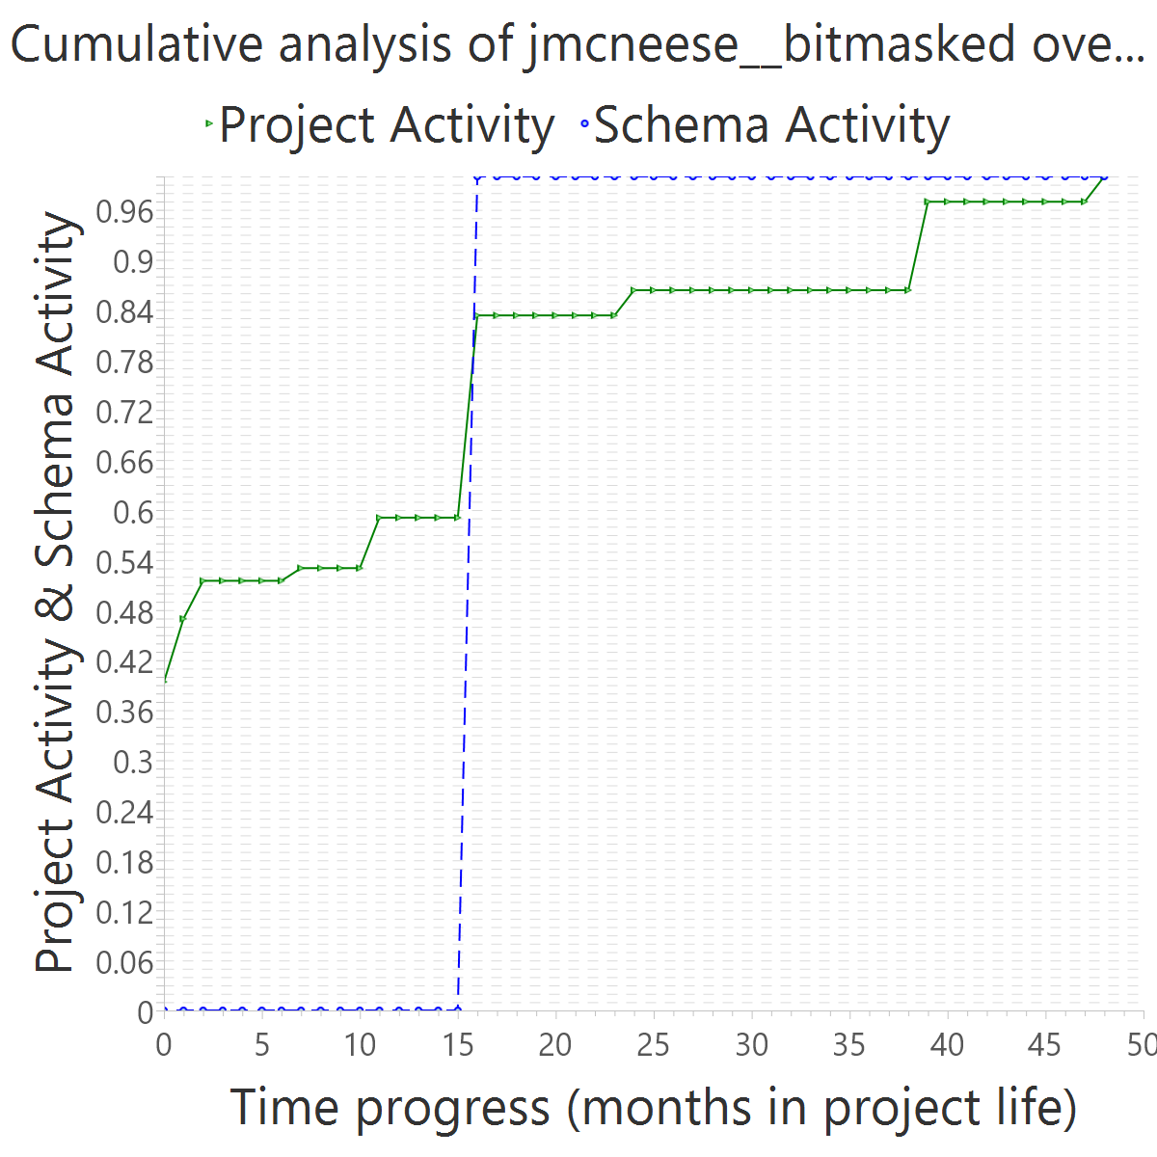
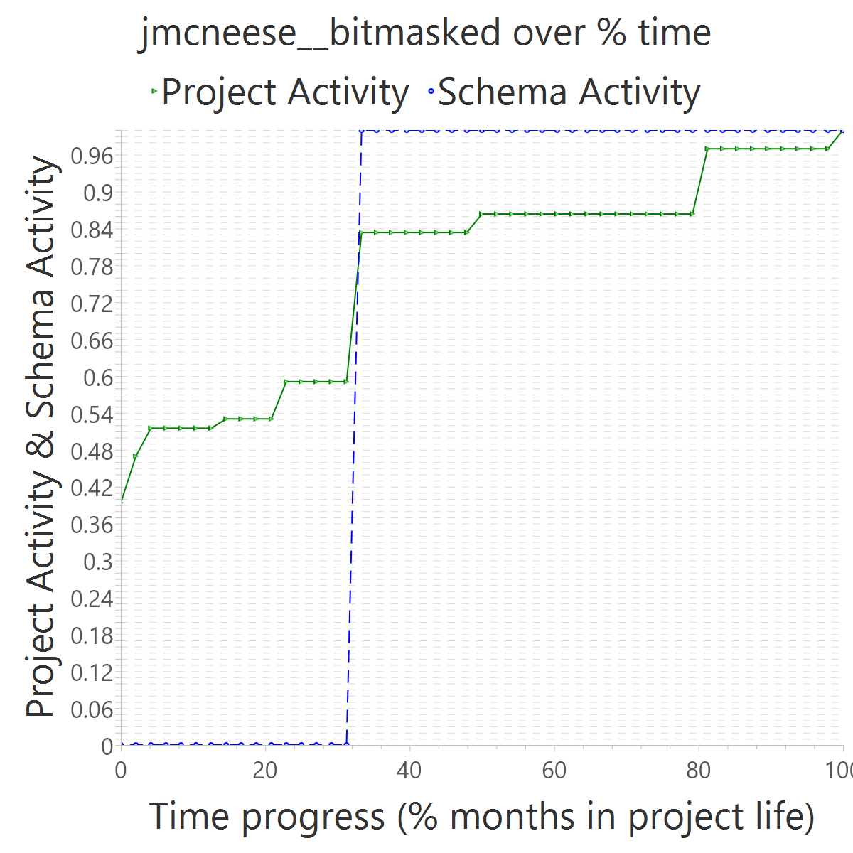
Project OVERALL CLASS #ActiveCommits #AreedspostV0 Activity Class SUP(Months) #Commits TotalActivity Project #Commits Project FileUpds Project Start Date UTC Project End Date UTC PUP+V0(Months) 10%-sync (%) 50%-attain.(%) 75%-attain.(%) 80%-attain.(%) 100%-attain.(%) AvgTimeLag AvgSrcLag TimeLagsSchemaAlways? SrcLagsSchemaAlways?
jmcneese__bitmasked 0_FROZEN 0 0 0_NONE 1 2 0 23 70 2011-04-04 21:33:25 +0000 2015-04-23 21:15:13 +0000 49 0.20 0.33 0.33 0.33 0.33 0.18 -0.10 FALSE FALSE

Slide 23
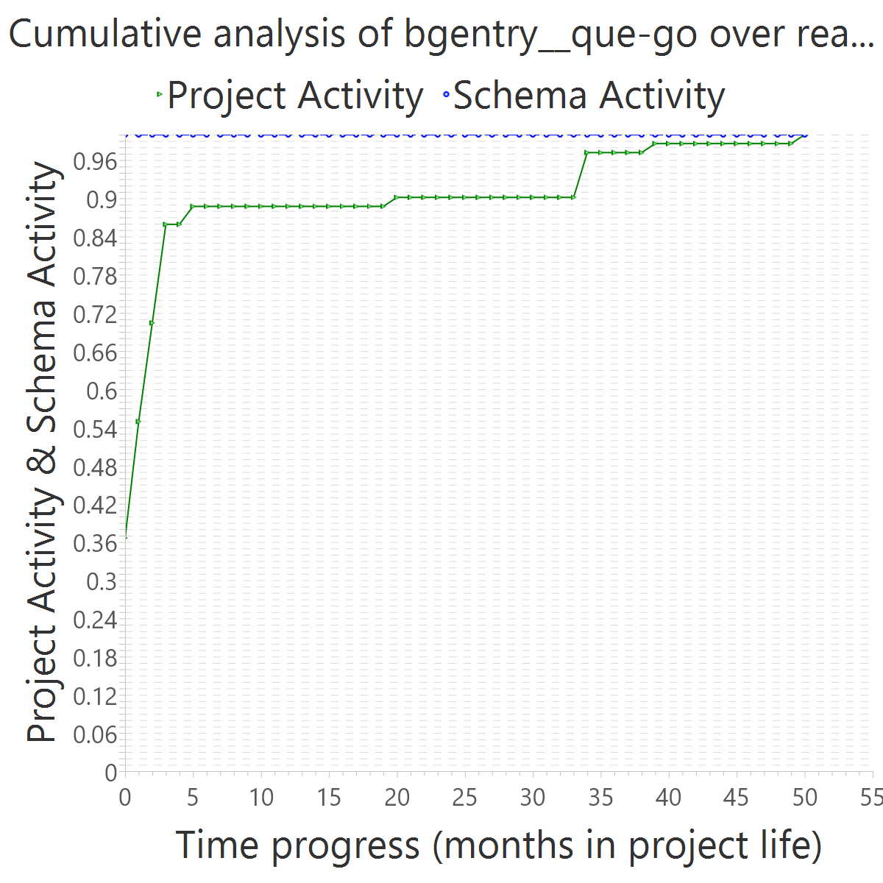
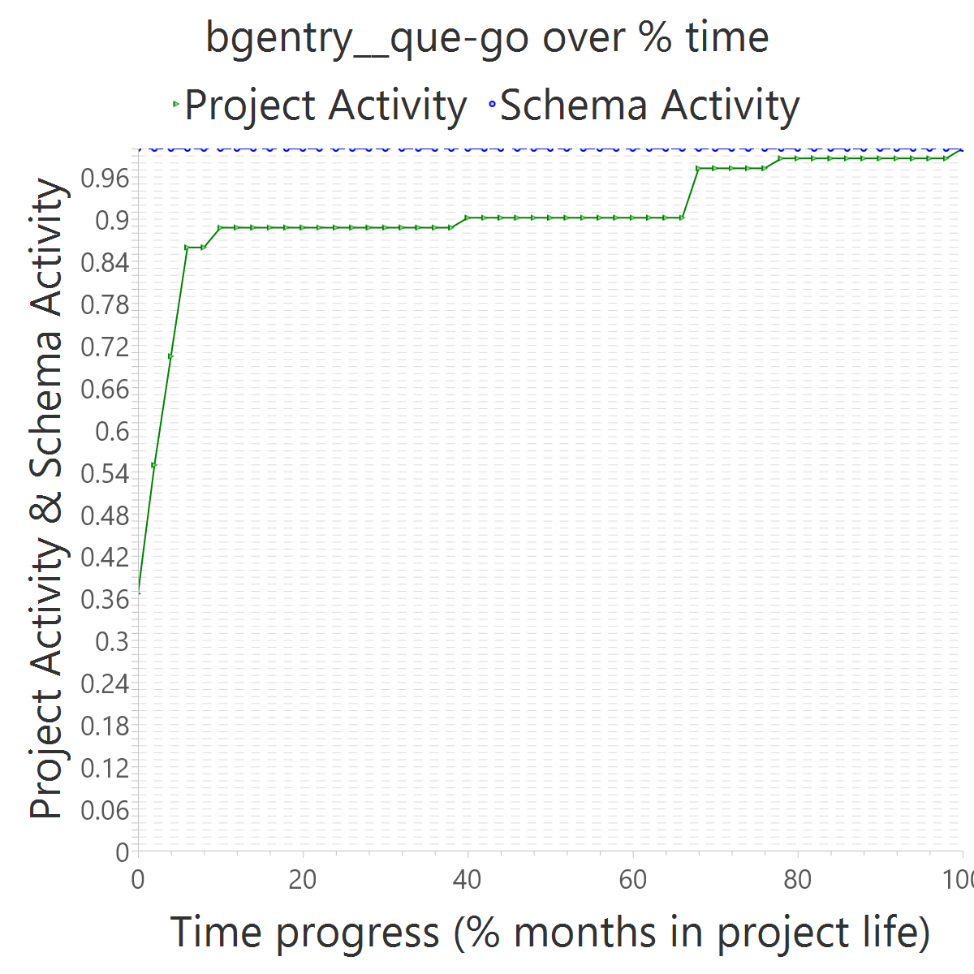
Project OVERALL CLASS #ActiveCommits #AreedspostV0 Activity Class SUP(Months) #Commits TotalActivity Project #Commits Project FileUpds Project Start Date UTC Project End Date UTC PUP+V0(Months) 10%-sync (%) 50%-attain.(%) 75%-attain.(%) 80%-attain.(%) 100%-attain.(%) AvgTimeLag AvgSrcLag TimeLagsSchemaAlways? SrcLagsSchemaAlways?
bgentry__que-go 0_FROZEN 0 0 0_NONE 22 3 0 43 74 2014-10-25 06:18:15 +0000 2018-12-08 20:21:47 +0000 51 0.61 0.00 0.00 0.00 0.00 0.51 0.10 TRUE TRUE

Slide 24
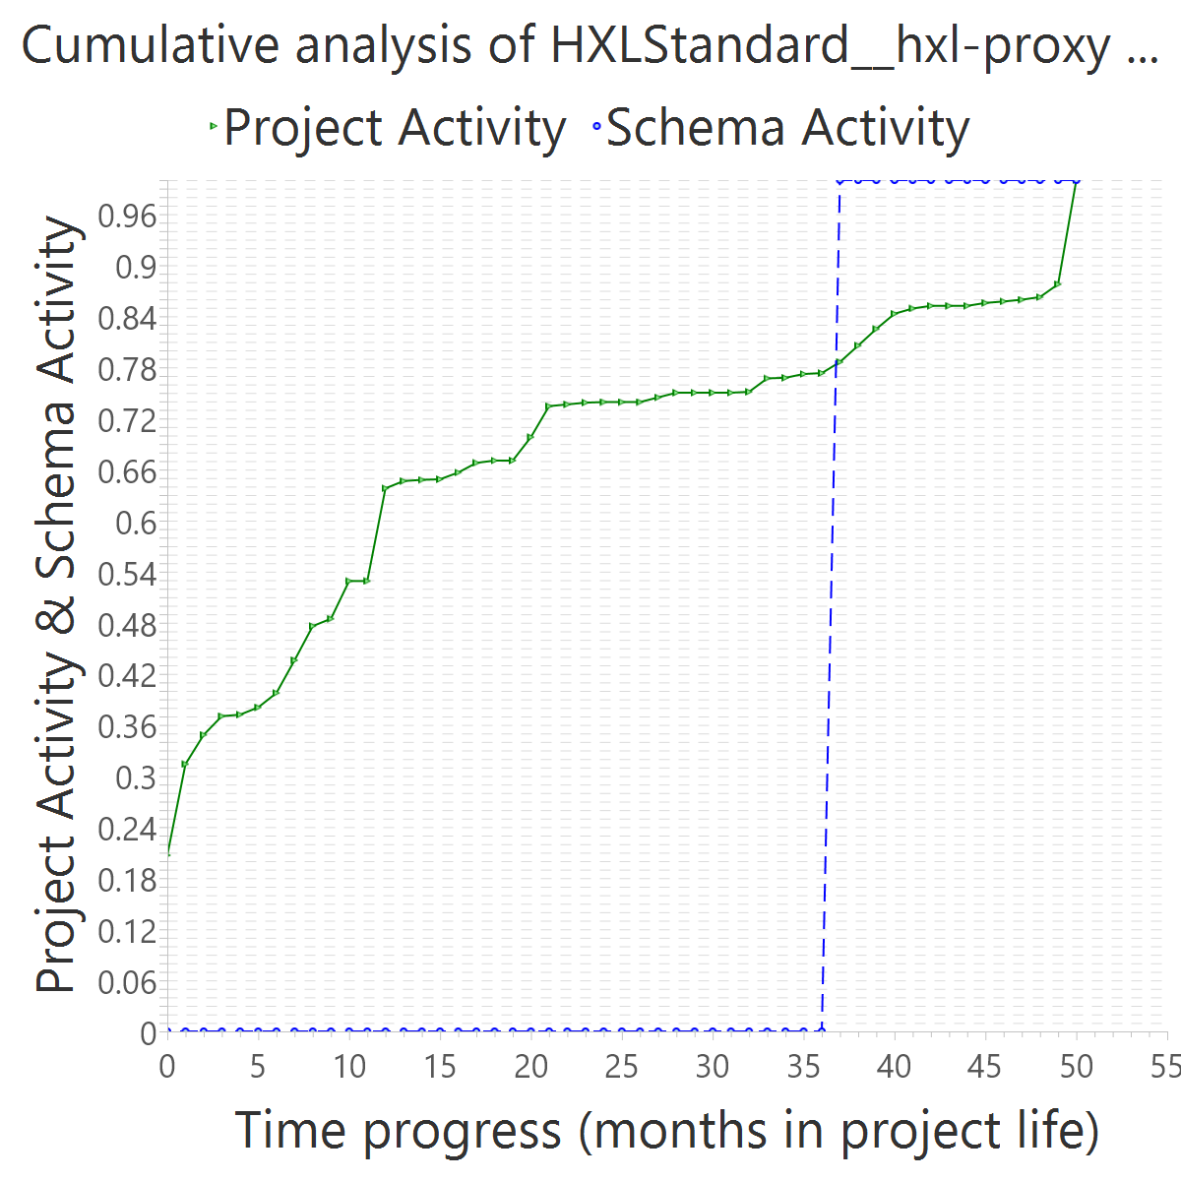
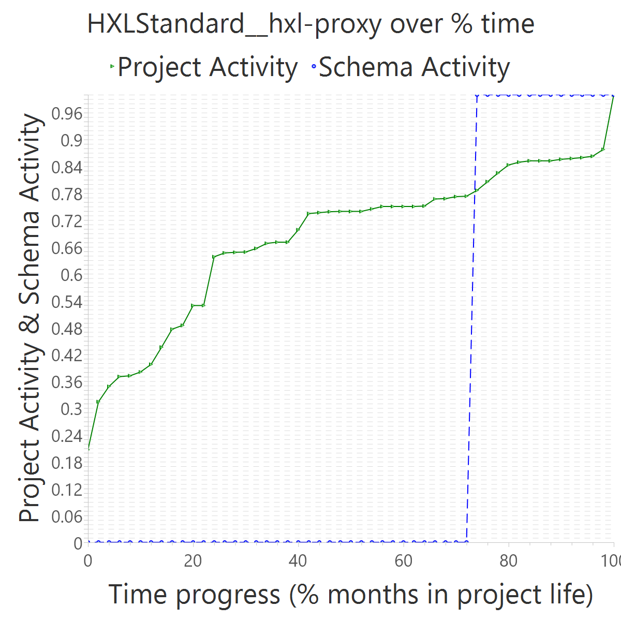
Project OVERALL CLASS #ActiveCommits #AreedspostV0 Activity Class SUP(Months) #Commits TotalActivity Project #Commits Project FileUpds Project Start Date UTC Project End Date UTC PUP+V0(Months) 10%-sync (%) 50%-attain.(%) 75%-attain.(%) 80%-attain.(%) 100%-attain.(%) AvgTimeLag AvgSrcLag TimeLagsSchemaAlways? SrcLagsSchemaAlways?
HXLStandard__hxl-proxy 0_FROZEN 0 0 0_NONE 2 3 0 809 2930 2015-02-07 22:05:19 +0000 2019-04-04 15:58:56 +0000 51 0.02 0.74 0.74 0.74 0.74 -0.23 -0.42 FALSE FALSE

Slide 25
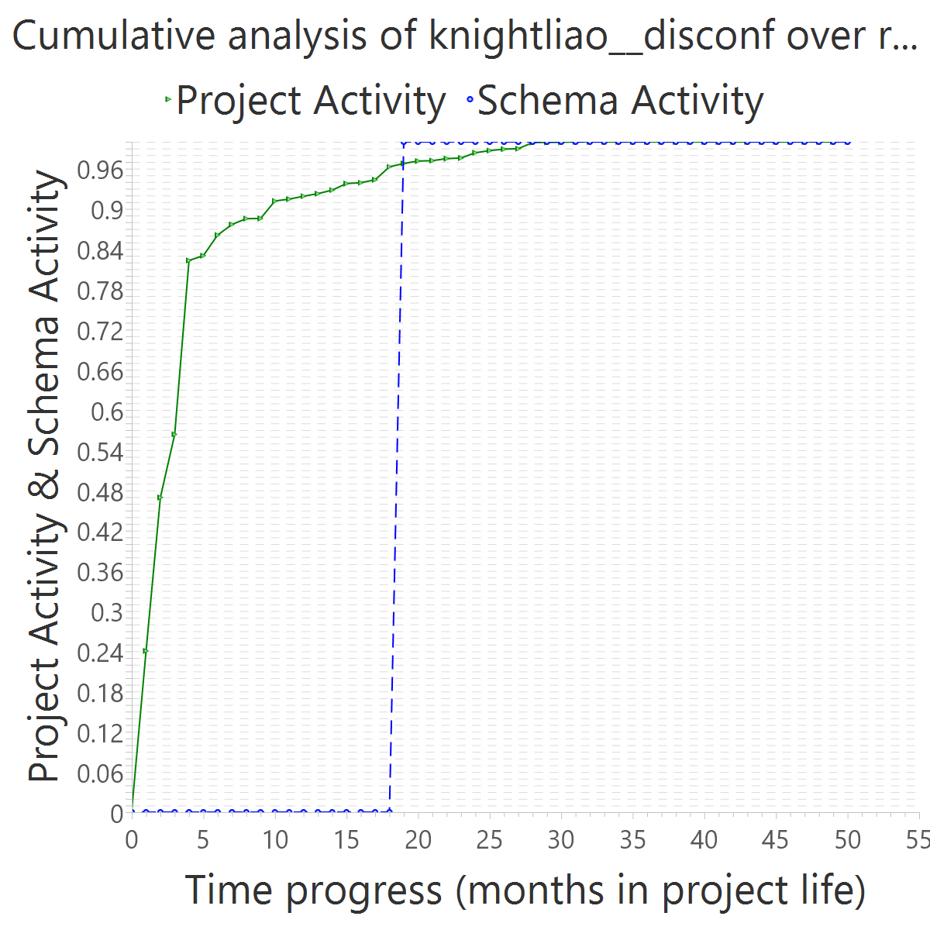
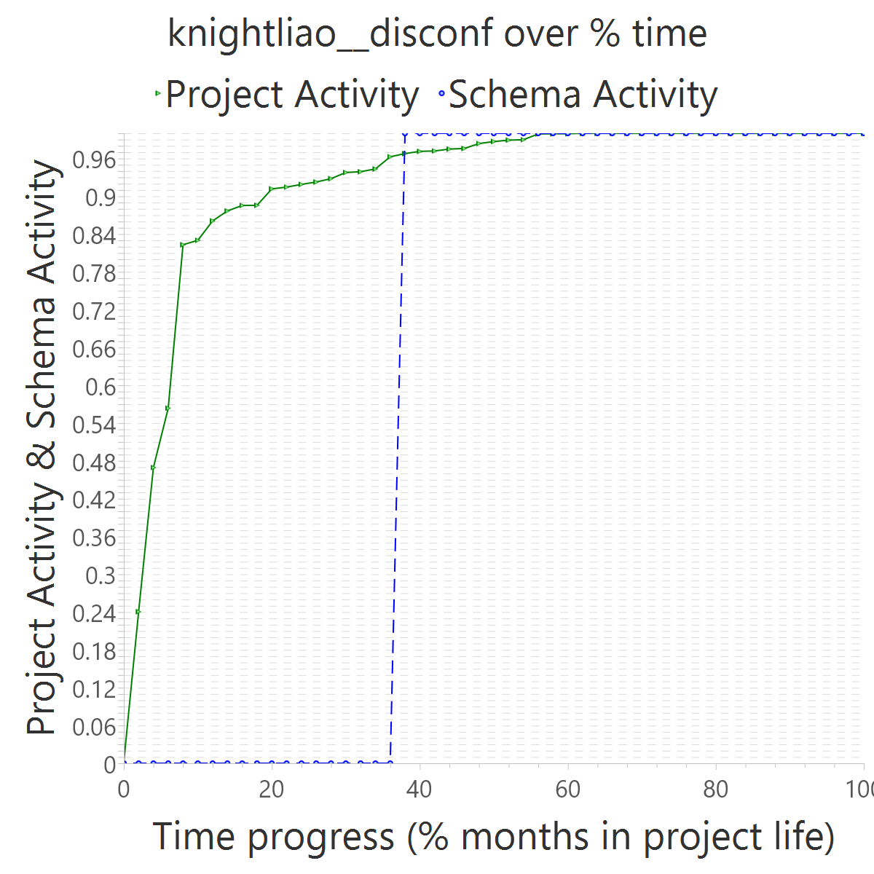
Project OVERALL CLASS #ActiveCommits #AreedspostV0 Activity Class SUP(Months) #Commits TotalActivity Project #Commits Project FileUpds Project Start Date UTC Project End Date UTC PUP+V0(Months) 10%-sync (%) 50%-attain.(%) 75%-attain.(%) 80%-attain.(%) 100%-attain.(%) AvgTimeLag AvgSrcLag TimeLagsSchemaAlways? SrcLagsSchemaAlways?
knightliao__disconf 0_FROZEN 0 0 0_NONE 1 2 0 1099 16556 2014-05-30 09:39:27 +0000 2018-07-26 06:31:05 +0000 51 0.65 0.38 0.38 0.38 0.38 0.13 -0.29 FALSE FALSE

Slide 26


Project OVERALL CLASS #ActiveCommits #AreedspostV0 Activity Class SUP(Months) #Commits TotalActivity Project #Commits Project FileUpds Project Start Date UTC Project End Date UTC PUP+V0(Months) 10%-sync (%) 50%-attain.(%) 75%-attain.(%) 80%-attain.(%) 100%-attain.(%) AvgTimeLag AvgSrcLag TimeLagsSchemaAlways? SrcLagsSchemaAlways?
shouldbee__reserved-usernames 0_FROZEN 0 0 0_NONE 55 10 0 19 64 2014-07-30 08:23:45 +0000 2019-02-17 21:08:23 +0000 56 0.39 0.00 0.00 0.00 0.00 0.51 0.27 TRUE TRUE

Slide 27


Project OVERALL CLASS #ActiveCommits #AreedspostV0 Activity Class SUP(Months) #Commits TotalActivity Project #Commits Project FileUpds Project Start Date UTC Project End Date UTC PUP+V0(Months) 10%-sync (%) 50%-attain.(%) 75%-attain.(%) 80%-attain.(%) 100%-attain.(%) AvgTimeLag AvgSrcLag TimeLagsSchemaAlways? SrcLagsSchemaAlways?
jalkoby__squasher 0_FROZEN 0 0 0_NONE 11 2 0 75 211 2014-01-19 19:09:47 +0000 2019-03-29 14:02:40 +0000 63 0.30 0.71 0.71 0.71 0.71 -0.20 -0.31 FALSE FALSE

Slide 28


Project OVERALL CLASS #ActiveCommits #AreedspostV0 Activity Class SUP(Months) #Commits TotalActivity Project #Commits Project FileUpds Project Start Date UTC Project End Date UTC PUP+V0(Months) 10%-sync (%) 50%-attain.(%) 75%-attain.(%) 80%-attain.(%) 100%-attain.(%) AvgTimeLag AvgSrcLag TimeLagsSchemaAlways? SrcLagsSchemaAlways?
jgauffin__griffin.mvccontrib 0_FROZEN 0 0 0_NONE 1 2 0 72 3276 2011-09-13 07:57:47 +0000 2016-11-03 11:40:21 +0000 63 0.83 0.06 0.06 0.06 0.06 0.44 0.04 FALSE FALSE

Slide 29


Project OVERALL CLASS #ActiveCommits #AreedspostV0 Activity Class SUP(Months) #Commits TotalActivity Project #Commits Project FileUpds Project Start Date UTC Project End Date UTC PUP+V0(Months) 10%-sync (%) 50%-attain.(%) 75%-attain.(%) 80%-attain.(%) 100%-attain.(%) AvgTimeLag AvgSrcLag TimeLagsSchemaAlways? SrcLagsSchemaAlways?
mbilbille__jpnforphp 0_FROZEN 0 0 0_NONE 1 2 0 262 661 2012-05-05 00:33:11 +0000 2017-07-26 14:35:05 +0000 63 0.06 0.63 0.63 0.63 0.63 -0.12 -0.14 FALSE FALSE

Slide 30


Project OVERALL CLASS #ActiveCommits #AreedspostV0 Activity Class SUP(Months) #Commits TotalActivity Project #Commits Project FileUpds Project Start Date UTC Project End Date UTC PUP+V0(Months) 10%-sync (%) 50%-attain.(%) 75%-attain.(%) 80%-attain.(%) 100%-attain.(%) AvgTimeLag AvgSrcLag TimeLagsSchemaAlways? SrcLagsSchemaAlways?
rogeriopvl__nodo 0_FROZEN 0 0 0_NONE 1 3 0 145 583 2012-04-19 09:44:24 +0000 2017-06-12 12:17:27 +0000 63 0.78 0.02 0.02 0.02 0.02 0.49 0.12 TRUE FALSE

Slide 31


Project OVERALL CLASS #ActiveCommits #AreedspostV0 Activity Class SUP(Months) #Commits TotalActivity Project #Commits Project FileUpds Project Start Date UTC Project End Date UTC PUP+V0(Months) 10%-sync (%) 50%-attain.(%) 75%-attain.(%) 80%-attain.(%) 100%-attain.(%) AvgTimeLag AvgSrcLag TimeLagsSchemaAlways? SrcLagsSchemaAlways?
voxpelli__node-connect-pg-simple 0_FROZEN 0 0 0_NONE 1 2 0 136 223 2014-03-05 09:03:09 +0000 2019-04-30 22:26:20 +0000 63 0.14 0.00 0.00 0.00 0.00 0.51 0.51 TRUE TRUE

Slide 32


Project OVERALL CLASS #ActiveCommits #AreedspostV0 Activity Class SUP(Months) #Commits TotalActivity Project #Commits Project FileUpds Project Start Date UTC Project End Date UTC PUP+V0(Months) 10%-sync (%) 50%-attain.(%) 75%-attain.(%) 80%-attain.(%) 100%-attain.(%) AvgTimeLag AvgSrcLag TimeLagsSchemaAlways? SrcLagsSchemaAlways?
mozilla__ichnaea 0_FROZEN 0 0 0_NONE 1 2 0 3099 12472 2013-04-17 13:40:08 +0000 2018-08-30 16:44:25 +0000 65 0.35 0.73 0.73 0.73 0.73 -0.41 -0.40 FALSE FALSE

Slide 33


Project OVERALL CLASS #ActiveCommits #AreedspostV0 Activity Class SUP(Months) #Commits TotalActivity Project #Commits Project FileUpds Project Start Date UTC Project End Date UTC PUP+V0(Months) 10%-sync (%) 50%-attain.(%) 75%-attain.(%) 80%-attain.(%) 100%-attain.(%) AvgTimeLag AvgSrcLag TimeLagsSchemaAlways? SrcLagsSchemaAlways?
symfony__security-acl 0_FROZEN 0 0 0_NONE 16 2 0 89 404 2013-06-18 21:56:09 +0000 2018-12-13 12:37:37 +0000 67 0.67 0.05 0.05 0.05 0.05 0.46 0.11 FALSE FALSE

Slide 34


Project OVERALL CLASS #ActiveCommits #AreedspostV0 Activity Class SUP(Months) #Commits TotalActivity Project #Commits Project FileUpds Project Start Date UTC Project End Date UTC PUP+V0(Months) 10%-sync (%) 50%-attain.(%) 75%-attain.(%) 80%-attain.(%) 100%-attain.(%) AvgTimeLag AvgSrcLag TimeLagsSchemaAlways? SrcLagsSchemaAlways?
shopware__shopware 0_FROZEN 0 0 0_NONE 69 11 0 11399 102329 2012-08-28 09:53:45 +0000 2019-05-22 08:24:53 +0000 82 0.16 0.15 0.15 0.15 0.15 0.36 0.23 FALSE FALSE

Slide 35


Project OVERALL CLASS #ActiveCommits #AreedspostV0 Activity Class SUP(Months) #Commits TotalActivity Project #Commits Project FileUpds Project Start Date UTC Project End Date UTC PUP+V0(Months) 10%-sync (%) 50%-attain.(%) 75%-attain.(%) 80%-attain.(%) 100%-attain.(%) AvgTimeLag AvgSrcLag TimeLagsSchemaAlways? SrcLagsSchemaAlways?
dneustadt__majima 1_ALMOST_FROZEN 1 0 1_ALMOST_FROZEN 1 2 2 20 100 2017-09-02 13:35:57 +0000 2017-09-06 22:13:34 +0000 1 1.00 0.00 0.00 0.00 0.00

Slide 36


Project OVERALL CLASS #ActiveCommits #AreedspostV0 Activity Class SUP(Months) #Commits TotalActivity Project #Commits Project FileUpds Project Start Date UTC Project End Date UTC PUP+V0(Months) 10%-sync (%) 50%-attain.(%) 75%-attain.(%) 80%-attain.(%) 100%-attain.(%) AvgTimeLag AvgSrcLag TimeLagsSchemaAlways? SrcLagsSchemaAlways?
eldersantos__winston-postgre 1_ALMOST_FROZEN 2 0 1_ALMOST_FROZEN 1 4 4 14 35 2014-07-31 23:45:11 +0000 2014-09-21 02:35:28 +0000 2 1.00 0.00 0.00 0.00 0.00 1.00 0.03 TRUE TRUE

Slide 37


Project OVERALL CLASS #ActiveCommits #AreedspostV0 Activity Class SUP(Months) #Commits TotalActivity Project #Commits Project FileUpds Project Start Date UTC Project End Date UTC PUP+V0(Months) 10%-sync (%) 50%-attain.(%) 75%-attain.(%) 80%-attain.(%) 100%-attain.(%) AvgTimeLag AvgSrcLag TimeLagsSchemaAlways? SrcLagsSchemaAlways?
flynn__flynn-subdomainer 1_ALMOST_FROZEN 1 0 1_ALMOST_FROZEN 1 2 1 7 168 2015-05-07 18:22:13 +0000 2015-06-02 22:23:36 +0000 2 1.00 0.00 0.00 0.00 1.00 0.91 -0.07 TRUE FALSE

Slide 38


Project OVERALL CLASS #ActiveCommits #AreedspostV0 Activity Class SUP(Months) #Commits TotalActivity Project #Commits Project FileUpds Project Start Date UTC Project End Date UTC PUP+V0(Months) 10%-sync (%) 50%-attain.(%) 75%-attain.(%) 80%-attain.(%) 100%-attain.(%) AvgTimeLag AvgSrcLag TimeLagsSchemaAlways? SrcLagsSchemaAlways?
colbygk__ARS 1_ALMOST_FROZEN 1 0 1_ALMOST_FROZEN 1 8 1 89 584 2015-02-26 23:33:57 +0000 2015-04-15 22:21:31 +0000 3 0.67 1.00 1.00 1.00 1.00 -0.25 -0.45 FALSE FALSE

Slide 39


Project OVERALL CLASS #ActiveCommits #AreedspostV0 Activity Class SUP(Months) #Commits TotalActivity Project #Commits Project FileUpds Project Start Date UTC Project End Date UTC PUP+V0(Months) 10%-sync (%) 50%-attain.(%) 75%-attain.(%) 80%-attain.(%) 100%-attain.(%) AvgTimeLag AvgSrcLag TimeLagsSchemaAlways? SrcLagsSchemaAlways?
mgilangjanuar__slimedoo 1_ALMOST_FROZEN 1 0 1_ALMOST_FROZEN 1 2 1 46 311 2015-08-14 01:49:42 +0000 2015-11-24 02:15:19 +0000 4 1.00 0.00 0.00 0.00 0.00 0.67 0.01 TRUE TRUE

Slide 40


Project OVERALL CLASS #ActiveCommits #AreedspostV0 Activity Class SUP(Months) #Commits TotalActivity Project #Commits Project FileUpds Project Start Date UTC Project End Date UTC PUP+V0(Months) 10%-sync (%) 50%-attain.(%) 75%-attain.(%) 80%-attain.(%) 100%-attain.(%) AvgTimeLag AvgSrcLag TimeLagsSchemaAlways? SrcLagsSchemaAlways?
tracer__tracer 1_ALMOST_FROZEN 1 0 1_ALMOST_FROZEN 1 6 1 143 258 2016-06-21 13:19:53 +0000 2016-09-17 09:21:07 +0000 4 1.00 0.33 0.33 0.33 0.33 0.33 -0.01 TRUE FALSE

Slide 41


Project OVERALL CLASS #ActiveCommits #AreedspostV0 Activity Class SUP(Months) #Commits TotalActivity Project #Commits Project FileUpds Project Start Date UTC Project End Date UTC PUP+V0(Months) 10%-sync (%) 50%-attain.(%) 75%-attain.(%) 80%-attain.(%) 100%-attain.(%) AvgTimeLag AvgSrcLag TimeLagsSchemaAlways? SrcLagsSchemaAlways?
yiier__forum 1_ALMOST_FROZEN 1 0 1_ALMOST_FROZEN 3 3 7 50 265 2014-02-24 13:24:59 +0000 2014-06-12 09:39:35 +0000 5 0.80 0.25 0.25 0.25 0.75 0.29 -0.16 TRUE FALSE

Slide 42


Project OVERALL CLASS #ActiveCommits #AreedspostV0 Activity Class SUP(Months) #Commits TotalActivity Project #Commits Project FileUpds Project Start Date UTC Project End Date UTC PUP+V0(Months) 10%-sync (%) 50%-attain.(%) 75%-attain.(%) 80%-attain.(%) 100%-attain.(%) AvgTimeLag AvgSrcLag TimeLagsSchemaAlways? SrcLagsSchemaAlways?
schimmy__shorty 1_ALMOST_FROZEN 3 0 1_ALMOST_FROZEN 2 7 10 57 138 2015-07-31 02:42:55 +0000 2015-12-01 18:56:28 +0000 6 0.67 0.20 0.20 0.20 0.20 0.40 0.11 TRUE FALSE

Slide 43


Project OVERALL CLASS #ActiveCommits #AreedspostV0 Activity Class SUP(Months) #Commits TotalActivity Project #Commits Project FileUpds Project Start Date UTC Project End Date UTC PUP+V0(Months) 10%-sync (%) 50%-attain.(%) 75%-attain.(%) 80%-attain.(%) 100%-attain.(%) AvgTimeLag AvgSrcLag TimeLagsSchemaAlways? SrcLagsSchemaAlways?
SalesforceEng__cucumber-metrics 1_ALMOST_FROZEN 2 0 1_ALMOST_FROZEN 5 4 2 29 102 2014-12-30 00:24:59 +0000 2015-06-26 18:48:34 +0000 7 0.14 0.17 0.17 0.17 1.00 0.40 0.34 TRUE FALSE

Slide 44


Project OVERALL CLASS #ActiveCommits #AreedspostV0 Activity Class SUP(Months) #Commits TotalActivity Project #Commits Project FileUpds Project Start Date UTC Project End Date UTC PUP+V0(Months) 10%-sync (%) 50%-attain.(%) 75%-attain.(%) 80%-attain.(%) 100%-attain.(%) AvgTimeLag AvgSrcLag TimeLagsSchemaAlways? SrcLagsSchemaAlways?
DevMine__repotool 1_ALMOST_FROZEN 2 0 1_ALMOST_FROZEN 5 4 8 90 150 2015-01-08 14:34:31 +0000 2015-08-30 07:18:51 +0000 8 0.38 0.00 0.00 0.00 0.71 0.54 0.32 TRUE TRUE

Slide 45


Project OVERALL CLASS #ActiveCommits #AreedspostV0 Activity Class SUP(Months) #Commits TotalActivity Project #Commits Project FileUpds Project Start Date UTC Project End Date UTC PUP+V0(Months) 10%-sync (%) 50%-attain.(%) 75%-attain.(%) 80%-attain.(%) 100%-attain.(%) AvgTimeLag AvgSrcLag TimeLagsSchemaAlways? SrcLagsSchemaAlways?
jessemillar__stalks 1_ALMOST_FROZEN 1 0 1_ALMOST_FROZEN 1 2 5 100 316 2015-11-06 23:49:00 +0000 2016-06-08 22:40:41 +0000 8 0.88 0.00 0.00 0.00 0.00 0.57 0.05 TRUE TRUE

Slide 46


Project OVERALL CLASS #ActiveCommits #AreedspostV0 Activity Class SUP(Months) #Commits TotalActivity Project #Commits Project FileUpds Project Start Date UTC Project End Date UTC PUP+V0(Months) 10%-sync (%) 50%-attain.(%) 75%-attain.(%) 80%-attain.(%) 100%-attain.(%) AvgTimeLag AvgSrcLag TimeLagsSchemaAlways? SrcLagsSchemaAlways?
ankitjain28may__registration-module 1_ALMOST_FROZEN 1 0 1_ALMOST_FROZEN 1 2 1 86 232 2016-04-19 19:19:30 +0000 2017-01-24 20:05:01 +0000 10 0.20 0.89 0.89 0.89 1.00 -0.34 -0.26 FALSE FALSE

Slide 47


Project OVERALL CLASS #ActiveCommits #AreedspostV0 Activity Class SUP(Months) #Commits TotalActivity Project #Commits Project FileUpds Project Start Date UTC Project End Date UTC PUP+V0(Months) 10%-sync (%) 50%-attain.(%) 75%-attain.(%) 80%-attain.(%) 100%-attain.(%) AvgTimeLag AvgSrcLag TimeLagsSchemaAlways? SrcLagsSchemaAlways?
mattinsler__work-it 1_ALMOST_FROZEN 1 0 1_ALMOST_FROZEN 1 4 4 63 316 2015-03-07 21:26:06 +0000 2016-01-15 20:08:05 +0000 11 0.82 0.10 0.10 0.10 0.10 0.45 -0.03 TRUE FALSE

Slide 48


Project OVERALL CLASS #ActiveCommits #AreedspostV0 Activity Class SUP(Months) #Commits TotalActivity Project #Commits Project FileUpds Project Start Date UTC Project End Date UTC PUP+V0(Months) 10%-sync (%) 50%-attain.(%) 75%-attain.(%) 80%-attain.(%) 100%-attain.(%) AvgTimeLag AvgSrcLag TimeLagsSchemaAlways? SrcLagsSchemaAlways?
scherersoftware__cake-wiki 1_ALMOST_FROZEN 1 0 1_ALMOST_FROZEN 4 2 1 30 105 2016-03-02 12:22:06 +0000 2017-01-30 21:16:48 +0000 11 0.09 0.00 0.00 0.00 0.30 0.52 0.30 TRUE TRUE

Slide 49


Project OVERALL CLASS #ActiveCommits #AreedspostV0 Activity Class SUP(Months) #Commits TotalActivity Project #Commits Project FileUpds Project Start Date UTC Project End Date UTC PUP+V0(Months) 10%-sync (%) 50%-attain.(%) 75%-attain.(%) 80%-attain.(%) 100%-attain.(%) AvgTimeLag AvgSrcLag TimeLagsSchemaAlways? SrcLagsSchemaAlways?
shiftcurrency__shift 1_ALMOST_FROZEN 1 0 1_ALMOST_FROZEN 1 2 1 139 6332 2016-03-20 20:31:34 +0000 2017-01-05 22:18:28 +0000 11 0.36 0.70 0.70 0.70 0.70 -0.15 -0.35 FALSE FALSE

Slide 50


Project OVERALL CLASS #ActiveCommits #AreedspostV0 Activity Class SUP(Months) #Commits TotalActivity Project #Commits Project FileUpds Project Start Date UTC Project End Date UTC PUP+V0(Months) 10%-sync (%) 50%-attain.(%) 75%-attain.(%) 80%-attain.(%) 100%-attain.(%) AvgTimeLag AvgSrcLag TimeLagsSchemaAlways? SrcLagsSchemaAlways?
skarllot__netpaper 1_ALMOST_FROZEN 2 0 1_ALMOST_FROZEN 1 3 8 76 578 2014-04-29 20:50:11 +0000 2015-05-09 20:50:06 +0000 14 0.29 0.69 0.69 0.69 0.69 -0.15 -0.28 FALSE FALSE

Slide 51


Project OVERALL CLASS #ActiveCommits #AreedspostV0 Activity Class SUP(Months) #Commits TotalActivity Project #Commits Project FileUpds Project Start Date UTC Project End Date UTC PUP+V0(Months) 10%-sync (%) 50%-attain.(%) 75%-attain.(%) 80%-attain.(%) 100%-attain.(%) AvgTimeLag AvgSrcLag TimeLagsSchemaAlways? SrcLagsSchemaAlways?
purefn__hipbot 1_ALMOST_FROZEN 1 0 1_ALMOST_FROZEN 1 2 1 36 103 2015-04-20 18:10:41 +0000 2016-03-10 09:59:14 +0000 15 0.27 0.00 0.00 0.00 0.00 0.54 0.22 TRUE TRUE

Slide 52


Project OVERALL CLASS #ActiveCommits #AreedspostV0 Activity Class SUP(Months) #Commits TotalActivity Project #Commits Project FileUpds Project Start Date UTC Project End Date UTC PUP+V0(Months) 10%-sync (%) 50%-attain.(%) 75%-attain.(%) 80%-attain.(%) 100%-attain.(%) AvgTimeLag AvgSrcLag TimeLagsSchemaAlways? SrcLagsSchemaAlways?
etsy__mixer 1_ALMOST_FROZEN 1 0 1_ALMOST_FROZEN 16 2 1 9 164 2015-09-16 20:49:56 +0000 2016-12-20 23:11:06 +0000 16 1.00 0.00 0.00 0.00 1.00 0.50 0.04 TRUE TRUE

Slide 53


Project OVERALL CLASS #ActiveCommits #AreedspostV0 Activity Class SUP(Months) #Commits TotalActivity Project #Commits Project FileUpds Project Start Date UTC Project End Date UTC PUP+V0(Months) 10%-sync (%) 50%-attain.(%) 75%-attain.(%) 80%-attain.(%) 100%-attain.(%) AvgTimeLag AvgSrcLag TimeLagsSchemaAlways? SrcLagsSchemaAlways?
hugodias__cakegallery 1_ALMOST_FROZEN 1 0 1_ALMOST_FROZEN 13 2 1 138 452 2014-04-11 16:01:02 +0000 2015-07-03 22:42:36 +0000 16 0.44 0.07 0.07 0.07 0.93 0.43 0.12 TRUE FALSE

Slide 54


Project OVERALL CLASS #ActiveCommits #AreedspostV0 Activity Class SUP(Months) #Commits TotalActivity Project #Commits Project FileUpds Project Start Date UTC Project End Date UTC PUP+V0(Months) 10%-sync (%) 50%-attain.(%) 75%-attain.(%) 80%-attain.(%) 100%-attain.(%) AvgTimeLag AvgSrcLag TimeLagsSchemaAlways? SrcLagsSchemaAlways?
rvadym__languages 1_ALMOST_FROZEN 1 0 1_ALMOST_FROZEN 1 2 1 65 162 2013-01-11 13:15:04 +0000 2014-07-18 08:53:55 +0000 19 0.32 1.00 1.00 1.00 1.00 -0.47 -0.43 FALSE FALSE

Slide 55


Project OVERALL CLASS #ActiveCommits #AreedspostV0 Activity Class SUP(Months) #Commits TotalActivity Project #Commits Project FileUpds Project Start Date UTC Project End Date UTC PUP+V0(Months) 10%-sync (%) 50%-attain.(%) 75%-attain.(%) 80%-attain.(%) 100%-attain.(%) AvgTimeLag AvgSrcLag TimeLagsSchemaAlways? SrcLagsSchemaAlways?
conceptsandtraining__libtree 1_ALMOST_FROZEN 1 0 1_ALMOST_FROZEN 11 3 4 301 851 2015-07-21 09:56:30 +0000 2017-03-07 10:11:53 +0000 21 0.38 0.05 0.55 0.55 0.55 0.27 -0.05 TRUE FALSE

Slide 56


Project OVERALL CLASS #ActiveCommits #AreedspostV0 Activity Class SUP(Months) #Commits TotalActivity Project #Commits Project FileUpds Project Start Date UTC Project End Date UTC PUP+V0(Months) 10%-sync (%) 50%-attain.(%) 75%-attain.(%) 80%-attain.(%) 100%-attain.(%) AvgTimeLag AvgSrcLag TimeLagsSchemaAlways? SrcLagsSchemaAlways?
teresko__palladium 1_ALMOST_FROZEN 2 0 1_ALMOST_FROZEN 1 4 10 261 816 2017-04-03 12:53:07 +0000 2019-01-16 23:26:55 +0000 22 0.55 0.00 0.05 0.05 0.05 0.51 0.09 TRUE TRUE

Slide 57


Project OVERALL CLASS #ActiveCommits #AreedspostV0 Activity Class SUP(Months) #Commits TotalActivity Project #Commits Project FileUpds Project Start Date UTC Project End Date UTC PUP+V0(Months) 10%-sync (%) 50%-attain.(%) 75%-attain.(%) 80%-attain.(%) 100%-attain.(%) AvgTimeLag AvgSrcLag TimeLagsSchemaAlways? SrcLagsSchemaAlways?
webinverters__win-with-logs 1_ALMOST_FROZEN 1 0 1_ALMOST_FROZEN 1 2 1 351 682 2015-03-16 02:54:42 +0000 2016-12-12 04:21:30 +0000 22 0.32 0.14 0.14 0.14 0.14 0.38 0.31 FALSE FALSE

Slide 58


Project OVERALL CLASS #ActiveCommits #AreedspostV0 Activity Class SUP(Months) #Commits TotalActivity Project #Commits Project FileUpds Project Start Date UTC Project End Date UTC PUP+V0(Months) 10%-sync (%) 50%-attain.(%) 75%-attain.(%) 80%-attain.(%) 100%-attain.(%) AvgTimeLag AvgSrcLag TimeLagsSchemaAlways? SrcLagsSchemaAlways?
josephspurrier__gowebapp 1_ALMOST_FROZEN 1 0 1_ALMOST_FROZEN 22 3 6 66 312 2015-06-28 21:39:48 +0000 2017-05-16 05:21:09 +0000 24 0.79 0.04 0.43 0.43 0.43 0.36 0.04 TRUE FALSE

Slide 59


Project OVERALL CLASS #ActiveCommits #AreedspostV0 Activity Class SUP(Months) #Commits TotalActivity Project #Commits Project FileUpds Project Start Date UTC Project End Date UTC PUP+V0(Months) 10%-sync (%) 50%-attain.(%) 75%-attain.(%) 80%-attain.(%) 100%-attain.(%) AvgTimeLag AvgSrcLag TimeLagsSchemaAlways? SrcLagsSchemaAlways?
wanlitao__HangfireExtension 1_ALMOST_FROZEN 1 0 1_ALMOST_FROZEN 1 2 2 26 143 2015-10-12 12:09:36 +0000 2017-09-12 09:46:31 +0000 24 0.04 0.96 0.96 0.96 0.96 -0.43 -0.45 FALSE FALSE

Slide 60


Project OVERALL CLASS #ActiveCommits #AreedspostV0 Activity Class SUP(Months) #Commits TotalActivity Project #Commits Project FileUpds Project Start Date UTC Project End Date UTC PUP+V0(Months) 10%-sync (%) 50%-attain.(%) 75%-attain.(%) 80%-attain.(%) 100%-attain.(%) AvgTimeLag AvgSrcLag TimeLagsSchemaAlways? SrcLagsSchemaAlways?
dotkernel__frontend 1_ALMOST_FROZEN 1 0 1_ALMOST_FROZEN 6 4 6 100 762 2016-10-12 16:18:26 +0000 2018-11-20 13:56:34 +0000 26 0.73 0.24 0.24 0.28 0.28 0.27 -0.10 FALSE FALSE

Slide 61


Project OVERALL CLASS #ActiveCommits #AreedspostV0 Activity Class SUP(Months) #Commits TotalActivity Project #Commits Project FileUpds Project Start Date UTC Project End Date UTC PUP+V0(Months) 10%-sync (%) 50%-attain.(%) 75%-attain.(%) 80%-attain.(%) 100%-attain.(%) AvgTimeLag AvgSrcLag TimeLagsSchemaAlways? SrcLagsSchemaAlways?
mem__padron 1_ALMOST_FROZEN 1 0 1_ALMOST_FROZEN 25 2 6 17 43 2014-01-26 21:37:20 +0000 2016-02-07 04:13:13 +0000 26 0.96 0.00 0.00 0.00 1.00 0.33 0.10 FALSE TRUE

Slide 62


Project OVERALL CLASS #ActiveCommits #AreedspostV0 Activity Class SUP(Months) #Commits TotalActivity Project #Commits Project FileUpds Project Start Date UTC Project End Date UTC PUP+V0(Months) 10%-sync (%) 50%-attain.(%) 75%-attain.(%) 80%-attain.(%) 100%-attain.(%) AvgTimeLag AvgSrcLag TimeLagsSchemaAlways? SrcLagsSchemaAlways?
leapp-to__prototype 1_ALMOST_FROZEN 1 0 1_ALMOST_FROZEN 1 4 1 1047 2598 2017-03-05 22:57:31 +0000 2019-05-22 16:22:10 +0000 27 0.37 0.50 0.50 0.50 0.50 0.02 -0.20 FALSE FALSE

Slide 63


Project OVERALL CLASS #ActiveCommits #AreedspostV0 Activity Class SUP(Months) #Commits TotalActivity Project #Commits Project FileUpds Project Start Date UTC Project End Date UTC PUP+V0(Months) 10%-sync (%) 50%-attain.(%) 75%-attain.(%) 80%-attain.(%) 100%-attain.(%) AvgTimeLag AvgSrcLag TimeLagsSchemaAlways? SrcLagsSchemaAlways?
jaredbeck__paper_trail-sinatra 1_ALMOST_FROZEN 1 0 1_ALMOST_FROZEN 12 3 2 28 101 2017-03-20 04:43:34 +0000 2019-03-18 17:19:19 +0000 28 0.14 0.11 0.11 0.11 0.52 0.34 0.32 FALSE FALSE

Slide 64


Project OVERALL CLASS #ActiveCommits #AreedspostV0 Activity Class SUP(Months) #Commits TotalActivity Project #Commits Project FileUpds Project Start Date UTC Project End Date UTC PUP+V0(Months) 10%-sync (%) 50%-attain.(%) 75%-attain.(%) 80%-attain.(%) 100%-attain.(%) AvgTimeLag AvgSrcLag TimeLagsSchemaAlways? SrcLagsSchemaAlways?
umpirsky__tld-list 1_ALMOST_FROZEN 2 0 1_ALMOST_FROZEN 27 4 2 9 57 2016-01-16 14:05:46 +0000 2018-04-15 15:03:30 +0000 28 0.64 0.00 0.93 1.00 1.00 0.04 0.02 FALSE FALSE

Slide 65


Project OVERALL CLASS #ActiveCommits #AreedspostV0 Activity Class SUP(Months) #Commits TotalActivity Project #Commits Project FileUpds Project Start Date UTC Project End Date UTC PUP+V0(Months) 10%-sync (%) 50%-attain.(%) 75%-attain.(%) 80%-attain.(%) 100%-attain.(%) AvgTimeLag AvgSrcLag TimeLagsSchemaAlways? SrcLagsSchemaAlways?
enova__prodder 1_ALMOST_FROZEN 1 0 1_ALMOST_FROZEN 9 3 4 30 82 2016-02-17 20:15:58 +0000 2018-06-06 23:11:59 +0000 29 0.17 0.00 0.00 0.29 0.29 0.45 0.28 TRUE TRUE

Slide 66


Project OVERALL CLASS #ActiveCommits #AreedspostV0 Activity Class SUP(Months) #Commits TotalActivity Project #Commits Project FileUpds Project Start Date UTC Project End Date UTC PUP+V0(Months) 10%-sync (%) 50%-attain.(%) 75%-attain.(%) 80%-attain.(%) 100%-attain.(%) AvgTimeLag AvgSrcLag TimeLagsSchemaAlways? SrcLagsSchemaAlways?
georgringer__logging 1_ALMOST_FROZEN 2 0 1_ALMOST_FROZEN 2 4 4 66 251 2014-10-31 18:49:21 +0000 2017-05-17 09:57:05 +0000 32 0.03 0.00 0.00 0.00 0.06 0.51 0.24 TRUE TRUE

Slide 67


Project OVERALL CLASS #ActiveCommits #AreedspostV0 Activity Class SUP(Months) #Commits TotalActivity Project #Commits Project FileUpds Project Start Date UTC Project End Date UTC PUP+V0(Months) 10%-sync (%) 50%-attain.(%) 75%-attain.(%) 80%-attain.(%) 100%-attain.(%) AvgTimeLag AvgSrcLag TimeLagsSchemaAlways? SrcLagsSchemaAlways?
n2n__page 1_ALMOST_FROZEN 1 0 1_ALMOST_FROZEN 22 7 5 223 602 2016-08-18 23:56:41 +0000 2019-04-08 07:39:07 +0000 33 0.15 0.00 0.00 0.00 0.19 0.49 0.36 TRUE TRUE

Slide 68


Project OVERALL CLASS #ActiveCommits #AreedspostV0 Activity Class SUP(Months) #Commits TotalActivity Project #Commits Project FileUpds Project Start Date UTC Project End Date UTC PUP+V0(Months) 10%-sync (%) 50%-attain.(%) 75%-attain.(%) 80%-attain.(%) 100%-attain.(%) AvgTimeLag AvgSrcLag TimeLagsSchemaAlways? SrcLagsSchemaAlways?
joomlatools__joomla-platform-content 1_ALMOST_FROZEN 1 0 1_ALMOST_FROZEN 28 9 7 106 813 2015-07-03 17:21:46 +0000 2018-04-03 03:59:20 +0000 34 0.44 0.00 0.00 0.00 0.58 0.48 0.25 TRUE FALSE

Slide 69


Project OVERALL CLASS #ActiveCommits #AreedspostV0 Activity Class SUP(Months) #Commits TotalActivity Project #Commits Project FileUpds Project Start Date UTC Project End Date UTC PUP+V0(Months) 10%-sync (%) 50%-attain.(%) 75%-attain.(%) 80%-attain.(%) 100%-attain.(%) AvgTimeLag AvgSrcLag TimeLagsSchemaAlways? SrcLagsSchemaAlways?
joomlatools__joomla-platform-categories 1_ALMOST_FROZEN 1 0 1_ALMOST_FROZEN 19 2 3 49 184 2015-07-07 19:27:31 +0000 2018-05-08 08:00:39 +0000 35 0.46 0.00 0.00 0.00 0.56 0.47 0.21 TRUE TRUE

Slide 70


Project OVERALL CLASS #ActiveCommits #AreedspostV0 Activity Class SUP(Months) #Commits TotalActivity Project #Commits Project FileUpds Project Start Date UTC Project End Date UTC PUP+V0(Months) 10%-sync (%) 50%-attain.(%) 75%-attain.(%) 80%-attain.(%) 100%-attain.(%) AvgTimeLag AvgSrcLag TimeLagsSchemaAlways? SrcLagsSchemaAlways?
joomlatools__joomla-platform-finder 1_ALMOST_FROZEN 2 0 1_ALMOST_FROZEN 20 3 5 40 263 2015-06-29 23:42:04 +0000 2018-04-03 06:04:01 +0000 35 0.43 0.03 0.03 0.03 0.62 0.45 0.07 FALSE FALSE

Slide 71


Project OVERALL CLASS #ActiveCommits #AreedspostV0 Activity Class SUP(Months) #Commits TotalActivity Project #Commits Project FileUpds Project Start Date UTC Project End Date UTC PUP+V0(Months) 10%-sync (%) 50%-attain.(%) 75%-attain.(%) 80%-attain.(%) 100%-attain.(%) AvgTimeLag AvgSrcLag TimeLagsSchemaAlways? SrcLagsSchemaAlways?
rolfvreijdenberger__izzum-statemachine 1_ALMOST_FROZEN 2 0 1_ALMOST_FROZEN 20 6 2 205 948 2014-09-19 14:25:55 +0000 2017-08-22 19:14:55 +0000 36 0.78 0.03 0.03 0.03 0.23 0.47 0.14 TRUE FALSE

Slide 72


Project OVERALL CLASS #ActiveCommits #AreedspostV0 Activity Class SUP(Months) #Commits TotalActivity Project #Commits Project FileUpds Project Start Date UTC Project End Date UTC PUP+V0(Months) 10%-sync (%) 50%-attain.(%) 75%-attain.(%) 80%-attain.(%) 100%-attain.(%) AvgTimeLag AvgSrcLag TimeLagsSchemaAlways? SrcLagsSchemaAlways?
atomjump__loop-server 1_ALMOST_FROZEN 1 0 1_ALMOST_FROZEN 10 8 1 1004 1785 2016-04-14 21:44:10 +0000 2019-04-30 00:20:45 +0000 37 0.05 0.00 0.00 0.00 0.28 0.51 0.21 TRUE TRUE

Slide 73


Project OVERALL CLASS #ActiveCommits #AreedspostV0 Activity Class SUP(Months) #Commits TotalActivity Project #Commits Project FileUpds Project Start Date UTC Project End Date UTC PUP+V0(Months) 10%-sync (%) 50%-attain.(%) 75%-attain.(%) 80%-attain.(%) 100%-attain.(%) AvgTimeLag AvgSrcLag TimeLagsSchemaAlways? SrcLagsSchemaAlways?
mozilla-services__autograph 1_ALMOST_FROZEN 2 0 1_ALMOST_FROZEN 1 4 5 691 89354 2016-01-05 17:55:26 +0000 2019-05-21 14:19:51 +0000 41 0.34 0.93 0.93 0.93 0.93 0.10 0.08 FALSE FALSE

Slide 74


Project OVERALL CLASS #ActiveCommits #AreedspostV0 Activity Class SUP(Months) #Commits TotalActivity Project #Commits Project FileUpds Project Start Date UTC Project End Date UTC PUP+V0(Months) 10%-sync (%) 50%-attain.(%) 75%-attain.(%) 80%-attain.(%) 100%-attain.(%) AvgTimeLag AvgSrcLag TimeLagsSchemaAlways? SrcLagsSchemaAlways?
SeldonIO__seldon-server 1_ALMOST_FROZEN 1 0 1_ALMOST_FROZEN 11 2 9 1273 6208 2015-02-11 13:49:35 +0000 2018-07-28 07:43:49 +0000 42 0.52 0.05 0.05 0.05 0.29 0.45 0.14 FALSE FALSE

Slide 75


Project OVERALL CLASS #ActiveCommits #AreedspostV0 Activity Class SUP(Months) #Commits TotalActivity Project #Commits Project FileUpds Project Start Date UTC Project End Date UTC PUP+V0(Months) 10%-sync (%) 50%-attain.(%) 75%-attain.(%) 80%-attain.(%) 100%-attain.(%) AvgTimeLag AvgSrcLag TimeLagsSchemaAlways? SrcLagsSchemaAlways?
sqlectron__sqlectron-core 1_ALMOST_FROZEN 2 0 1_ALMOST_FROZEN 7 5 2 252 583 2015-10-26 21:15:35 +0000 2019-04-25 22:36:04 +0000 43 0.65 0.02 0.02 0.17 0.19 0.45 0.15 TRUE FALSE

Slide 76


Project OVERALL CLASS #ActiveCommits #AreedspostV0 Activity Class SUP(Months) #Commits TotalActivity Project #Commits Project FileUpds Project Start Date UTC Project End Date UTC PUP+V0(Months) 10%-sync (%) 50%-attain.(%) 75%-attain.(%) 80%-attain.(%) 100%-attain.(%) AvgTimeLag AvgSrcLag TimeLagsSchemaAlways? SrcLagsSchemaAlways?
thesues__catkeeper 1_ALMOST_FROZEN 2 0 1_ALMOST_FROZEN 1 3 5 103 291 2014-06-09 09:46:31 +0000 2017-12-15 08:04:36 +0000 43 0.95 0.00 0.02 0.02 0.02 0.50 0.04 TRUE TRUE

Slide 77


Project OVERALL CLASS #ActiveCommits #AreedspostV0 Activity Class SUP(Months) #Commits TotalActivity Project #Commits Project FileUpds Project Start Date UTC Project End Date UTC PUP+V0(Months) 10%-sync (%) 50%-attain.(%) 75%-attain.(%) 80%-attain.(%) 100%-attain.(%) AvgTimeLag AvgSrcLag TimeLagsSchemaAlways? SrcLagsSchemaAlways?
APTrust__exchange 1_ALMOST_FROZEN 1 0 1_ALMOST_FROZEN 1 2 9 1664 16720 2015-08-25 18:12:52 +0000 2019-05-22 13:28:44 +0000 46 0.33 0.44 0.44 0.44 0.44 0.07 0.24 FALSE FALSE

Slide 78


Project OVERALL CLASS #ActiveCommits #AreedspostV0 Activity Class SUP(Months) #Commits TotalActivity Project #Commits Project FileUpds Project Start Date UTC Project End Date UTC PUP+V0(Months) 10%-sync (%) 50%-attain.(%) 75%-attain.(%) 80%-attain.(%) 100%-attain.(%) AvgTimeLag AvgSrcLag TimeLagsSchemaAlways? SrcLagsSchemaAlways?
mozilla-services__go-bouncer 1_ALMOST_FROZEN 1 0 1_ALMOST_FROZEN 28 4 2 301 722 2015-07-21 19:33:27 +0000 2019-04-10 16:06:55 +0000 46 0.33 0.00 0.00 0.00 0.29 0.17 0.34 FALSE FALSE

Slide 79


Project OVERALL CLASS #ActiveCommits #AreedspostV0 Activity Class SUP(Months) #Commits TotalActivity Project #Commits Project FileUpds Project Start Date UTC Project End Date UTC PUP+V0(Months) 10%-sync (%) 50%-attain.(%) 75%-attain.(%) 80%-attain.(%) 100%-attain.(%) AvgTimeLag AvgSrcLag TimeLagsSchemaAlways? SrcLagsSchemaAlways?
senecajs__seneca-postgres-store 1_ALMOST_FROZEN 2 0 1_ALMOST_FROZEN 4 4 5 198 312 2012-11-28 09:01:42 +0000 2016-09-01 09:55:36 +0000 47 0.47 0.80 0.80 0.80 0.89 -0.30 -0.10 FALSE FALSE

Slide 80


Project OVERALL CLASS #ActiveCommits #AreedspostV0 Activity Class SUP(Months) #Commits TotalActivity Project #Commits Project FileUpds Project Start Date UTC Project End Date UTC PUP+V0(Months) 10%-sync (%) 50%-attain.(%) 75%-attain.(%) 80%-attain.(%) 100%-attain.(%) AvgTimeLag AvgSrcLag TimeLagsSchemaAlways? SrcLagsSchemaAlways?
the42__ogdat 1_ALMOST_FROZEN 3 0 1_ALMOST_FROZEN 7 5 4 612 2594 2011-07-25 17:56:05 +0000 2015-07-27 13:37:57 +0000 49 0.39 0.44 0.44 0.44 0.48 0.07 -0.03 FALSE FALSE

Slide 81


Project OVERALL CLASS #ActiveCommits #AreedspostV0 Activity Class SUP(Months) #Commits TotalActivity Project #Commits Project FileUpds Project Start Date UTC Project End Date UTC PUP+V0(Months) 10%-sync (%) 50%-attain.(%) 75%-attain.(%) 80%-attain.(%) 100%-attain.(%) AvgTimeLag AvgSrcLag TimeLagsSchemaAlways? SrcLagsSchemaAlways?
travis-ci__jupiter-brain 1_ALMOST_FROZEN 3 0 1_ALMOST_FROZEN 1 4 9 135 1205 2015-03-21 01:17:13 +0000 2019-03-29 21:03:18 +0000 49 0.73 0.10 0.10 0.10 0.10 0.41 0.08 FALSE FALSE

Slide 82


Project OVERALL CLASS #ActiveCommits #AreedspostV0 Activity Class SUP(Months) #Commits TotalActivity Project #Commits Project FileUpds Project Start Date UTC Project End Date UTC PUP+V0(Months) 10%-sync (%) 50%-attain.(%) 75%-attain.(%) 80%-attain.(%) 100%-attain.(%) AvgTimeLag AvgSrcLag TimeLagsSchemaAlways? SrcLagsSchemaAlways?
remind101__empire 1_ALMOST_FROZEN 1 0 1_ALMOST_FROZEN 1 2 1 1699 14679 2015-01-30 03:54:35 +0000 2019-03-30 02:16:23 +0000 51 0.18 0.86 0.86 0.86 0.86 -0.35 -0.68 FALSE FALSE

Slide 83


Project OVERALL CLASS #ActiveCommits #AreedspostV0 Activity Class SUP(Months) #Commits TotalActivity Project #Commits Project FileUpds Project Start Date UTC Project End Date UTC PUP+V0(Months) 10%-sync (%) 50%-attain.(%) 75%-attain.(%) 80%-attain.(%) 100%-attain.(%) AvgTimeLag AvgSrcLag TimeLagsSchemaAlways? SrcLagsSchemaAlways?
vzex__dog-tunnel 1_ALMOST_FROZEN 1 0 1_ALMOST_FROZEN 16 3 1 131 269 2014-02-01 02:13:52 +0000 2018-04-11 23:12:03 +0000 51 0.41 0.06 0.06 0.06 0.36 0.43 0.23 FALSE FALSE

Slide 84


Project OVERALL CLASS #ActiveCommits #AreedspostV0 Activity Class SUP(Months) #Commits TotalActivity Project #Commits Project FileUpds Project Start Date UTC Project End Date UTC PUP+V0(Months) 10%-sync (%) 50%-attain.(%) 75%-attain.(%) 80%-attain.(%) 100%-attain.(%) AvgTimeLag AvgSrcLag TimeLagsSchemaAlways? SrcLagsSchemaAlways?
jingweno__jqplay 1_ALMOST_FROZEN 1 0 1_ALMOST_FROZEN 1 2 2 306 2854 2014-03-20 19:21:45 +0000 2018-11-25 04:31:58 +0000 57 0.30 0.61 0.61 0.61 0.61 -0.10 -0.08 FALSE FALSE

Slide 85


Project OVERALL CLASS #ActiveCommits #AreedspostV0 Activity Class SUP(Months) #Commits TotalActivity Project #Commits Project FileUpds Project Start Date UTC Project End Date UTC PUP+V0(Months) 10%-sync (%) 50%-attain.(%) 75%-attain.(%) 80%-attain.(%) 100%-attain.(%) AvgTimeLag AvgSrcLag TimeLagsSchemaAlways? SrcLagsSchemaAlways?
jcoppieters__cody 1_ALMOST_FROZEN 2 0 1_ALMOST_FROZEN 21 13 2 267 7486 2013-03-08 15:44:34 +0000 2017-12-01 15:31:28 +0000 58 0.69 0.32 0.32 0.32 0.39 0.19 -0.16 FALSE FALSE

Slide 86


Project OVERALL CLASS #ActiveCommits #AreedspostV0 Activity Class SUP(Months) #Commits TotalActivity Project #Commits Project FileUpds Project Start Date UTC Project End Date UTC PUP+V0(Months) 10%-sync (%) 50%-attain.(%) 75%-attain.(%) 80%-attain.(%) 100%-attain.(%) AvgTimeLag AvgSrcLag TimeLagsSchemaAlways? SrcLagsSchemaAlways?
UlricQin__beego-blog 1_ALMOST_FROZEN 1 0 1_ALMOST_FROZEN 1 2 3 55 407 2014-04-04 03:59:52 +0000 2019-02-10 02:53:35 +0000 59 0.02 0.00 0.00 0.00 0.00 0.51 0.23 TRUE TRUE

Slide 87


Project OVERALL CLASS #ActiveCommits #AreedspostV0 Activity Class SUP(Months) #Commits TotalActivity Project #Commits Project FileUpds Project Start Date UTC Project End Date UTC PUP+V0(Months) 10%-sync (%) 50%-attain.(%) 75%-attain.(%) 80%-attain.(%) 100%-attain.(%) AvgTimeLag AvgSrcLag TimeLagsSchemaAlways? SrcLagsSchemaAlways?
ironsmile__httpms 1_ALMOST_FROZEN 2 0 1_ALMOST_FROZEN 36 4 3 294 951 2014-01-01 12:51:54 +0000 2019-05-19 09:15:28 +0000 65 0.17 0.00 0.00 0.00 0.55 0.42 0.41 TRUE TRUE

Slide 88


Project OVERALL CLASS #ActiveCommits #AreedspostV0 Activity Class SUP(Months) #Commits TotalActivity Project #Commits Project FileUpds Project Start Date UTC Project End Date UTC PUP+V0(Months) 10%-sync (%) 50%-attain.(%) 75%-attain.(%) 80%-attain.(%) 100%-attain.(%) AvgTimeLag AvgSrcLag TimeLagsSchemaAlways? SrcLagsSchemaAlways?
chill117__express-mysql-session 1_ALMOST_FROZEN 1 0 1_ALMOST_FROZEN 31 2 2 214 553 2013-11-17 05:36:45 +0000 2019-05-15 15:09:25 +0000 67 0.28 0.05 0.52 0.52 0.52 0.27 0.17 FALSE FALSE

Slide 89


Project OVERALL CLASS #ActiveCommits #AreedspostV0 Activity Class SUP(Months) #Commits TotalActivity Project #Commits Project FileUpds Project Start Date UTC Project End Date UTC PUP+V0(Months) 10%-sync (%) 50%-attain.(%) 75%-attain.(%) 80%-attain.(%) 100%-attain.(%) AvgTimeLag AvgSrcLag TimeLagsSchemaAlways? SrcLagsSchemaAlways?
tpolecat__doobie 1_ALMOST_FROZEN 1 0 1_ALMOST_FROZEN 62 4 9 1393 6695 2013-11-21 22:30:31 +0000 2019-05-26 05:37:44 +0000 67 0.19 0.00 0.20 0.20 0.20 0.45 0.46 TRUE TRUE

Slide 90


Project OVERALL CLASS #ActiveCommits #AreedspostV0 Activity Class SUP(Months) #Commits TotalActivity Project #Commits Project FileUpds Project Start Date UTC Project End Date UTC PUP+V0(Months) 10%-sync (%) 50%-attain.(%) 75%-attain.(%) 80%-attain.(%) 100%-attain.(%) AvgTimeLag AvgSrcLag TimeLagsSchemaAlways? SrcLagsSchemaAlways?
openzipkin__zipkin 1_ALMOST_FROZEN 1 0 1_ALMOST_FROZEN 11 5 1 1791 21674 2012-06-06 18:28:34 +0000 2019-05-22 02:50:30 +0000 84 0.61 0.87 0.87 0.87 0.99 -0.37 -0.12 FALSE FALSE

Slide 91


Project OVERALL CLASS #ActiveCommits #AreedspostV0 Activity Class SUP(Months) #Commits TotalActivity Project #Commits Project FileUpds Project Start Date UTC Project End Date UTC PUP+V0(Months) 10%-sync (%) 50%-attain.(%) 75%-attain.(%) 80%-attain.(%) 100%-attain.(%) AvgTimeLag AvgSrcLag TimeLagsSchemaAlways? SrcLagsSchemaAlways?
seatgeek__djjob 1_ALMOST_FROZEN 1 0 1_ALMOST_FROZEN 3 2 1 70 86 2010-10-20 22:16:18 +0000 2017-09-12 14:40:21 +0000 84 0.44 0.00 0.00 0.00 0.04 0.50 0.23 TRUE TRUE

Slide 92


Project OVERALL CLASS #ActiveCommits #AreedspostV0 Activity Class SUP(Months) #Commits TotalActivity Project #Commits Project FileUpds Project Start Date UTC Project End Date UTC PUP+V0(Months) 10%-sync (%) 50%-attain.(%) 75%-attain.(%) 80%-attain.(%) 100%-attain.(%) AvgTimeLag AvgSrcLag TimeLagsSchemaAlways? SrcLagsSchemaAlways?
twitter__zipkin 1_ALMOST_FROZEN 1 0 1_ALMOST_FROZEN 11 5 1 1791 21674 2012-06-06 18:28:34 +0000 2019-05-22 02:50:30 +0000 84 0.61 0.87 0.87 0.87 0.99 -0.37 -0.12 FALSE FALSE

Slide 93


Project OVERALL CLASS #ActiveCommits #AreedspostV0 Activity Class SUP(Months) #Commits TotalActivity Project #Commits Project FileUpds Project Start Date UTC Project End Date UTC PUP+V0(Months) 10%-sync (%) 50%-attain.(%) 75%-attain.(%) 80%-attain.(%) 100%-attain.(%) AvgTimeLag AvgSrcLag TimeLagsSchemaAlways? SrcLagsSchemaAlways?
guardian__alerta 1_ALMOST_FROZEN 2 0 1_ALMOST_FROZEN 20 13 10 2687 12244 2012-03-27 14:27:40 +0000 2019-05-23 22:01:12 +0000 87 0.37 0.77 0.77 0.77 0.99 -0.28 -0.46 FALSE FALSE

Slide 94


Project OVERALL CLASS #ActiveCommits #AreedspostV0 Activity Class SUP(Months) #Commits TotalActivity Project #Commits Project FileUpds Project Start Date UTC Project End Date UTC PUP+V0(Months) 10%-sync (%) 50%-attain.(%) 75%-attain.(%) 80%-attain.(%) 100%-attain.(%) AvgTimeLag AvgSrcLag TimeLagsSchemaAlways? SrcLagsSchemaAlways?
RubyMoney__money-rails 1_ALMOST_FROZEN 2 0 1_ALMOST_FROZEN 17 3 3 492 1072 2012-03-27 17:24:47 +0000 2019-05-15 07:23:04 +0000 87 0.18 0.03 0.03 0.03 0.22 0.45 0.27 FALSE FALSE

Slide 95


Project OVERALL CLASS #ActiveCommits #AreedspostV0 Activity Class SUP(Months) #Commits TotalActivity Project #Commits Project FileUpds Project Start Date UTC Project End Date UTC PUP+V0(Months) 10%-sync (%) 50%-attain.(%) 75%-attain.(%) 80%-attain.(%) 100%-attain.(%) AvgTimeLag AvgSrcLag TimeLagsSchemaAlways? SrcLagsSchemaAlways?
mapbox__node-mbtiles 1_ALMOST_FROZEN 1 0 1_ALMOST_FROZEN 31 3 3 305 981 2011-05-07 01:11:30 +0000 2019-05-10 02:41:27 +0000 97 0.80 0.00 0.00 0.00 0.32 0.45 0.06 TRUE TRUE

Slide 96


Project OVERALL CLASS #ActiveCommits #AreedspostV0 Activity Class SUP(Months) #Commits TotalActivity Project #Commits Project FileUpds Project Start Date UTC Project End Date UTC PUP+V0(Months) 10%-sync (%) 50%-attain.(%) 75%-attain.(%) 80%-attain.(%) 100%-attain.(%) AvgTimeLag AvgSrcLag TimeLagsSchemaAlways? SrcLagsSchemaAlways?
spring-projects__spring-social 1_ALMOST_FROZEN 1 0 1_ALMOST_FROZEN 37 3 3 1504 10402 2010-08-16 22:04:49 +0000 2019-04-04 19:46:28 +0000 105 0.73 0.19 0.19 0.54 0.54 0.24 -0.11 FALSE FALSE

Slide 97


Project OVERALL CLASS #ActiveCommits #AreedspostV0 Activity Class SUP(Months) #Commits TotalActivity Project #Commits Project FileUpds Project Start Date UTC Project End Date UTC PUP+V0(Months) 10%-sync (%) 50%-attain.(%) 75%-attain.(%) 80%-attain.(%) 100%-attain.(%) AvgTimeLag AvgSrcLag TimeLagsSchemaAlways? SrcLagsSchemaAlways?
blueriver__MuraCMS 1_ALMOST_FROZEN 1 0 1_ALMOST_FROZEN 13 5 3 13797 123980 2009-03-26 04:35:20 +0000 2019-05-24 23:53:46 +0000 123 0.36 0.80 0.80 0.80 0.91 -0.30 -0.29 FALSE FALSE

Slide 98


Project OVERALL CLASS #ActiveCommits #AreedspostV0 Activity Class SUP(Months) #Commits TotalActivity Project #Commits Project FileUpds Project Start Date UTC Project End Date UTC PUP+V0(Months) 10%-sync (%) 50%-attain.(%) 75%-attain.(%) 80%-attain.(%) 100%-attain.(%) AvgTimeLag AvgSrcLag TimeLagsSchemaAlways? SrcLagsSchemaAlways?
neos__flow-development-collection 1_ALMOST_FROZEN 3 0 1_ALMOST_FROZEN 9 4 3 7937 74492 2008-02-07 16:25:25 +0000 2019-05-21 09:37:13 +0000 136 0.34 0.75 0.75 0.81 0.81 -0.26 -0.29 FALSE FALSE

Slide 99


Project OVERALL CLASS #ActiveCommits #AreedspostV0 Activity Class SUP(Months) #Commits TotalActivity Project #Commits Project FileUpds Project Start Date UTC Project End Date UTC PUP+V0(Months) 10%-sync (%) 50%-attain.(%) 75%-attain.(%) 80%-attain.(%) 100%-attain.(%) AvgTimeLag AvgSrcLag TimeLagsSchemaAlways? SrcLagsSchemaAlways?
simplepie__simplepie 1_ALMOST_FROZEN 2 0 1_ALMOST_FROZEN 99 3 2 1362 7545 2006-03-07 05:05:15 +0000 2019-02-19 11:52:57 +0000 156 0.81 0.14 0.14 0.14 0.77 0.26 -0.08 FALSE FALSE

Slide 100


Project OVERALL CLASS #ActiveCommits #AreedspostV0 Activity Class SUP(Months) #Commits TotalActivity Project #Commits Project FileUpds Project Start Date UTC Project End Date UTC PUP+V0(Months) 10%-sync (%) 50%-attain.(%) 75%-attain.(%) 80%-attain.(%) 100%-attain.(%) AvgTimeLag AvgSrcLag TimeLagsSchemaAlways? SrcLagsSchemaAlways?
jadekler__git-go-d3-concertsap 1_FocusedShot_n_FROZEN 2 1 2_SMALL 1 8 19 159 848 2014-03-13 00:07:32 +0000 2014-04-23 23:04:43 +0000 2 0.50 0.00 0.00 0.00 1.00 0.96 0.28 TRUE TRUE

Slide 101


Project OVERALL CLASS #ActiveCommits #AreedspostV0 Activity Class SUP(Months) #Commits TotalActivity Project #Commits Project FileUpds Project Start Date UTC Project End Date UTC PUP+V0(Months) 10%-sync (%) 50%-attain.(%) 75%-attain.(%) 80%-attain.(%) 100%-attain.(%) AvgTimeLag AvgSrcLag TimeLagsSchemaAlways? SrcLagsSchemaAlways?
williamespindola__field 1_FocusedShot_n_FROZEN 3 1 2_SMALL 3 6 28 41 225 2015-07-03 17:24:28 +0000 2015-09-23 21:45:03 +0000 3 1.00 1.00 1.00 1.00 1.00 0.14 -0.06 FALSE FALSE

Slide 102


Project OVERALL CLASS #ActiveCommits #AreedspostV0 Activity Class SUP(Months) #Commits TotalActivity Project #Commits Project FileUpds Project Start Date UTC Project End Date UTC PUP+V0(Months) 10%-sync (%) 50%-attain.(%) 75%-attain.(%) 80%-attain.(%) 100%-attain.(%) AvgTimeLag AvgSrcLag TimeLagsSchemaAlways? SrcLagsSchemaAlways?
NPRA__EmissionCalculatorLib 1_FocusedShot_n_FROZEN 2 1 4_HIGH 1 6 137 160 224 2017-08-09 10:27:13 +0000 2017-12-07 13:49:12 +0000 5 0.40 0.75 0.75 0.75 0.75 -0.13 -0.31 FALSE FALSE

Slide 103


Project OVERALL CLASS #ActiveCommits #AreedspostV0 Activity Class SUP(Months) #Commits TotalActivity Project #Commits Project FileUpds Project Start Date UTC Project End Date UTC PUP+V0(Months) 10%-sync (%) 50%-attain.(%) 75%-attain.(%) 80%-attain.(%) 100%-attain.(%) AvgTimeLag AvgSrcLag TimeLagsSchemaAlways? SrcLagsSchemaAlways?
royzhao__prot-coderun 1_FocusedShot_n_FROZEN 1 1 2_SMALL 1 2 17 146 1217 2015-02-02 00:47:44 +0000 2015-07-25 05:50:53 +0000 6 0.67 0.20 0.20 0.20 0.20 0.40 0.24 TRUE FALSE

Slide 104


Project OVERALL CLASS #ActiveCommits #AreedspostV0 Activity Class SUP(Months) #Commits TotalActivity Project #Commits Project FileUpds Project Start Date UTC Project End Date UTC PUP+V0(Months) 10%-sync (%) 50%-attain.(%) 75%-attain.(%) 80%-attain.(%) 100%-attain.(%) AvgTimeLag AvgSrcLag TimeLagsSchemaAlways? SrcLagsSchemaAlways?
liujianping__scaffold 1_FocusedShot_n_FROZEN 1 1 3_MODERATE 2 3 39 54 2054 2016-01-06 12:26:58 +0000 2016-08-16 05:02:12 +0000 8 0.25 0.86 0.86 0.86 0.86 -0.22 -0.44 FALSE FALSE

Slide 105


Project OVERALL CLASS #ActiveCommits #AreedspostV0 Activity Class SUP(Months) #Commits TotalActivity Project #Commits Project FileUpds Project Start Date UTC Project End Date UTC PUP+V0(Months) 10%-sync (%) 50%-attain.(%) 75%-attain.(%) 80%-attain.(%) 100%-attain.(%) AvgTimeLag AvgSrcLag TimeLagsSchemaAlways? SrcLagsSchemaAlways?
snakerflow__snakerflow 1_FocusedShot_n_FROZEN 3 1 3_MODERATE 6 4 32 119 802 2014-06-02 08:51:22 +0000 2015-03-05 14:46:26 +0000 10 0.40 0.11 0.67 0.67 0.67 0.29 0.03 TRUE FALSE

Slide 106


Project OVERALL CLASS #ActiveCommits #AreedspostV0 Activity Class SUP(Months) #Commits TotalActivity Project #Commits Project FileUpds Project Start Date UTC Project End Date UTC PUP+V0(Months) 10%-sync (%) 50%-attain.(%) 75%-attain.(%) 80%-attain.(%) 100%-attain.(%) AvgTimeLag AvgSrcLag TimeLagsSchemaAlways? SrcLagsSchemaAlways?
dburry__indexed_search 1_FocusedShot_n_FROZEN 3 0 2_SMALL 8 4 23 102 344 2012-05-09 16:34:00 +0000 2013-05-09 23:53:19 +0000 13 0.77 0.17 0.17 0.75 0.75 0.25 -0.03 FALSE FALSE

Slide 107


Project OVERALL CLASS #ActiveCommits #AreedspostV0 Activity Class SUP(Months) #Commits TotalActivity Project #Commits Project FileUpds Project Start Date UTC Project End Date UTC PUP+V0(Months) 10%-sync (%) 50%-attain.(%) 75%-attain.(%) 80%-attain.(%) 100%-attain.(%) AvgTimeLag AvgSrcLag TimeLagsSchemaAlways? SrcLagsSchemaAlways?
mukatee__pypro 1_FocusedShot_n_FROZEN 1 0 2_SMALL 2 4 11 67 628 2014-12-19 14:13:54 +0000 2015-12-03 13:01:30 +0000 13 0.54 0.17 0.17 0.17 0.17 0.38 0.26 FALSE FALSE

Slide 108


Project OVERALL CLASS #ActiveCommits #AreedspostV0 Activity Class SUP(Months) #Commits TotalActivity Project #Commits Project FileUpds Project Start Date UTC Project End Date UTC PUP+V0(Months) 10%-sync (%) 50%-attain.(%) 75%-attain.(%) 80%-attain.(%) 100%-attain.(%) AvgTimeLag AvgSrcLag TimeLagsSchemaAlways? SrcLagsSchemaAlways?
webnuts__post_json 1_FocusedShot_n_FROZEN 2 1 2_SMALL 1 3 28 124 304 2013-10-11 05:23:58 +0000 2014-10-25 14:06:07 +0000 13 1.00 0.00 0.00 0.00 0.00 0.54 0.01 TRUE TRUE

Slide 109


Project OVERALL CLASS #ActiveCommits #AreedspostV0 Activity Class SUP(Months) #Commits TotalActivity Project #Commits Project FileUpds Project Start Date UTC Project End Date UTC PUP+V0(Months) 10%-sync (%) 50%-attain.(%) 75%-attain.(%) 80%-attain.(%) 100%-attain.(%) AvgTimeLag AvgSrcLag TimeLagsSchemaAlways? SrcLagsSchemaAlways?
magnus-lycka__gocddash 1_FocusedShot_n_FROZEN 1 1 2_SMALL 2 3 21 569 2060 2015-11-26 12:37:07 +0000 2016-12-16 12:00:11 +0000 14 0.71 0.85 0.92 0.92 0.92 -0.33 -0.18 FALSE FALSE

Slide 110


Project OVERALL CLASS #ActiveCommits #AreedspostV0 Activity Class SUP(Months) #Commits TotalActivity Project #Commits Project FileUpds Project Start Date UTC Project End Date UTC PUP+V0(Months) 10%-sync (%) 50%-attain.(%) 75%-attain.(%) 80%-attain.(%) 100%-attain.(%) AvgTimeLag AvgSrcLag TimeLagsSchemaAlways? SrcLagsSchemaAlways?
JRonak__OnlineJudge 1_FocusedShot_n_FROZEN 2 0 2_SMALL 1 3 11 55 581 2015-07-15 02:42:10 +0000 2016-09-14 15:52:50 +0000 15 0.93 0.00 0.00 0.07 0.07 0.52 0.00 TRUE FALSE

Slide 111


Project OVERALL CLASS #ActiveCommits #AreedspostV0 Activity Class SUP(Months) #Commits TotalActivity Project #Commits Project FileUpds Project Start Date UTC Project End Date UTC PUP+V0(Months) 10%-sync (%) 50%-attain.(%) 75%-attain.(%) 80%-attain.(%) 100%-attain.(%) AvgTimeLag AvgSrcLag TimeLagsSchemaAlways? SrcLagsSchemaAlways?
accgit__acl 1_FocusedShot_n_FROZEN 2 1 3_MODERATE 15 17 31 260 607 2017-05-23 11:08:53 +0000 2019-02-15 07:33:57 +0000 22 0.36 0.10 0.10 0.19 0.19 0.44 0.21 TRUE TRUE

Slide 112


Project OVERALL CLASS #ActiveCommits #AreedspostV0 Activity Class SUP(Months) #Commits TotalActivity Project #Commits Project FileUpds Project Start Date UTC Project End Date UTC PUP+V0(Months) 10%-sync (%) 50%-attain.(%) 75%-attain.(%) 80%-attain.(%) 100%-attain.(%) AvgTimeLag AvgSrcLag TimeLagsSchemaAlways? SrcLagsSchemaAlways?
jasongrimes__silex-simpleuser 1_FocusedShot_n_FROZEN 3 0 2_SMALL 19 6 11 140 266 2013-04-14 14:23:35 +0000 2015-03-11 00:33:42 +0000 24 0.88 0.70 0.78 0.78 0.78 0.07 0.09 FALSE TRUE

Slide 113


Project OVERALL CLASS #ActiveCommits #AreedspostV0 Activity Class SUP(Months) #Commits TotalActivity Project #Commits Project FileUpds Project Start Date UTC Project End Date UTC PUP+V0(Months) 10%-sync (%) 50%-attain.(%) 75%-attain.(%) 80%-attain.(%) 100%-attain.(%) AvgTimeLag AvgSrcLag TimeLagsSchemaAlways? SrcLagsSchemaAlways?
3ev__tev_label 1_FocusedShot_n_FROZEN 2 1 2_SMALL 23 4 20 36 86 2013-09-20 10:08:08 +0000 2015-09-16 13:18:29 +0000 25 0.72 0.96 0.96 0.96 0.96 -0.12 0.01 FALSE FALSE

Slide 114


Project OVERALL CLASS #ActiveCommits #AreedspostV0 Activity Class SUP(Months) #Commits TotalActivity Project #Commits Project FileUpds Project Start Date UTC Project End Date UTC PUP+V0(Months) 10%-sync (%) 50%-attain.(%) 75%-attain.(%) 80%-attain.(%) 100%-attain.(%) AvgTimeLag AvgSrcLag TimeLagsSchemaAlways? SrcLagsSchemaAlways?
archan937__cached_record 1_FocusedShot_n_FROZEN 2 0 2_SMALL 2 5 14 54 203 2013-10-18 20:16:52 +0000 2015-12-17 06:58:48 +0000 27 0.85 0.04 0.04 0.04 0.04 0.50 0.05 TRUE TRUE

Slide 115


Project OVERALL CLASS #ActiveCommits #AreedspostV0 Activity Class SUP(Months) #Commits TotalActivity Project #Commits Project FileUpds Project Start Date UTC Project End Date UTC PUP+V0(Months) 10%-sync (%) 50%-attain.(%) 75%-attain.(%) 80%-attain.(%) 100%-attain.(%) AvgTimeLag AvgSrcLag TimeLagsSchemaAlways? SrcLagsSchemaAlways?
EricDepagne__Astrodb 1_FocusedShot_n_FROZEN 1 1 2_SMALL 1 2 19 74 89 2015-01-06 15:56:09 +0000 2017-05-18 05:44:30 +0000 29 0.83 0.00 0.00 0.00 0.00 0.52 0.10 TRUE TRUE

Slide 116


Project OVERALL CLASS #ActiveCommits #AreedspostV0 Activity Class SUP(Months) #Commits TotalActivity Project #Commits Project FileUpds Project Start Date UTC Project End Date UTC PUP+V0(Months) 10%-sync (%) 50%-attain.(%) 75%-attain.(%) 80%-attain.(%) 100%-attain.(%) AvgTimeLag AvgSrcLag TimeLagsSchemaAlways? SrcLagsSchemaAlways?
fastpress__fastpress 1_FocusedShot_n_FROZEN 1 1 2_SMALL 1 2 24 36 1029 2015-10-09 18:31:55 +0000 2018-06-25 20:37:46 +0000 33 1.00 0.00 0.00 0.00 0.00 0.52 0.00 TRUE TRUE

Slide 117


Project OVERALL CLASS #ActiveCommits #AreedspostV0 Activity Class SUP(Months) #Commits TotalActivity Project #Commits Project FileUpds Project Start Date UTC Project End Date UTC PUP+V0(Months) 10%-sync (%) 50%-attain.(%) 75%-attain.(%) 80%-attain.(%) 100%-attain.(%) AvgTimeLag AvgSrcLag TimeLagsSchemaAlways? SrcLagsSchemaAlways?
webadmin87__rzwebsys7 1_FocusedShot_n_FROZEN 2 2 4_HIGH 10 3 117 429 2948 2014-04-13 18:48:59 +0000 2017-05-12 11:39:55 +0000 38 0.68 0.19 0.35 0.35 0.35 0.28 -0.08 FALSE FALSE

Slide 118


Project OVERALL CLASS #ActiveCommits #AreedspostV0 Activity Class SUP(Months) #Commits TotalActivity Project #Commits Project FileUpds Project Start Date UTC Project End Date UTC PUP+V0(Months) 10%-sync (%) 50%-attain.(%) 75%-attain.(%) 80%-attain.(%) 100%-attain.(%) AvgTimeLag AvgSrcLag TimeLagsSchemaAlways? SrcLagsSchemaAlways?
dlds__yii2-mlm 1_FocusedShot_n_FROZEN 3 3 3_MODERATE 13 4 54 62 374 2015-04-11 21:04:57 +0000 2018-07-04 08:32:01 +0000 40 0.13 0.67 0.67 1.00 1.00 -0.22 -0.20 FALSE FALSE

Slide 119


Project OVERALL CLASS #ActiveCommits #AreedspostV0 Activity Class SUP(Months) #Commits TotalActivity Project #Commits Project FileUpds Project Start Date UTC Project End Date UTC PUP+V0(Months) 10%-sync (%) 50%-attain.(%) 75%-attain.(%) 80%-attain.(%) 100%-attain.(%) AvgTimeLag AvgSrcLag TimeLagsSchemaAlways? SrcLagsSchemaAlways?
Terry-Mao__gopush-cluster 1_FocusedShot_n_FROZEN 2 1 3_MODERATE 1 3 31 485 1561 2013-12-27 08:56:10 +0000 2017-04-10 08:53:51 +0000 41 0.80 0.10 0.13 0.13 0.13 0.40 0.00 FALSE FALSE

Slide 120


Project OVERALL CLASS #ActiveCommits #AreedspostV0 Activity Class SUP(Months) #Commits TotalActivity Project #Commits Project FileUpds Project Start Date UTC Project End Date UTC PUP+V0(Months) 10%-sync (%) 50%-attain.(%) 75%-attain.(%) 80%-attain.(%) 100%-attain.(%) AvgTimeLag AvgSrcLag TimeLagsSchemaAlways? SrcLagsSchemaAlways?
duythien__blog 1_FocusedShot_n_FROZEN 1 1 2_SMALL 10 4 22 87 2878 2013-05-02 16:00:45 +0000 2017-10-11 12:47:16 +0000 54 0.83 0.15 0.15 0.17 0.17 0.35 -0.05 FALSE FALSE

Slide 121


Project OVERALL CLASS #ActiveCommits #AreedspostV0 Activity Class SUP(Months) #Commits TotalActivity Project #Commits Project FileUpds Project Start Date UTC Project End Date UTC PUP+V0(Months) 10%-sync (%) 50%-attain.(%) 75%-attain.(%) 80%-attain.(%) 100%-attain.(%) AvgTimeLag AvgSrcLag TimeLagsSchemaAlways? SrcLagsSchemaAlways?
BotBotMe__botbot-bot 1_FocusedShot_n_FROZEN 1 1 2_SMALL 41 2 24 127 245 2013-08-16 22:38:28 +0000 2018-04-28 04:51:08 +0000 57 0.25 0.80 0.80 0.80 0.80 0.03 -0.29 FALSE FALSE

Slide 122


Project OVERALL CLASS #ActiveCommits #AreedspostV0 Activity Class SUP(Months) #Commits TotalActivity Project #Commits Project FileUpds Project Start Date UTC Project End Date UTC PUP+V0(Months) 10%-sync (%) 50%-attain.(%) 75%-attain.(%) 80%-attain.(%) 100%-attain.(%) AvgTimeLag AvgSrcLag TimeLagsSchemaAlways? SrcLagsSchemaAlways?
devture__silex-user-bundle 1_FocusedShot_n_FROZEN 1 0 2_SMALL 2 2 13 86 264 2012-04-13 19:59:14 +0000 2016-12-14 08:08:45 +0000 57 0.42 0.20 0.20 0.20 0.20 0.32 0.09 FALSE FALSE

Slide 123


Project OVERALL CLASS #ActiveCommits #AreedspostV0 Activity Class SUP(Months) #Commits TotalActivity Project #Commits Project FileUpds Project Start Date UTC Project End Date UTC PUP+V0(Months) 10%-sync (%) 50%-attain.(%) 75%-attain.(%) 80%-attain.(%) 100%-attain.(%) AvgTimeLag AvgSrcLag TimeLagsSchemaAlways? SrcLagsSchemaAlways?
gem__oq-engine 1_FocusedShot_n_FROZEN 1 1 4_HIGH 20 9 383 31566 123703 2010-07-21 21:41:45 +0000 2019-05-25 06:23:19 +0000 107 0.13 0.63 0.63 0.63 0.63 -0.12 -0.12 FALSE FALSE

Slide 124


Project OVERALL CLASS #ActiveCommits #AreedspostV0 Activity Class SUP(Months) #Commits TotalActivity Project #Commits Project FileUpds Project Start Date UTC Project End Date UTC PUP+V0(Months) 10%-sync (%) 50%-attain.(%) 75%-attain.(%) 80%-attain.(%) 100%-attain.(%) AvgTimeLag AvgSrcLag TimeLagsSchemaAlways? SrcLagsSchemaAlways?
tstack__lnav 1_FocusedShot_n_FROZEN 1 0 2_SMALL 46 5 12 1380 7063 2009-09-14 01:07:32 +0000 2019-05-24 04:21:39 +0000 117 0.38 0.78 0.78 0.78 0.78 -0.22 -0.13 FALSE FALSE

Slide 125


Project OVERALL CLASS #ActiveCommits #AreedspostV0 Activity Class SUP(Months) #Commits TotalActivity Project #Commits Project FileUpds Project Start Date UTC Project End Date UTC PUP+V0(Months) 10%-sync (%) 50%-attain.(%) 75%-attain.(%) 80%-attain.(%) 100%-attain.(%) AvgTimeLag AvgSrcLag TimeLagsSchemaAlways? SrcLagsSchemaAlways?
aiyi__go-user 2_MODERATE 7 0 3_MODERATE 1 10 63 109 588 2015-09-02 11:09:17 +0000 2015-10-14 13:00:34 +0000 2 0.50 0.00 0.00 0.00 0.00 1.00 0.44 TRUE TRUE

Slide 126


Project OVERALL CLASS #ActiveCommits #AreedspostV0 Activity Class SUP(Months) #Commits TotalActivity Project #Commits Project FileUpds Project Start Date UTC Project End Date UTC PUP+V0(Months) 10%-sync (%) 50%-attain.(%) 75%-attain.(%) 80%-attain.(%) 100%-attain.(%) AvgTimeLag AvgSrcLag TimeLagsSchemaAlways? SrcLagsSchemaAlways?
MorpheusXAUT__eveauth 2_MODERATE 12 0 3_MODERATE 4 16 43 225 665 2015-01-09 18:06:25 +0000 2015-05-23 13:02:58 +0000 5 0.40 0.00 0.00 0.00 0.75 0.54 0.18 TRUE TRUE

Slide 127


Project OVERALL CLASS #ActiveCommits #AreedspostV0 Activity Class SUP(Months) #Commits TotalActivity Project #Commits Project FileUpds Project Start Date UTC Project End Date UTC PUP+V0(Months) 10%-sync (%) 50%-attain.(%) 75%-attain.(%) 80%-attain.(%) 100%-attain.(%) AvgTimeLag AvgSrcLag TimeLagsSchemaAlways? SrcLagsSchemaAlways?
IamBc__abc 2_MODERATE 8 0 2_SMALL 5 14 14 233 543 2015-12-20 20:00:13 +0000 2016-05-13 20:34:02 +0000 6 0.33 0.00 0.60 0.60 1.00 0.39 0.27 TRUE TRUE

Slide 128


Project OVERALL CLASS #ActiveCommits #AreedspostV0 Activity Class SUP(Months) #Commits TotalActivity Project #Commits Project FileUpds Project Start Date UTC Project End Date UTC PUP+V0(Months) 10%-sync (%) 50%-attain.(%) 75%-attain.(%) 80%-attain.(%) 100%-attain.(%) AvgTimeLag AvgSrcLag TimeLagsSchemaAlways? SrcLagsSchemaAlways?
wskm__deruv 2_MODERATE 5 0 2_SMALL 4 10 17 93 2039 2017-06-24 06:20:26 +0000 2018-05-23 05:28:34 +0000 12 0.83 0.18 0.18 0.18 0.45 0.34 -0.10 FALSE FALSE

Slide 129


Project OVERALL CLASS #ActiveCommits #AreedspostV0 Activity Class SUP(Months) #Commits TotalActivity Project #Commits Project FileUpds Project Start Date UTC Project End Date UTC PUP+V0(Months) 10%-sync (%) 50%-attain.(%) 75%-attain.(%) 80%-attain.(%) 100%-attain.(%) AvgTimeLag AvgSrcLag TimeLagsSchemaAlways? SrcLagsSchemaAlways?
soapboxsys__ombudslib 2_MODERATE 5 0 2_SMALL 2 9 12 122 468 2015-01-26 02:16:09 +0000 2016-03-23 15:46:13 +0000 15 0.27 0.71 0.79 0.79 0.86 -0.21 -0.04 FALSE FALSE

Slide 130


Project OVERALL CLASS #ActiveCommits #AreedspostV0 Activity Class SUP(Months) #Commits TotalActivity Project #Commits Project FileUpds Project Start Date UTC Project End Date UTC PUP+V0(Months) 10%-sync (%) 50%-attain.(%) 75%-attain.(%) 80%-attain.(%) 100%-attain.(%) AvgTimeLag AvgSrcLag TimeLagsSchemaAlways? SrcLagsSchemaAlways?
comforme__comforme 2_MODERATE 7 0 2_SMALL 9 21 13 509 1294 2015-01-10 00:16:51 +0000 2016-05-17 02:17:22 +0000 17 0.53 0.00 0.00 0.00 0.06 0.53 0.14 TRUE TRUE

Slide 131


Project OVERALL CLASS #ActiveCommits #AreedspostV0 Activity Class SUP(Months) #Commits TotalActivity Project #Commits Project FileUpds Project Start Date UTC Project End Date UTC PUP+V0(Months) 10%-sync (%) 50%-attain.(%) 75%-attain.(%) 80%-attain.(%) 100%-attain.(%) AvgTimeLag AvgSrcLag TimeLagsSchemaAlways? SrcLagsSchemaAlways?
Attendly__maillist 2_MODERATE 6 0 2_SMALL 4 9 13 48 200 2015-12-02 22:55:27 +0000 2017-08-14 03:59:57 +0000 21 0.71 0.00 0.00 0.00 0.15 0.52 0.10 TRUE TRUE

Slide 132


Project OVERALL CLASS #ActiveCommits #AreedspostV0 Activity Class SUP(Months) #Commits TotalActivity Project #Commits Project FileUpds Project Start Date UTC Project End Date UTC PUP+V0(Months) 10%-sync (%) 50%-attain.(%) 75%-attain.(%) 80%-attain.(%) 100%-attain.(%) AvgTimeLag AvgSrcLag TimeLagsSchemaAlways? SrcLagsSchemaAlways?
mapbox__osm-comments-parser 2_MODERATE 9 0 3_MODERATE 20 13 34 119 259 2015-11-10 06:21:44 +0000 2017-09-07 05:26:10 +0000 23 0.43 0.55 0.68 0.68 0.95 0.13 0.06 FALSE FALSE

Slide 133


Project OVERALL CLASS #ActiveCommits #AreedspostV0 Activity Class SUP(Months) #Commits TotalActivity Project #Commits Project FileUpds Project Start Date UTC Project End Date UTC PUP+V0(Months) 10%-sync (%) 50%-attain.(%) 75%-attain.(%) 80%-attain.(%) 100%-attain.(%) AvgTimeLag AvgSrcLag TimeLagsSchemaAlways? SrcLagsSchemaAlways?
ZachBergh__spark-mysql-protocol 2_MODERATE 4 0 2_SMALL 3 5 11 137 315 2014-06-10 15:15:56 +0000 2016-12-12 12:17:58 +0000 31 0.06 0.67 0.67 0.67 0.70 -0.14 -0.12 FALSE FALSE

Slide 134


Project OVERALL CLASS #ActiveCommits #AreedspostV0 Activity Class SUP(Months) #Commits TotalActivity Project #Commits Project FileUpds Project Start Date UTC Project End Date UTC PUP+V0(Months) 10%-sync (%) 50%-attain.(%) 75%-attain.(%) 80%-attain.(%) 100%-attain.(%) AvgTimeLag AvgSrcLag TimeLagsSchemaAlways? SrcLagsSchemaAlways?
imsamurai__cakephp-task-plugin 2_MODERATE 6 0 2_SMALL 33 10 17 226 435 2013-06-10 14:13:00 +0000 2016-02-17 12:46:29 +0000 33 0.55 0.00 0.28 0.47 1.00 0.35 0.17 FALSE FALSE

Slide 135


Project OVERALL CLASS #ActiveCommits #AreedspostV0 Activity Class SUP(Months) #Commits TotalActivity Project #Commits Project FileUpds Project Start Date UTC Project End Date UTC PUP+V0(Months) 10%-sync (%) 50%-attain.(%) 75%-attain.(%) 80%-attain.(%) 100%-attain.(%) AvgTimeLag AvgSrcLag TimeLagsSchemaAlways? SrcLagsSchemaAlways?
lisong__code-push-server 2_MODERATE 4 0 2_SMALL 21 7 23 326 883 2016-08-02 07:19:19 +0000 2019-04-05 12:33:58 +0000 33 0.64 0.16 0.16 0.19 0.78 0.26 0.00 FALSE FALSE

Slide 136


Project OVERALL CLASS #ActiveCommits #AreedspostV0 Activity Class SUP(Months) #Commits TotalActivity Project #Commits Project FileUpds Project Start Date UTC Project End Date UTC PUP+V0(Months) 10%-sync (%) 50%-attain.(%) 75%-attain.(%) 80%-attain.(%) 100%-attain.(%) AvgTimeLag AvgSrcLag TimeLagsSchemaAlways? SrcLagsSchemaAlways?
byteball__byteballcore 2_MODERATE 7 0 3_MODERATE 4 12 36 1316 2024 2016-08-14 13:49:24 +0000 2019-05-21 08:51:36 +0000 34 0.18 0.88 0.88 0.88 0.97 -0.37 -0.47 FALSE FALSE

Slide 137


Project OVERALL CLASS #ActiveCommits #AreedspostV0 Activity Class SUP(Months) #Commits TotalActivity Project #Commits Project FileUpds Project Start Date UTC Project End Date UTC PUP+V0(Months) 10%-sync (%) 50%-attain.(%) 75%-attain.(%) 80%-attain.(%) 100%-attain.(%) AvgTimeLag AvgSrcLag TimeLagsSchemaAlways? SrcLagsSchemaAlways?
ranaroussi__qtpylib 2_MODERATE 4 0 2_SMALL 3 5 18 798 1648 2016-08-19 14:56:46 +0000 2019-05-17 06:42:42 +0000 34 0.26 0.00 0.06 0.06 0.09 0.49 0.17 TRUE TRUE

Slide 138


Project OVERALL CLASS #ActiveCommits #AreedspostV0 Activity Class SUP(Months) #Commits TotalActivity Project #Commits Project FileUpds Project Start Date UTC Project End Date UTC PUP+V0(Months) 10%-sync (%) 50%-attain.(%) 75%-attain.(%) 80%-attain.(%) 100%-attain.(%) AvgTimeLag AvgSrcLag TimeLagsSchemaAlways? SrcLagsSchemaAlways?
lamassu__lamassu-admin 2_MODERATE 12 1 3_MODERATE 27 18 69 262 700 2014-01-08 17:53:10 +0000 2017-03-01 18:30:53 +0000 39 0.95 0.05 0.05 0.05 0.08 0.47 0.04 TRUE FALSE

Slide 139


Project OVERALL CLASS #ActiveCommits #AreedspostV0 Activity Class SUP(Months) #Commits TotalActivity Project #Commits Project FileUpds Project Start Date UTC Project End Date UTC PUP+V0(Months) 10%-sync (%) 50%-attain.(%) 75%-attain.(%) 80%-attain.(%) 100%-attain.(%) AvgTimeLag AvgSrcLag TimeLagsSchemaAlways? SrcLagsSchemaAlways?
nats-io__nats-streaming-server 2_MODERATE 5 0 2_SMALL 9 9 13 862 3779 2016-01-20 15:49:03 +0000 2019-05-21 17:28:39 +0000 41 0.34 0.50 0.53 0.53 0.65 0.00 -0.07 FALSE FALSE

Slide 140


Project OVERALL CLASS #ActiveCommits #AreedspostV0 Activity Class SUP(Months) #Commits TotalActivity Project #Commits Project FileUpds Project Start Date UTC Project End Date UTC PUP+V0(Months) 10%-sync (%) 50%-attain.(%) 75%-attain.(%) 80%-attain.(%) 100%-attain.(%) AvgTimeLag AvgSrcLag TimeLagsSchemaAlways? SrcLagsSchemaAlways?
thewhitetulip__Tasks 2_MODERATE 7 0 2_SMALL 10 10 27 185 700 2015-11-13 09:04:42 +0000 2019-04-10 12:51:29 +0000 42 0.90 0.07 0.15 0.15 0.22 0.42 -0.01 TRUE FALSE

Slide 141


Project OVERALL CLASS #ActiveCommits #AreedspostV0 Activity Class SUP(Months) #Commits TotalActivity Project #Commits Project FileUpds Project Start Date UTC Project End Date UTC PUP+V0(Months) 10%-sync (%) 50%-attain.(%) 75%-attain.(%) 80%-attain.(%) 100%-attain.(%) AvgTimeLag AvgSrcLag TimeLagsSchemaAlways? SrcLagsSchemaAlways?
teaminmedias-pluswerk__ke_search 2_MODERATE 11 0 2_SMALL 40 15 18 485 1567 2015-09-16 17:12:26 +0000 2019-05-06 15:16:28 +0000 45 0.11 0.00 0.00 0.00 0.82 0.46 0.41 TRUE TRUE

Slide 142


Project OVERALL CLASS #ActiveCommits #AreedspostV0 Activity Class SUP(Months) #Commits TotalActivity Project #Commits Project FileUpds Project Start Date UTC Project End Date UTC PUP+V0(Months) 10%-sync (%) 50%-attain.(%) 75%-attain.(%) 80%-attain.(%) 100%-attain.(%) AvgTimeLag AvgSrcLag TimeLagsSchemaAlways? SrcLagsSchemaAlways?
neocogent__sqlchain 2_MODERATE 5 0 3_MODERATE 29 8 37 397 888 2015-03-04 18:47:09 +0000 2018-12-17 02:37:46 +0000 46 0.41 0.11 0.11 0.73 0.73 0.25 0.19 FALSE FALSE

Slide 143


Project OVERALL CLASS #ActiveCommits #AreedspostV0 Activity Class SUP(Months) #Commits TotalActivity Project #Commits Project FileUpds Project Start Date UTC Project End Date UTC PUP+V0(Months) 10%-sync (%) 50%-attain.(%) 75%-attain.(%) 80%-attain.(%) 100%-attain.(%) AvgTimeLag AvgSrcLag TimeLagsSchemaAlways? SrcLagsSchemaAlways?
benoitletondor__TwitterBot 2_MODERATE 8 0 3_MODERATE 49 10 32 89 253 2015-02-11 23:13:53 +0000 2019-02-28 12:59:27 +0000 49 0.22 0.02 0.02 0.02 1.00 0.33 -0.07 FALSE FALSE

Slide 144


Project OVERALL CLASS #ActiveCommits #AreedspostV0 Activity Class SUP(Months) #Commits TotalActivity Project #Commits Project FileUpds Project Start Date UTC Project End Date UTC PUP+V0(Months) 10%-sync (%) 50%-attain.(%) 75%-attain.(%) 80%-attain.(%) 100%-attain.(%) AvgTimeLag AvgSrcLag TimeLagsSchemaAlways? SrcLagsSchemaAlways?
jaybennett89__thorium-go 2_MODERATE 4 0 2_SMALL 2 7 16 146 496 2015-05-31 20:02:13 +0000 2019-05-05 03:36:13 +0000 49 0.06 0.15 0.17 0.17 0.17 0.36 0.17 FALSE FALSE

Slide 145


Project OVERALL CLASS #ActiveCommits #AreedspostV0 Activity Class SUP(Months) #Commits TotalActivity Project #Commits Project FileUpds Project Start Date UTC Project End Date UTC PUP+V0(Months) 10%-sync (%) 50%-attain.(%) 75%-attain.(%) 80%-attain.(%) 100%-attain.(%) AvgTimeLag AvgSrcLag TimeLagsSchemaAlways? SrcLagsSchemaAlways?
scorelab__Bassa 2_MODERATE 5 0 2_SMALL 31 7 29 366 868 2015-05-04 07:01:33 +0000 2019-05-09 06:42:09 +0000 49 0.43 0.25 0.25 0.29 0.31 0.34 0.20 TRUE FALSE

Slide 146


Project OVERALL CLASS #ActiveCommits #AreedspostV0 Activity Class SUP(Months) #Commits TotalActivity Project #Commits Project FileUpds Project Start Date UTC Project End Date UTC PUP+V0(Months) 10%-sync (%) 50%-attain.(%) 75%-attain.(%) 80%-attain.(%) 100%-attain.(%) AvgTimeLag AvgSrcLag TimeLagsSchemaAlways? SrcLagsSchemaAlways?
cartalyst__sentry 2_MODERATE 7 0 2_SMALL 7 13 21 584 2289 2012-04-24 17:08:17 +0000 2016-09-05 00:18:34 +0000 54 0.85 0.17 0.21 0.21 0.25 0.32 0.02 FALSE FALSE

Slide 147


Project OVERALL CLASS #ActiveCommits #AreedspostV0 Activity Class SUP(Months) #Commits TotalActivity Project #Commits Project FileUpds Project Start Date UTC Project End Date UTC PUP+V0(Months) 10%-sync (%) 50%-attain.(%) 75%-attain.(%) 80%-attain.(%) 100%-attain.(%) AvgTimeLag AvgSrcLag TimeLagsSchemaAlways? SrcLagsSchemaAlways?
aimeos__aimeos-typo3 2_MODERATE 5 0 2_SMALL 54 6 14 602 2820 2014-09-27 20:47:59 +0000 2019-04-24 12:03:49 +0000 56 0.27 0.02 0.89 0.89 0.98 0.16 0.00 FALSE FALSE

Slide 148


Project OVERALL CLASS #ActiveCommits #AreedspostV0 Activity Class SUP(Months) #Commits TotalActivity Project #Commits Project FileUpds Project Start Date UTC Project End Date UTC PUP+V0(Months) 10%-sync (%) 50%-attain.(%) 75%-attain.(%) 80%-attain.(%) 100%-attain.(%) AvgTimeLag AvgSrcLag TimeLagsSchemaAlways? SrcLagsSchemaAlways?
mozilla__tls-observatory 2_MODERATE 22 0 3_MODERATE 31 43 34 927 29442 2014-09-11 15:23:25 +0000 2019-04-04 16:46:30 +0000 56 0.48 0.25 0.44 0.45 0.82 -0.23 -0.36 FALSE FALSE

Slide 149


Project OVERALL CLASS #ActiveCommits #AreedspostV0 Activity Class SUP(Months) #Commits TotalActivity Project #Commits Project FileUpds Project Start Date UTC Project End Date UTC PUP+V0(Months) 10%-sync (%) 50%-attain.(%) 75%-attain.(%) 80%-attain.(%) 100%-attain.(%) AvgTimeLag AvgSrcLag TimeLagsSchemaAlways? SrcLagsSchemaAlways?
mozilla__mig 2_MODERATE 18 2 3_MODERATE 40 31 57 1764 12220 2013-08-08 01:45:27 +0000 2019-03-28 04:19:17 +0000 68 0.50 0.34 0.45 0.45 0.94 0.51 0.32 TRUE TRUE

Slide 150


Project OVERALL CLASS #ActiveCommits #AreedspostV0 Activity Class SUP(Months) #Commits TotalActivity Project #Commits Project FileUpds Project Start Date UTC Project End Date UTC PUP+V0(Months) 10%-sync (%) 50%-attain.(%) 75%-attain.(%) 80%-attain.(%) 100%-attain.(%) AvgTimeLag AvgSrcLag TimeLagsSchemaAlways? SrcLagsSchemaAlways?
gousiosg__github-mirror 2_MODERATE 6 0 2_SMALL 29 14 21 818 2136 2011-11-26 13:04:22 +0000 2018-11-19 14:00:46 +0000 85 0.15 0.55 0.55 0.55 0.88 -0.06 -0.18 FALSE FALSE

Slide 151


Project OVERALL CLASS #ActiveCommits #AreedspostV0 Activity Class SUP(Months) #Commits TotalActivity Project #Commits Project FileUpds Project Start Date UTC Project End Date UTC PUP+V0(Months) 10%-sync (%) 50%-attain.(%) 75%-attain.(%) 80%-attain.(%) 100%-attain.(%) AvgTimeLag AvgSrcLag TimeLagsSchemaAlways? SrcLagsSchemaAlways?
imbo__imbo 2_MODERATE 9 0 3_MODERATE 46 10 42 2767 9765 2011-02-22 07:45:11 +0000 2018-12-17 16:42:26 +0000 95 0.55 0.48 0.59 0.60 0.79 0.03 -0.15 FALSE FALSE

Slide 152


Project OVERALL CLASS #ActiveCommits #AreedspostV0 Activity Class SUP(Months) #Commits TotalActivity Project #Commits Project FileUpds Project Start Date UTC Project End Date UTC PUP+V0(Months) 10%-sync (%) 50%-attain.(%) 75%-attain.(%) 80%-attain.(%) 100%-attain.(%) AvgTimeLag AvgSrcLag TimeLagsSchemaAlways? SrcLagsSchemaAlways?
nawork__nawork-uri 2_MODERATE 22 2 3_MODERATE 100 26 88 523 2147 2008-12-16 09:57:52 +0000 2019-03-24 10:29:23 +0000 124 0.36 0.00 0.27 0.28 0.80 0.34 0.23 TRUE TRUE

Slide 153


Project OVERALL CLASS #ActiveCommits #AreedspostV0 Activity Class SUP(Months) #Commits TotalActivity Project #Commits Project FileUpds Project Start Date UTC Project End Date UTC PUP+V0(Months) 10%-sync (%) 50%-attain.(%) 75%-attain.(%) 80%-attain.(%) 100%-attain.(%) AvgTimeLag AvgSrcLag TimeLagsSchemaAlways? SrcLagsSchemaAlways?
symphonycms__symphony-2 2_MODERATE 17 0 3_MODERATE 68 24 38 4989 10935 2008-09-18 11:19:56 +0000 2019-04-08 19:40:50 +0000 128 0.52 0.30 0.33 0.36 0.83 0.15 0.01 FALSE FALSE

Slide 154


Project OVERALL CLASS #ActiveCommits #AreedspostV0 Activity Class SUP(Months) #Commits TotalActivity Project #Commits Project FileUpds Project Start Date UTC Project End Date UTC PUP+V0(Months) 10%-sync (%) 50%-attain.(%) 75%-attain.(%) 80%-attain.(%) 100%-attain.(%) AvgTimeLag AvgSrcLag TimeLagsSchemaAlways? SrcLagsSchemaAlways?
jasdel__harvester 3_FocusedShot_n_LOW 7 2 3_MODERATE 1 12 55 43 248 2015-01-01 07:55:47 +0000 2015-01-06 08:45:52 +0000 1 1.00 0.00 0.00 0.00 0.00

Slide 155


Project OVERALL CLASS #ActiveCommits #AreedspostV0 Activity Class SUP(Months) #Commits TotalActivity Project #Commits Project FileUpds Project Start Date UTC Project End Date UTC PUP+V0(Months) 10%-sync (%) 50%-attain.(%) 75%-attain.(%) 80%-attain.(%) 100%-attain.(%) AvgTimeLag AvgSrcLag TimeLagsSchemaAlways? SrcLagsSchemaAlways?
milogert__ocdns 3_FocusedShot_n_LOW 6 1 3_MODERATE 2 9 55 37 53 2014-09-25 22:57:34 +0000 2014-12-17 18:43:59 +0000 4 0.50 1.00 1.00 1.00 1.00 -0.17 -0.23 FALSE FALSE

Slide 156


Project OVERALL CLASS #ActiveCommits #AreedspostV0 Activity Class SUP(Months) #Commits TotalActivity Project #Commits Project FileUpds Project Start Date UTC Project End Date UTC PUP+V0(Months) 10%-sync (%) 50%-attain.(%) 75%-attain.(%) 80%-attain.(%) 100%-attain.(%) AvgTimeLag AvgSrcLag TimeLagsSchemaAlways? SrcLagsSchemaAlways?
spaceboats__busbus 3_FocusedShot_n_LOW 5 2 3_MODERATE 1 8 57 204 407 2014-11-09 01:03:41 +0000 2015-05-09 20:05:32 +0000 7 0.57 0.83 0.83 0.83 1.00 -0.25 -0.06 FALSE FALSE

Slide 157


Project OVERALL CLASS #ActiveCommits #AreedspostV0 Activity Class SUP(Months) #Commits TotalActivity Project #Commits Project FileUpds Project Start Date UTC Project End Date UTC PUP+V0(Months) 10%-sync (%) 50%-attain.(%) 75%-attain.(%) 80%-attain.(%) 100%-attain.(%) AvgTimeLag AvgSrcLag TimeLagsSchemaAlways? SrcLagsSchemaAlways?
joyplus__o2oadmin 3_FocusedShot_n_LOW 4 2 3_MODERATE 2 10 86 155 1575 2015-04-20 13:48:41 +0000 2016-03-07 15:51:43 +0000 12 0.58 0.45 0.45 0.45 0.55 0.08 -0.15 FALSE FALSE

Slide 158


Project OVERALL CLASS #ActiveCommits #AreedspostV0 Activity Class SUP(Months) #Commits TotalActivity Project #Commits Project FileUpds Project Start Date UTC Project End Date UTC PUP+V0(Months) 10%-sync (%) 50%-attain.(%) 75%-attain.(%) 80%-attain.(%) 100%-attain.(%) AvgTimeLag AvgSrcLag TimeLagsSchemaAlways? SrcLagsSchemaAlways?
pw-press__web-project 3_FocusedShot_n_LOW 5 2 3_MODERATE 10 11 65 179 964 2015-05-03 15:01:38 +0000 2016-05-30 14:19:09 +0000 13 0.85 0.25 0.33 0.33 0.92 0.23 0.08 FALSE FALSE

Slide 159


Project OVERALL CLASS #ActiveCommits #AreedspostV0 Activity Class SUP(Months) #Commits TotalActivity Project #Commits Project FileUpds Project Start Date UTC Project End Date UTC PUP+V0(Months) 10%-sync (%) 50%-attain.(%) 75%-attain.(%) 80%-attain.(%) 100%-attain.(%) AvgTimeLag AvgSrcLag TimeLagsSchemaAlways? SrcLagsSchemaAlways?
hurad__hurad 3_FocusedShot_n_LOW 10 1 4_HIGH 10 15 315 1330 7266 2012-09-29 16:45:20 +0000 2014-04-14 15:31:12 +0000 20 0.40 0.47 0.74 0.79 0.89 -0.02 -0.24 FALSE FALSE

Slide 160


Project OVERALL CLASS #ActiveCommits #AreedspostV0 Activity Class SUP(Months) #Commits TotalActivity Project #Commits Project FileUpds Project Start Date UTC Project End Date UTC PUP+V0(Months) 10%-sync (%) 50%-attain.(%) 75%-attain.(%) 80%-attain.(%) 100%-attain.(%) AvgTimeLag AvgSrcLag TimeLagsSchemaAlways? SrcLagsSchemaAlways?
brettkromkamp__topic_db 3_FocusedShot_n_LOW 9 1 4_HIGH 28 16 116 172 789 2016-12-21 16:24:00 +0000 2019-05-26 05:29:21 +0000 30 0.97 0.07 0.07 0.07 0.93 0.32 -0.04 FALSE FALSE

Slide 161


Project OVERALL CLASS #ActiveCommits #AreedspostV0 Activity Class SUP(Months) #Commits TotalActivity Project #Commits Project FileUpds Project Start Date UTC Project End Date UTC PUP+V0(Months) 10%-sync (%) 50%-attain.(%) 75%-attain.(%) 80%-attain.(%) 100%-attain.(%) AvgTimeLag AvgSrcLag TimeLagsSchemaAlways? SrcLagsSchemaAlways?
CityGrid__twonicorn 3_FocusedShot_n_LOW 7 2 3_MODERATE 6 9 70 312 864 2014-08-28 14:28:41 +0000 2017-04-12 23:28:21 +0000 33 0.82 0.19 0.22 0.28 0.38 0.29 -0.09 FALSE FALSE

Slide 162


Project OVERALL CLASS #ActiveCommits #AreedspostV0 Activity Class SUP(Months) #Commits TotalActivity Project #Commits Project FileUpds Project Start Date UTC Project End Date UTC PUP+V0(Months) 10%-sync (%) 50%-attain.(%) 75%-attain.(%) 80%-attain.(%) 100%-attain.(%) AvgTimeLag AvgSrcLag TimeLagsSchemaAlways? SrcLagsSchemaAlways?
keybase__node-client 3_FocusedShot_n_LOW 4 1 3_MODERATE 2 7 36 1261 10858 2013-10-25 17:42:31 +0000 2016-09-15 14:54:54 +0000 36 0.47 0.06 0.06 0.06 0.11 0.45 0.21 FALSE FALSE

Slide 163


Project OVERALL CLASS #ActiveCommits #AreedspostV0 Activity Class SUP(Months) #Commits TotalActivity Project #Commits Project FileUpds Project Start Date UTC Project End Date UTC PUP+V0(Months) 10%-sync (%) 50%-attain.(%) 75%-attain.(%) 80%-attain.(%) 100%-attain.(%) AvgTimeLag AvgSrcLag TimeLagsSchemaAlways? SrcLagsSchemaAlways?
h2oai__steam 3_FocusedShot_n_LOW 8 1 3_MODERATE 3 10 72 1321 7145 2016-04-07 04:05:34 +0000 2019-04-06 19:20:24 +0000 37 0.89 0.11 0.14 0.14 0.17 0.39 -0.03 FALSE FALSE

Slide 164


Project OVERALL CLASS #ActiveCommits #AreedspostV0 Activity Class SUP(Months) #Commits TotalActivity Project #Commits Project FileUpds Project Start Date UTC Project End Date UTC PUP+V0(Months) 10%-sync (%) 50%-attain.(%) 75%-attain.(%) 80%-attain.(%) 100%-attain.(%) AvgTimeLag AvgSrcLag TimeLagsSchemaAlways? SrcLagsSchemaAlways?
lamassu__lamassu-scripts 3_FocusedShot_n_LOW 5 1 2_SMALL 25 16 27 216 277 2014-03-26 18:30:48 +0000 2017-07-31 16:31:27 +0000 41 0.34 0.03 0.15 0.15 0.15 0.46 0.32 TRUE TRUE

Slide 165


Project OVERALL CLASS #ActiveCommits #AreedspostV0 Activity Class SUP(Months) #Commits TotalActivity Project #Commits Project FileUpds Project Start Date UTC Project End Date UTC PUP+V0(Months) 10%-sync (%) 50%-attain.(%) 75%-attain.(%) 80%-attain.(%) 100%-attain.(%) AvgTimeLag AvgSrcLag TimeLagsSchemaAlways? SrcLagsSchemaAlways?
TalkingData__OWL-v3 3_FocusedShot_n_LOW 7 1 4_HIGH 27 14 214 188 3411 2015-10-29 04:05:58 +0000 2019-03-07 07:15:12 +0000 42 0.57 0.71 0.71 0.71 0.76 -0.01 -0.06 FALSE FALSE

Slide 166


Project OVERALL CLASS #ActiveCommits #AreedspostV0 Activity Class SUP(Months) #Commits TotalActivity Project #Commits Project FileUpds Project Start Date UTC Project End Date UTC PUP+V0(Months) 10%-sync (%) 50%-attain.(%) 75%-attain.(%) 80%-attain.(%) 100%-attain.(%) AvgTimeLag AvgSrcLag TimeLagsSchemaAlways? SrcLagsSchemaAlways?
TwitchScience__rs_ingester 3_FocusedShot_n_LOW 6 1 3_MODERATE 38 8 33 133 1569 2014-07-22 19:52:50 +0000 2018-01-30 18:38:11 +0000 43 0.51 0.43 0.50 0.50 0.98 0.07 0.10 FALSE FALSE

Slide 167


Project OVERALL CLASS #ActiveCommits #AreedspostV0 Activity Class SUP(Months) #Commits TotalActivity Project #Commits Project FileUpds Project Start Date UTC Project End Date UTC PUP+V0(Months) 10%-sync (%) 50%-attain.(%) 75%-attain.(%) 80%-attain.(%) 100%-attain.(%) AvgTimeLag AvgSrcLag TimeLagsSchemaAlways? SrcLagsSchemaAlways?
gugoan__economizzer 3_FocusedShot_n_LOW 6 2 4_HIGH 43 12 199 319 1292 2015-01-11 21:38:19 +0000 2018-09-24 00:27:54 +0000 45 0.64 0.25 0.25 0.25 0.52 0.32 -0.02 TRUE FALSE

Slide 168


Project OVERALL CLASS #ActiveCommits #AreedspostV0 Activity Class SUP(Months) #Commits TotalActivity Project #Commits Project FileUpds Project Start Date UTC Project End Date UTC PUP+V0(Months) 10%-sync (%) 50%-attain.(%) 75%-attain.(%) 80%-attain.(%) 100%-attain.(%) AvgTimeLag AvgSrcLag TimeLagsSchemaAlways? SrcLagsSchemaAlways?
curt-labs__GoSurvey 3_FocusedShot_n_LOW 4 1 3_MODERATE 1 7 37 95 5993 2014-04-30 18:44:02 +0000 2018-02-16 21:47:20 +0000 47 0.98 0.00 0.02 0.02 0.02 0.50 0.01 TRUE FALSE

Slide 169


Project OVERALL CLASS #ActiveCommits #AreedspostV0 Activity Class SUP(Months) #Commits TotalActivity Project #Commits Project FileUpds Project Start Date UTC Project End Date UTC PUP+V0(Months) 10%-sync (%) 50%-attain.(%) 75%-attain.(%) 80%-attain.(%) 100%-attain.(%) AvgTimeLag AvgSrcLag TimeLagsSchemaAlways? SrcLagsSchemaAlways?
kronusme__dota2-api 3_FocusedShot_n_LOW 7 2 4_HIGH 34 15 149 297 925 2013-02-02 15:52:55 +0000 2016-12-05 19:25:56 +0000 47 0.36 0.35 0.87 0.87 0.87 0.05 -0.06 FALSE FALSE

Slide 170


Project OVERALL CLASS #ActiveCommits #AreedspostV0 Activity Class SUP(Months) #Commits TotalActivity Project #Commits Project FileUpds Project Start Date UTC Project End Date UTC PUP+V0(Months) 10%-sync (%) 50%-attain.(%) 75%-attain.(%) 80%-attain.(%) 100%-attain.(%) AvgTimeLag AvgSrcLag TimeLagsSchemaAlways? SrcLagsSchemaAlways?
n2n__rocket 3_FocusedShot_n_LOW 4 1 3_MODERATE 27 7 73 1661 18032 2015-04-27 12:50:53 +0000 2019-05-06 13:58:08 +0000 50 0.62 0.33 0.33 0.37 0.84 0.09 0.18 FALSE FALSE

Slide 171


Project OVERALL CLASS #ActiveCommits #AreedspostV0 Activity Class SUP(Months) #Commits TotalActivity Project #Commits Project FileUpds Project Start Date UTC Project End Date UTC PUP+V0(Months) 10%-sync (%) 50%-attain.(%) 75%-attain.(%) 80%-attain.(%) 100%-attain.(%) AvgTimeLag AvgSrcLag TimeLagsSchemaAlways? SrcLagsSchemaAlways?
GoBelieveIO__im_service 3_FocusedShot_n_LOW 7 2 4_HIGH 53 9 283 375 1524 2014-06-09 12:48:37 +0000 2019-05-05 10:49:24 +0000 60 0.27 0.15 0.15 0.15 0.88 0.33 0.26 FALSE FALSE

Slide 172


Project OVERALL CLASS #ActiveCommits #AreedspostV0 Activity Class SUP(Months) #Commits TotalActivity Project #Commits Project FileUpds Project Start Date UTC Project End Date UTC PUP+V0(Months) 10%-sync (%) 50%-attain.(%) 75%-attain.(%) 80%-attain.(%) 100%-attain.(%) AvgTimeLag AvgSrcLag TimeLagsSchemaAlways? SrcLagsSchemaAlways?
alextselegidis__easyappointments 3_FocusedShot_n_LOW 8 1 3_MODERATE 57 19 36 1131 9070 2012-11-11 17:47:25 +0000 2018-11-06 08:43:47 +0000 73 0.37 0.15 0.93 0.93 0.93 0.09 0.01 FALSE FALSE

Slide 173


Project OVERALL CLASS #ActiveCommits #AreedspostV0 Activity Class SUP(Months) #Commits TotalActivity Project #Commits Project FileUpds Project Start Date UTC Project End Date UTC PUP+V0(Months) 10%-sync (%) 50%-attain.(%) 75%-attain.(%) 80%-attain.(%) 100%-attain.(%) AvgTimeLag AvgSrcLag TimeLagsSchemaAlways? SrcLagsSchemaAlways?
anchorcms__anchor-cms 3_FocusedShot_n_LOW 7 1 4_HIGH 51 17 125 1476 6267 2011-05-03 16:58:24 +0000 2019-04-01 12:31:42 +0000 96 0.49 0.22 0.22 0.22 0.71 0.29 0.05 FALSE FALSE

Slide 174


Project OVERALL CLASS #ActiveCommits #AreedspostV0 Activity Class SUP(Months) #Commits TotalActivity Project #Commits Project FileUpds Project Start Date UTC Project End Date UTC PUP+V0(Months) 10%-sync (%) 50%-attain.(%) 75%-attain.(%) 80%-attain.(%) 100%-attain.(%) AvgTimeLag AvgSrcLag TimeLagsSchemaAlways? SrcLagsSchemaAlways?
EPICPaaS__appmsgsrv 4_ACTIVE 21 3 4_HIGH 3 24 178 318 798 2014-10-08 09:38:34 +0000 2015-05-07 09:54:03 +0000 8 0.88 0.00 0.14 0.14 0.29 0.49 0.05 TRUE TRUE

Slide 175


Project OVERALL CLASS #ActiveCommits #AreedspostV0 Activity Class SUP(Months) #Commits TotalActivity Project #Commits Project FileUpds Project Start Date UTC Project End Date UTC PUP+V0(Months) 10%-sync (%) 50%-attain.(%) 75%-attain.(%) 80%-attain.(%) 100%-attain.(%) AvgTimeLag AvgSrcLag TimeLagsSchemaAlways? SrcLagsSchemaAlways?
builderscon__octav 4_ACTIVE 58 1 4_HIGH 17 74 255 882 3814 2016-02-21 13:16:19 +0000 2017-07-10 01:30:17 +0000 18 0.89 0.24 0.35 0.47 1.00 0.25 0.04 TRUE FALSE

Slide 176


Project OVERALL CLASS #ActiveCommits #AreedspostV0 Activity Class SUP(Months) #Commits TotalActivity Project #Commits Project FileUpds Project Start Date UTC Project End Date UTC PUP+V0(Months) 10%-sync (%) 50%-attain.(%) 75%-attain.(%) 80%-attain.(%) 100%-attain.(%) AvgTimeLag AvgSrcLag TimeLagsSchemaAlways? SrcLagsSchemaAlways?
AA-ALERT__frbcatdb 4_ACTIVE 12 3 4_HIGH 11 16 174 231 571 2016-08-17 10:08:46 +0000 2019-01-29 20:38:14 +0000 30 0.43 0.10 0.10 0.10 0.45 0.39 0.21 FALSE FALSE

Slide 177


Project OVERALL CLASS #ActiveCommits #AreedspostV0 Activity Class SUP(Months) #Commits TotalActivity Project #Commits Project FileUpds Project Start Date UTC Project End Date UTC PUP+V0(Months) 10%-sync (%) 50%-attain.(%) 75%-attain.(%) 80%-attain.(%) 100%-attain.(%) AvgTimeLag AvgSrcLag TimeLagsSchemaAlways? SrcLagsSchemaAlways?
foodcoopshop__foodcoopshop 4_ACTIVE 58 3 4_HIGH 15 67 253 2826 13288 2016-10-18 14:04:18 +0000 2019-05-23 05:11:08 +0000 32 0.34 0.52 0.65 0.68 0.94 -0.05 0.00 FALSE FALSE

Slide 178


Project OVERALL CLASS #ActiveCommits #AreedspostV0 Activity Class SUP(Months) #Commits TotalActivity Project #Commits Project FileUpds Project Start Date UTC Project End Date UTC PUP+V0(Months) 10%-sync (%) 50%-attain.(%) 75%-attain.(%) 80%-attain.(%) 100%-attain.(%) AvgTimeLag AvgSrcLag TimeLagsSchemaAlways? SrcLagsSchemaAlways?
arnoldasgudas__Hangfire.MySqlStorage 4_ACTIVE 10 4 4_HIGH 35 15 358 79 265 2015-12-01 20:25:36 +0000 2018-11-22 21:42:56 +0000 36 0.03 0.77 1.00 1.00 1.00 -0.18 -0.43 FALSE FALSE

Slide 179


Project OVERALL CLASS #ActiveCommits #AreedspostV0 Activity Class SUP(Months) #Commits TotalActivity Project #Commits Project FileUpds Project Start Date UTC Project End Date UTC PUP+V0(Months) 10%-sync (%) 50%-attain.(%) 75%-attain.(%) 80%-attain.(%) 100%-attain.(%) AvgTimeLag AvgSrcLag TimeLagsSchemaAlways? SrcLagsSchemaAlways?
enova__landable 4_ACTIVE 16 4 4_HIGH 17 24 121 454 1455 2014-05-07 18:18:36 +0000 2017-06-29 16:20:59 +0000 39 0.59 0.03 0.03 0.03 0.42 0.46 0.19 TRUE FALSE

Slide 180


Project OVERALL CLASS #ActiveCommits #AreedspostV0 Activity Class SUP(Months) #Commits TotalActivity Project #Commits Project FileUpds Project Start Date UTC Project End Date UTC PUP+V0(Months) 10%-sync (%) 50%-attain.(%) 75%-attain.(%) 80%-attain.(%) 100%-attain.(%) AvgTimeLag AvgSrcLag TimeLagsSchemaAlways? SrcLagsSchemaAlways?
HaliteChallenge__Halite-II 4_ACTIVE 40 15 4_HIGH 6 50 623 5443 17634 2015-10-11 15:11:18 +0000 2019-02-09 19:41:44 +0000 41 0.66 0.55 0.60 0.60 0.63 -0.04 -0.14 FALSE FALSE

Slide 181


Project OVERALL CLASS #ActiveCommits #AreedspostV0 Activity Class SUP(Months) #Commits TotalActivity Project #Commits Project FileUpds Project Start Date UTC Project End Date UTC PUP+V0(Months) 10%-sync (%) 50%-attain.(%) 75%-attain.(%) 80%-attain.(%) 100%-attain.(%) AvgTimeLag AvgSrcLag TimeLagsSchemaAlways? SrcLagsSchemaAlways?
pinterest__teletraan 4_ACTIVE 48 7 4_HIGH 28 52 537 851 4201 2016-01-13 19:45:42 +0000 2019-05-15 18:04:51 +0000 41 0.59 0.05 0.13 0.15 0.70 0.43 0.09 TRUE TRUE

Slide 182


Project OVERALL CLASS #ActiveCommits #AreedspostV0 Activity Class SUP(Months) #Commits TotalActivity Project #Commits Project FileUpds Project Start Date UTC Project End Date UTC PUP+V0(Months) 10%-sync (%) 50%-attain.(%) 75%-attain.(%) 80%-attain.(%) 100%-attain.(%) AvgTimeLag AvgSrcLag TimeLagsSchemaAlways? SrcLagsSchemaAlways?
joomlatools__joomla-platform 4_ACTIVE 16 6 4_HIGH 23 18 1267 591 19789 2015-06-17 12:24:24 +0000 2018-10-03 14:51:29 +0000 44 0.55 0.05 0.05 0.07 0.58 0.46 0.20 TRUE TRUE

Slide 183


Project OVERALL CLASS #ActiveCommits #AreedspostV0 Activity Class SUP(Months) #Commits TotalActivity Project #Commits Project FileUpds Project Start Date UTC Project End Date UTC PUP+V0(Months) 10%-sync (%) 50%-attain.(%) 75%-attain.(%) 80%-attain.(%) 100%-attain.(%) AvgTimeLag AvgSrcLag TimeLagsSchemaAlways? SrcLagsSchemaAlways?
MDSLab__s4t-iotronic-standalone 4_ACTIVE 20 5 4_HIGH 42 26 245 428 2284 2015-03-06 11:52:57 +0000 2019-03-27 09:50:18 +0000 49 0.35 0.60 0.69 0.77 1.00 0.00 -0.20 FALSE FALSE

Slide 184


Project OVERALL CLASS #ActiveCommits #AreedspostV0 Activity Class SUP(Months) #Commits TotalActivity Project #Commits Project FileUpds Project Start Date UTC Project End Date UTC PUP+V0(Months) 10%-sync (%) 50%-attain.(%) 75%-attain.(%) 80%-attain.(%) 100%-attain.(%) AvgTimeLag AvgSrcLag TimeLagsSchemaAlways? SrcLagsSchemaAlways?
quickapps__cms 4_ACTIVE 11 2 4_HIGH 24 27 148 1477 12473 2014-04-05 02:26:44 +0000 2018-05-15 17:56:49 +0000 50 0.80 0.22 0.27 0.27 0.71 0.27 -0.06 FALSE FALSE

Slide 185


Project OVERALL CLASS #ActiveCommits #AreedspostV0 Activity Class SUP(Months) #Commits TotalActivity Project #Commits Project FileUpds Project Start Date UTC Project End Date UTC PUP+V0(Months) 10%-sync (%) 50%-attain.(%) 75%-attain.(%) 80%-attain.(%) 100%-attain.(%) AvgTimeLag AvgSrcLag TimeLagsSchemaAlways? SrcLagsSchemaAlways?
blabla1337__skf-flask 4_ACTIVE 21 3 4_HIGH 47 45 217 1890 113669 2015-01-23 22:01:05 +0000 2019-05-10 08:26:56 +0000 53 0.32 0.58 0.87 0.87 0.94 -0.08 -0.06 FALSE FALSE

Slide 186


Project OVERALL CLASS #ActiveCommits #AreedspostV0 Activity Class SUP(Months) #Commits TotalActivity Project #Commits Project FileUpds Project Start Date UTC Project End Date UTC PUP+V0(Months) 10%-sync (%) 50%-attain.(%) 75%-attain.(%) 80%-attain.(%) 100%-attain.(%) AvgTimeLag AvgSrcLag TimeLagsSchemaAlways? SrcLagsSchemaAlways?
nooku__joomla-todo 4_ACTIVE 7 7 4_HIGH 10 9 190 132 462 2013-08-07 06:57:35 +0000 2018-02-27 10:00:01 +0000 55 0.78 0.31 0.43 0.43 0.44 0.17 -0.05 FALSE FALSE

Slide 187


Project OVERALL CLASS #ActiveCommits #AreedspostV0 Activity Class SUP(Months) #Commits TotalActivity Project #Commits Project FileUpds Project Start Date UTC Project End Date UTC PUP+V0(Months) 10%-sync (%) 50%-attain.(%) 75%-attain.(%) 80%-attain.(%) 100%-attain.(%) AvgTimeLag AvgSrcLag TimeLagsSchemaAlways? SrcLagsSchemaAlways?
studygolang__studygolang 4_ACTIVE 39 9 4_HIGH 34 46 372 750 5461 2013-03-05 04:38:52 +0000 2019-05-07 03:26:12 +0000 75 0.56 0.68 0.70 0.73 0.99 -0.13 -0.12 FALSE FALSE

Slide 188


Project OVERALL CLASS #ActiveCommits #AreedspostV0 Activity Class SUP(Months) #Commits TotalActivity Project #Commits Project FileUpds Project Start Date UTC Project End Date UTC PUP+V0(Months) 10%-sync (%) 50%-attain.(%) 75%-attain.(%) 80%-attain.(%) 100%-attain.(%) AvgTimeLag AvgSrcLag TimeLagsSchemaAlways? SrcLagsSchemaAlways?
intelliants__subrion 4_ACTIVE 63 8 4_HIGH 65 266 710 2094 22417 2013-01-29 06:57:00 +0000 2019-05-02 04:40:38 +0000 77 0.61 0.49 0.78 0.78 1.00 0.02 -0.01 FALSE FALSE

Slide 189


Project OVERALL CLASS #ActiveCommits #AreedspostV0 Activity Class SUP(Months) #Commits TotalActivity Project #Commits Project FileUpds Project Start Date UTC Project End Date UTC PUP+V0(Months) 10%-sync (%) 50%-attain.(%) 75%-attain.(%) 80%-attain.(%) 100%-attain.(%) AvgTimeLag AvgSrcLag TimeLagsSchemaAlways? SrcLagsSchemaAlways?
tronsha__cerberus 4_ACTIVE 20 1 4_HIGH 48 24 113 999 2412 2012-08-29 11:24:12 +0000 2019-02-20 08:48:39 +0000 79 0.63 0.50 0.50 0.53 1.00 -0.02 0.10 FALSE FALSE

Slide 190


Project OVERALL CLASS #ActiveCommits #AreedspostV0 Activity Class SUP(Months) #Commits TotalActivity Project #Commits Project FileUpds Project Start Date UTC Project End Date UTC PUP+V0(Months) 10%-sync (%) 50%-attain.(%) 75%-attain.(%) 80%-attain.(%) 100%-attain.(%) AvgTimeLag AvgSrcLag TimeLagsSchemaAlways? SrcLagsSchemaAlways?
torrentpier__torrentpier 4_ACTIVE 46 6 4_HIGH 84 126 304 953 20132 2011-06-27 21:23:51 +0000 2018-06-26 21:06:05 +0000 85 0.16 0.00 0.32 0.37 0.86 0.38 0.44 TRUE TRUE

Slide 191


Project OVERALL CLASS #ActiveCommits #AreedspostV0 Activity Class SUP(Months) #Commits TotalActivity Project #Commits Project FileUpds Project Start Date UTC Project End Date UTC PUP+V0(Months) 10%-sync (%) 50%-attain.(%) 75%-attain.(%) 80%-attain.(%) 100%-attain.(%) AvgTimeLag AvgSrcLag TimeLagsSchemaAlways? SrcLagsSchemaAlways?
cgrates__cgrates 4_ACTIVE 168 31 4_HIGH 71 190 1452 7498 38248 2012-01-24 10:06:01 +0000 2019-05-24 09:19:01 +0000 89 0.55 0.47 0.76 0.80 0.99 -0.01 0.08 FALSE FALSE

Slide 192


Project OVERALL CLASS #ActiveCommits #AreedspostV0 Activity Class SUP(Months) #Commits TotalActivity Project #Commits Project FileUpds Project Start Date UTC Project End Date UTC PUP+V0(Months) 10%-sync (%) 50%-attain.(%) 75%-attain.(%) 80%-attain.(%) 100%-attain.(%) AvgTimeLag AvgSrcLag TimeLagsSchemaAlways? SrcLagsSchemaAlways?
energine-cmf__energine 4_ACTIVE 23 7 4_HIGH 37 29 189 3008 17514 2008-06-28 14:50:20 +0000 2018-05-30 09:51:21 +0000 120 0.45 0.49 0.53 0.53 0.80 -0.02 -0.08 FALSE FALSE

Slide 193


Project OVERALL CLASS #ActiveCommits #AreedspostV0 Activity Class SUP(Months) #Commits TotalActivity Project #Commits Project FileUpds Project Start Date UTC Project End Date UTC PUP+V0(Months) 10%-sync (%) 50%-attain.(%) 75%-attain.(%) 80%-attain.(%) 100%-attain.(%) AvgTimeLag AvgSrcLag TimeLagsSchemaAlways? SrcLagsSchemaAlways?
opencart__opencart 4_ACTIVE 232 25 4_HIGH 105 516 3845 7150 114511 2009-02-11 17:25:48 +0000 2019-05-05 04:35:34 +0000 124 0.22 0.11 0.43 0.47 0.85 0.26 0.22 TRUE FALSE

Slide 194


Project OVERALL CLASS #ActiveCommits #AreedspostV0 Activity Class SUP(Months) #Commits TotalActivity Project #Commits Project FileUpds Project Start Date UTC Project End Date UTC PUP+V0(Months) 10%-sync (%) 50%-attain.(%) 75%-attain.(%) 80%-attain.(%) 100%-attain.(%) AvgTimeLag AvgSrcLag TimeLagsSchemaAlways? SrcLagsSchemaAlways?
pods-framework__pods 4_ACTIVE 29 8 4_HIGH 54 44 352 6297 15233 2008-10-08 17:09:05 +0000 2019-04-23 17:23:42 +0000 127 0.16 0.06 0.28 0.28 0.37 0.36 0.38 TRUE FALSE

Slide 195


Project OVERALL CLASS #ActiveCommits #AreedspostV0 Activity Class SUP(Months) #Commits TotalActivity Project #Commits Project FileUpds Project Start Date UTC Project End Date UTC PUP+V0(Months) 10%-sync (%) 50%-attain.(%) 75%-attain.(%) 80%-attain.(%) 100%-attain.(%) AvgTimeLag AvgSrcLag TimeLagsSchemaAlways? SrcLagsSchemaAlways?
processone__ejabberd 4_ACTIVE 9 3 4_HIGH 15 14 112 6722 21937 2002-11-18 20:39:47 +0000 2019-05-25 09:30:04 +0000 199 0.21 0.91 0.97 0.98 0.98 -0.43 -0.33 FALSE FALSE

